Slide 1
ACMA Tune-up
400 MHz (Update and Milestone 3) 803-960 MHz - Introduction
11 March 2016

Slide 2
Overview of Today’s Tune-up
Roll Call
Administrative matters
400 MHz
Progress
Exceptions
Milestone 3
803-960 MHz
Review Outcomes
Implementation

Slide 3
400 MHz Review Objectives - 2008
Improve the harmonisation of spectrum use by government
Facilitate new technologies and possible complementary uses of the band
Implement arrangements that take advantage of the different spectrum management requirements and challenges between different geographic areas

Slide 4
400 MHz Implementation: Outputs & Outcomes
Harmonised Government Bands
Economies of scale and scope
Support use of new technologies
National interoperability
Increased capacity of 400 MHz band
More productive utilisation

Slide 5
Issues for today…
Milestone 2
Milestone 3
What is it?
Does it affect me?
What do I need to do (options)?
How the ACMA can assist
Exceptions policy and licensing options
Exceptions policy – what is it, can I use it?
Licensing process – what leads to non-renewal?
803-960 MHz Review/Implementation
Q and A Session

Slide 6
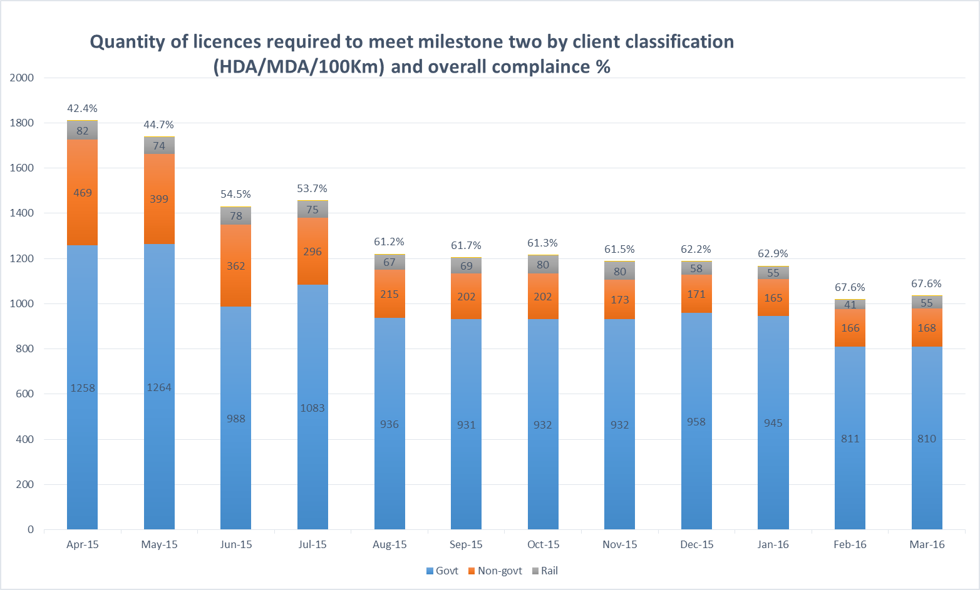
Milestone 2 Progress

Slide 7
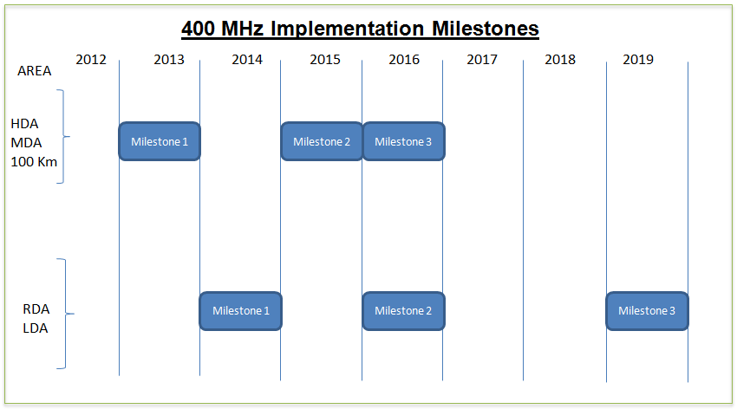

Slide 8
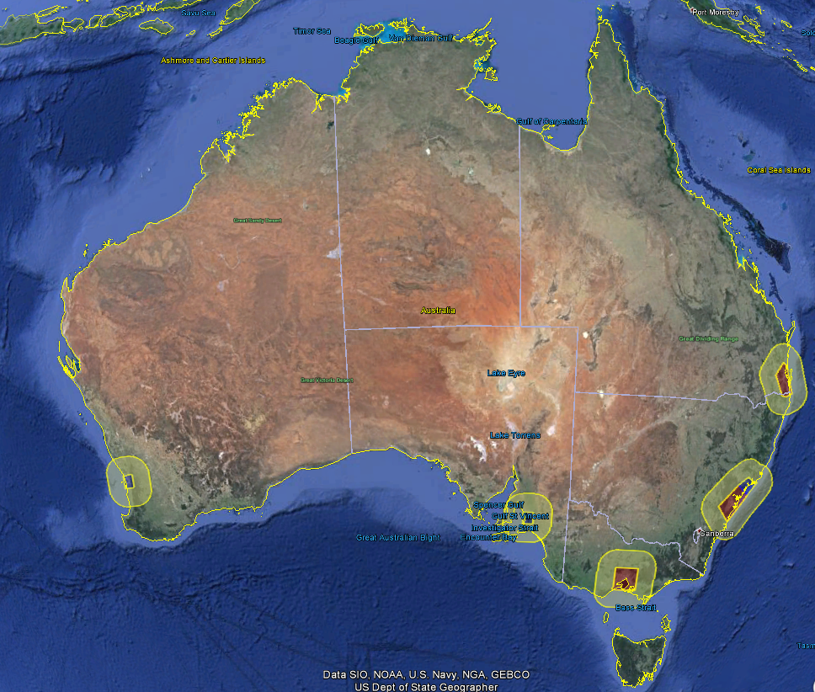

Slide 9
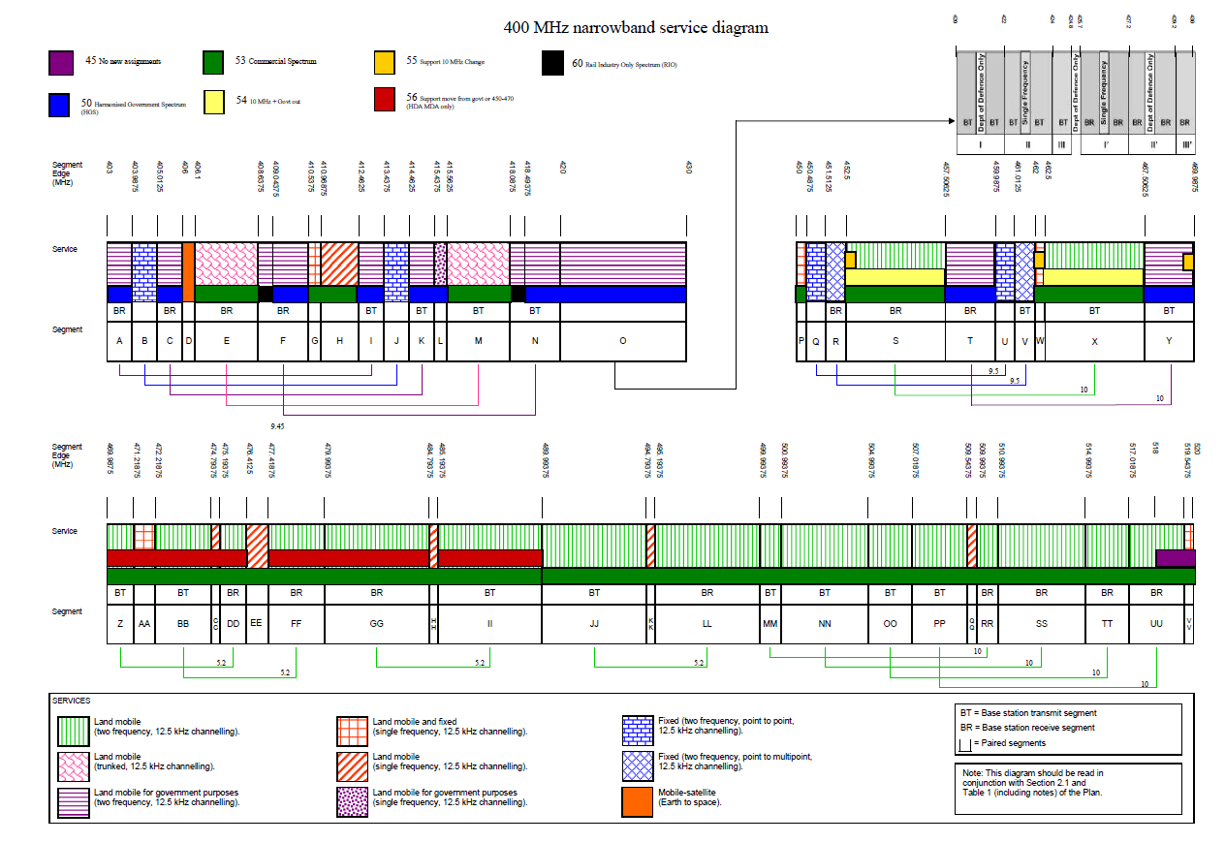

Slide 10
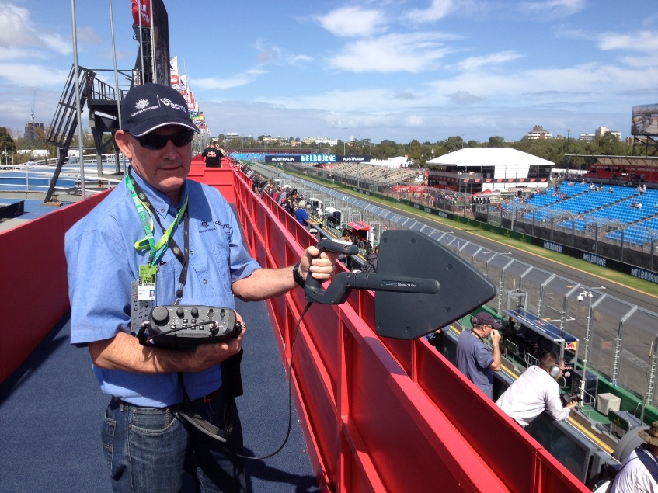
Licensing renewal process
The ACMA will not automatically renew existing licences if the licence does not meet milestone requirements
This means that an automatic renewal notice will not be generated or sent out in the mail to you for a licence that is non-compliant.

Slide 11
MS3 letter renewal process
Licences renewed from January 2016 are advised by a letter from the ACMA 6 months prior to their licence expiry date. Renewal of the licence will not occur unless the licence is compliant with MS3. The conditions of the licence have to change.
Licences not renewed unless transitioned to new arrangements or granted an exception!
Clients licences were renewed
Clients advised 6 months in advance
March 2015
Sep 2015
March 2016
Letter 2 sent to clients advising of 6 months to transition to new arrangements

Slide 12
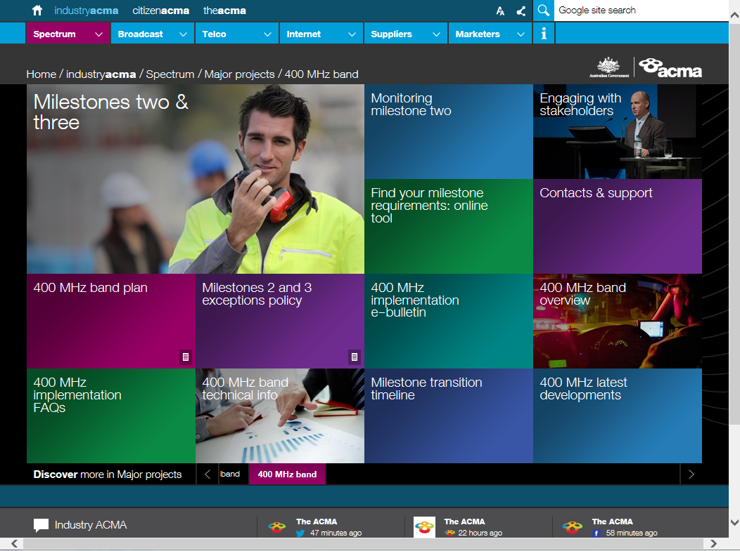
How do I find out the specific changes I need to make to my spectrum holdings?
Online tool available at the ACMA’s website at: http://www.acma.gov.au/Industry/Spectrum/Spectrum-projects/400-MHz-band/tech-info
Using this tool you can enter your licence or client numbers and the tool will tell you exactly what is required for transition.
The database is updated every 2 hours.

Slide 13
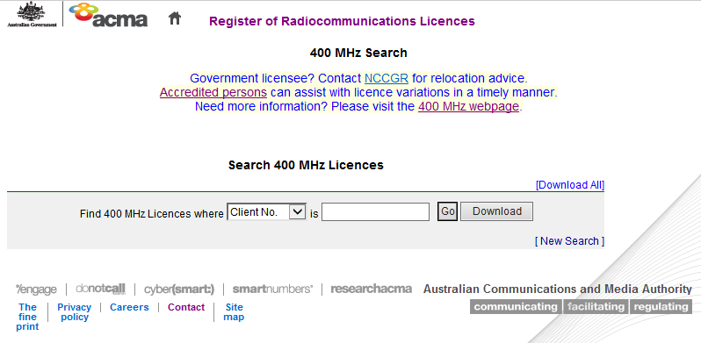
400MHz online licensing tool
http://web.acma.gov.au/pls/radcom/register_search.main_page

Slide 14
Exception Policy - Meeting the milestones
The ACMA will not renew licences after the transition dates if the conditions on the licence do not meet the requirements of the 400 MHz Plan.
To renew such a licence would be inconsistent with the transition timelines set out in the 400 MHz Plan
The ACMA continues to be firmly committed to the 400 MHz Plan

Slide 15
What happens if a licensee cannot comply by the deadline?
If the licensee can demonstrate that compelling circumstances or factors exist, the ACMA will consider applications for renewal that do not comply with the 400 MHz Plan
Exception process in place: guidelines and forms on the 400MHz website
Exceptions will be considered on a case by case basis for MS2 and MS3
An engineering assessment of spectrum denial will be undertaken by the ACMA when considering each exception request
If granted, provides licensee a further timeframe to implement changes while still having to comply with the 400 MHz plan

Slide 16
Exceptions
Exceptions are normally granted for a period of one year from the licence renewal date
Exceptions for longer periods may occasionally be granted if circumstances are compelling
Under normal circumstances only one exception would be granted for a licence or group of licences

Slide 17
Exceptions - Process
Every application in-depth assessment
Based on 3 key drivers of the 400 MHz review
Congestion
Introduction to new technologies
Spectrum Harmonisation
ACMA engages with licensee to gain spectrum efficiencies where possible (mitigation process)
3 tier rating system for spectrum impact ( Minor, Moderate, Major)
Approval is subject to approval from EM, GM and Authority respectively

Slide 18
Requests for lengthy exceptions
Require:
Commitment to a 400 MHz transition plan stating how and when the applicant intends to meet the transition arrangements
A statement of commitment from a person within the licensee’s organisation, with the authority and accountability to ensure that the commitment is met
The ACMA may request that subsequent information is provided, as confirmation of progress in accordance with their 400 MHz transition plan

Slide 19
Circumstances and factors the ACMA will consider
Funds required to transition have not been able to be obtained in a timely manner: Supporting evidence must be supplied
It can be demonstrated that there will be significant financial savings by delaying transition (e.g. more than $1 million)
Licence renewal is warranted to accommodate a short delay for supply/installation/commissioning/network upgrade
Consequential impact of the delay is low if the licence is renewed (e.g. low power, short duration, remote location)
A non-government user has written agreement from their NCCGR representative that the service can be accommodated in HGS for an extended or indefinite period of time

Slide 20
Assessment of exception requests
Assessment of MS2 and MS3 exception requests take time
Allow sufficient time before licence expiry
The 400 MHz Project Team does not make decisions on exceptions
The decision on whether to grant or deny the request may be made by the
Executive Manager of the Spectrum Operations and Services Branch,
General Manager of the Communications Infrastructure Division or
ACMA Authority

Slide 21
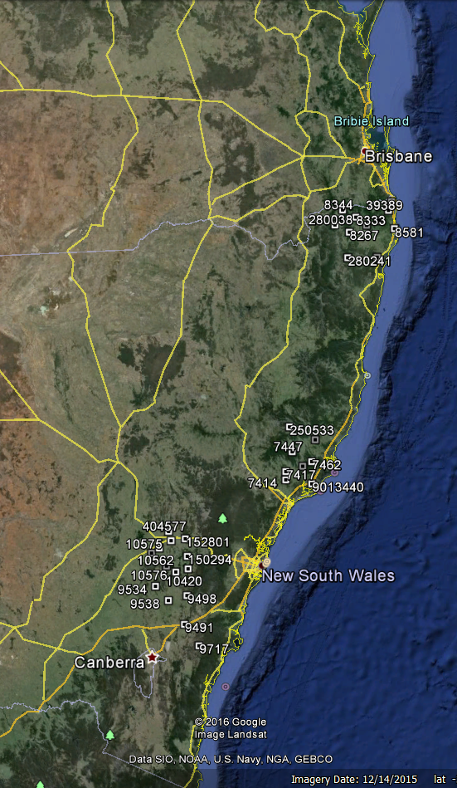
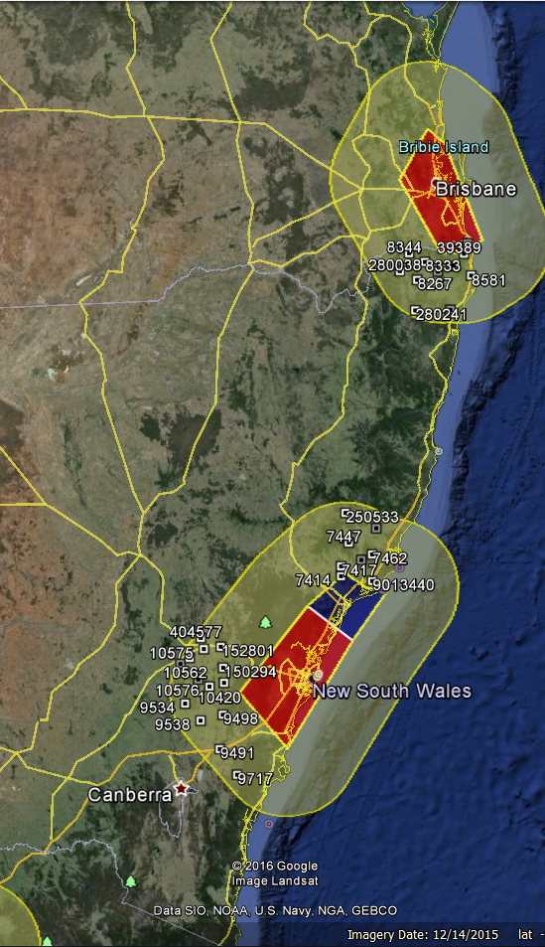
Exception examples
Client has 42 licences
All within “high impact” areas
Seeks a 5 month extension
Extension still within milestone window
Agrees to make 6 problematic ones compliant
ACMA approves request for remaining 36

Slide 22
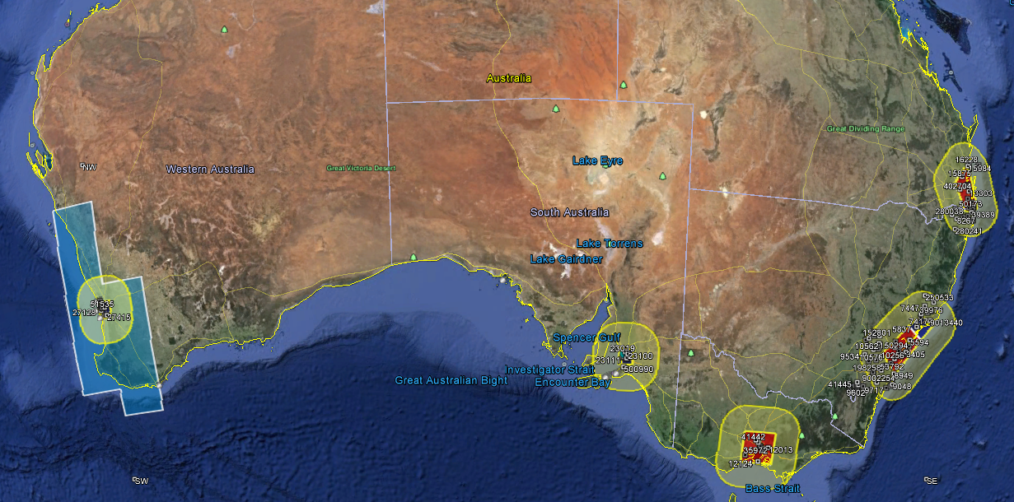
Exception examples
Client has 200 licences
All within “high impact” areas
Seeks a 3 year extension
Extensive assessment of impact on others
Extensive negotiation
ACMA approves request (at Authority level) pending delivery of detailed plan to meet compliance.

Slide 24
Q&A Session
Milestone 2 changes
2016 in LDA RDA
450-470 MHz
Milestone 3
2016 HDA, MDA +100
Government spectrum harmonisation
Are you affected?
Make plans now!

Slide 25
Review of the 803-960 MHz band
Chris Worley
Andrew Stewart
Communications Infrastructure Division

Slide 26
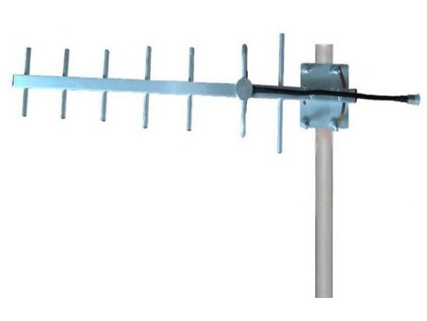
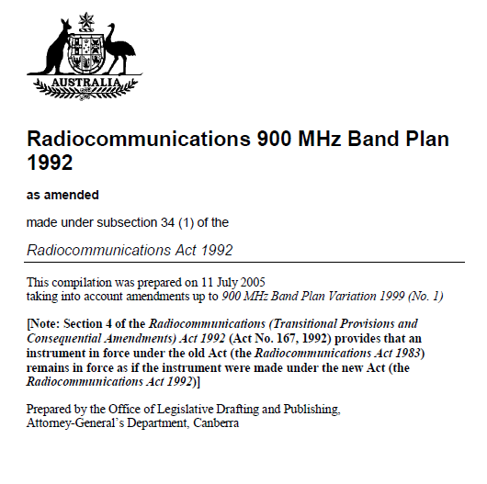
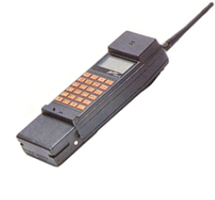
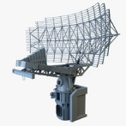
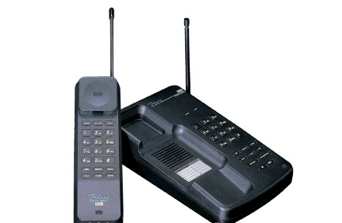
1992…

Slide 27
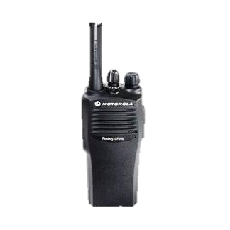
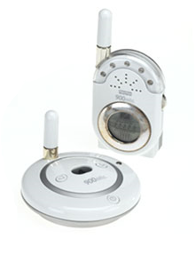
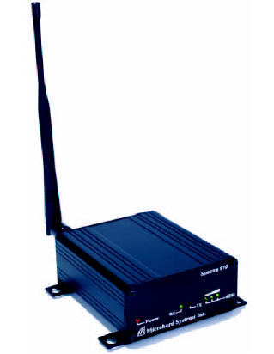
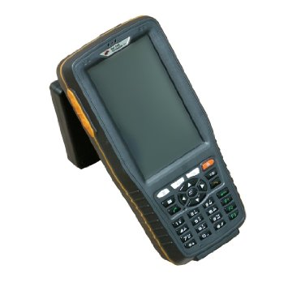
Now…

Slide 28
Drivers
Inefficiency and fragmentation
Failure to reflect demand
Evolving technology standards
Consumer
Industrial
Digital Dividend
803-820 MHz cleared

Slide 29
The changing landscape
Evolving terminology
Ageing documentation
Evolving government PSMB consideration
‘GSM’ band complications

Slide 30
Key outcomes
New band plans (incl. 803-820 MHz)
Mobile broadband: 850 MHz expansion
(Separate consideration of 900 MHz FDD band)
Industrial/utilities: Additional LIPD spectrum
Reorganisation of fixed, LMR (45 MHz FDD split)

Slide 31
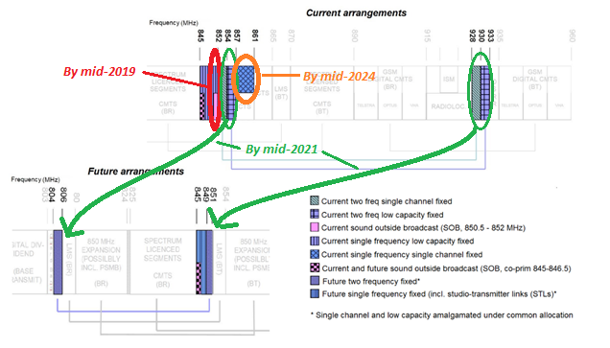
Specific implications – fixed links

Slide 32
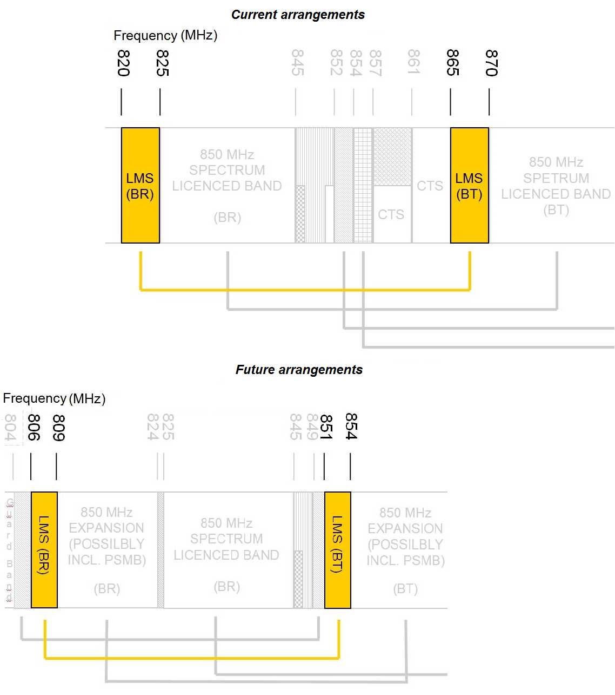
Specific implications - TLMS
Transition to occur between 2021 and 2024
(Earlier subject to coordination on a case-by-case basis)

Slide 33
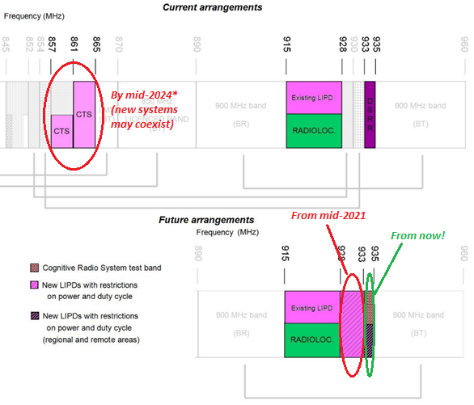
Specific implications – LIPDs/M2M

Slide 34
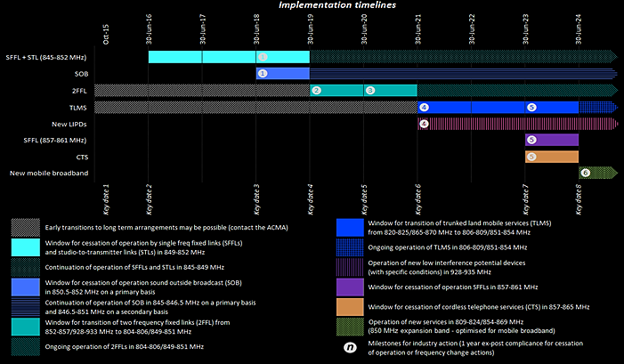
Implementation

Slide 36
Implementation
How 400 MHz is working (and could work better)
Highly consultative approach
Facilitate – communicate - regulate.
Importance of engaging with:
those affected
Industry associations
Exceptions policy
Industry Tune-up tomorrow!

Slide 37
Thank You
Chris Worley: christopher.worley@acma.gov.au
Andrew Stewart: andrew.stewart@acma.gov.au

