Slide 1
The defragmentation dividend Thoughts on a more efficient use of the UHF band
Presentation for RadComms 2018 – Session 9
Marc Eschenburg

Slide 2
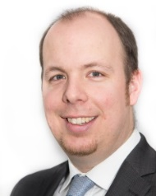
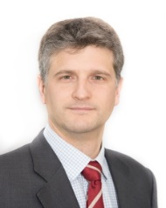
About Aetha Consulting
The company
The authors
Specialist telecoms consultancy, founded in 2011
Prime area of expertise is in spectrum management
we assist regulators in developing and implementing sustainable spectrum policy.
we support operators to understand their spectrum needs, value spectrum and bid in auctions.
Marc Eschenburg (Partner, Aetha Consulting)
Worked in telecoms industry for over 10 years
Main area of work is supporting MNOs ahead of spectrum auctions
Lee Sanders (Partner, Aetha Consulting)
Worked in telecoms industry for over 15 years
Has led high-profile spectrum studies for the European Commission, Ofcom (UK) and the IDA (Singapore)
William Webb (Webb Search)
Technical expert, with decades of experience of wireless/mobile technologies
Was the Head of Research and Development and one of the senior spectrum strategists at Ofcom (UK)
Over 80 spectrum projects across all 5 continents within the last 7 years
Spectrum assignments
Other countries where Aetha’s staff have undertaken projects

Slide 3
The rationale for our report
Continuing the historic approach of ‘salami-slicing’ UHF spectrum…
470MHz
606MHz
694MHz
790MHz
854MHz
900MHz
960MHz
DTT left with just 136MHz (44% of the quantity post digital switchover)
2000
Analogue TV
800MHz
2010+
DTT
700MHz
Today
DTT
Mobile left with a fragmented band plan, which is costly to operate and unsuited for the requirements of asymmetric data traffic and future technologies
700MHz
850MHz
900MHz
Today
DTT
…could create the risk for a lose-lose situation post 2030
600MHz
2030+ (??)
DTT
Analogue TV/DTT
Mobile
Other uses / guard bands

Slide 4
How to read our report…
Focuses on long-term (!!!) proposals for a more efficient use of the band
Focus on situation in the UK / Europe
Discusses a 2030 issue today to utilise a unique window of opportunity for the future
Aims to highlight major (workable) principles, rather than detailed band plans
Focuses on 694-960MHz, to ensure wider debate on UHF band at WRC-23

Slide 5
Our proposals for a ‘defragmentation dividend’
694MHz
790MHz
862MHz
960MHz
Existing use
UL
SDL
DL
DL
UL
UL
DL
A single, large FDD band, plus two SDL bands
Option 1: One large FDD band
SDL
UL
SDL
DL
Option 2: Three TDD bands
All current FDD bands are replaced with three TDD bands
TDD
TDD
TDD
The most ambitious option considered – a single TDD band
Option 3: One large TDD band
TDD

Slide 6
There are significant benefits, but the issues must be analysed further
Between 25 – 70% more downlink capacity for mobile (and other) uses
Mobile spectrum re-organised to be future-proofed for 5G (and later) technologies
Reduced impact on other spectrum users in the UHF band
Technical constraints – TDD is not (yet) a ‘tried-and-tested’ technology
Migration costs for existing users could be significant under some scenarios
Economies of scale are needed – at least an implementation at European level required
Transitional licencing and competition issues need to be considered

Slide 7
Further thoughts & initial feedback on the report
What is the report trying to achieve?
Our report includes first proposals on potential future allocations in 694-960MHz
It is intended to provoke a response by all those parties interested in UHF spectrum in the long term
Using TDD in low bands is really tricky…
The need for (cross-border) network synchronisation may bring along various issues
For TDD low-band networks, there could be issues around self-interference and increased latency
Is the real long-term constraint the need for more uplink capacity?
Recent technology developments focus on de-coupling UL / DL and aggregating (uplink-constrained, capacity-rich) high bands with (capacity-constrained, good-coverage) low bands
This may shift spectrum demand in low bands to providing more uplink capacity…
This is all too costly!
In response to our report, the UK Spectrum Policy published a report in August 2018, which discusses the potential cost implications for MNOs in more detail (see next slide)
Could this be done outside Europe / the UK?
There were good reasons to focus our report on the situation in the UK / Europe
However, we have also discussed the report with interested parties in South America and have heard from interest in South-East Asia

Slide 8
Our study has recently been critiqued by the UK Spectrum Policy Forum
Background
The UK Spectrum Policy Forum is an industry-led 'sounding board' to UK Government and Ofcom on future policy and approaches on spectrum
In August 2018, it published a report by LS telcom with the intention of further analysing the proposals put forward in our report
Main criticism
The report estimates the cost of migrating to a defragmentation dividend at about GBP1 billion per UK mobile operator
There is a risk that a move to a TDD configuration may reduce the coverage achieved with sub-1GHz spectrum
Positive aspects
LS telcom agrees that our proposals for a defragmentation are credible from a technical, regulatory and commercial perspective
The report further extends the thinking on potential transitioning plans, outlining that there will be capacity increases along the way
It states that mobile operators may not require extra UHF spectrum in 2030 and beyond
It outlines specific recommendations for further research, giving more credibility to the concept of a defragmentation dividend
In summary, the LS telcom report acknowledges the feasibility of our proposals, presents first views on potential migration costs, but also highlights that the demand for additional UHF spectrum from the mobile industry may be limited.

Slide 9
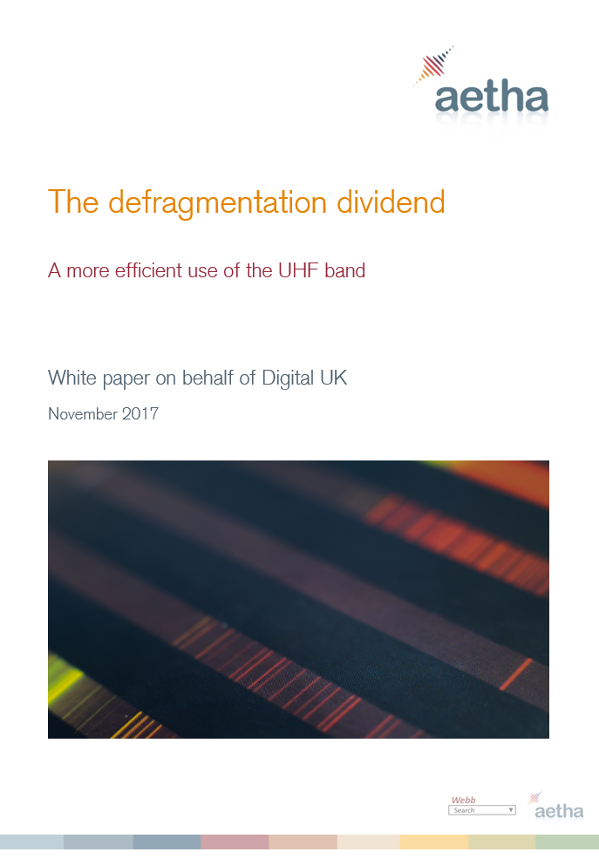
Thank you!
Marc Eschenburg
Partner, Aetha Consulting
marc.eschenburg@aethaconsulting.com
Tel: +44 7557 040032
Our report is available to download at the Digital UK website
Lee Sanders
Partner, Aetha Consulting
lee.sanders@aethaconsulting.com
Tel: +44 7766 058245
William Webb
CEO, Webb Search drwilliamwebb@gmail.com
Tel: +44 7834 432015

