Slide 1
Spectrum Futures

Slide 2
Australia’s TV spectrum (pre-2014)
57 channels for analog (405 MHz)
50 channels used for:
- digital introduction &
- analog simulcast
Band I
Band II
Band III
VHF
45
52
85
92
137
144
174
230 MHz
56
70
94
108
Band IV
Band V
UHF
698
520
550
630
694
770
806
820 MHz

Slide 3
Australia’s digital dividend
57 channels for analog (405 MHz)
50 channels used for:
- digital introduction &
- analog simulcast
30 channels for digital only television (plus 2 for DAB+)
Band I
Band II
Band III
VHF
45
52
85
92
137
144
174
230 MHz
56
70
94
108
Band IV
Band V
700 MHz Digital Dividend
UHF
698
520
550
630
694
770
806
820 MHz
9 MHz
Guard Band (GB)
Base Station Receive/Handset Transmit
45 MHz
Base Station Transmit/Handset Receive
45 MHz
3 MHz GB
Centre Gap
10 MHz
694
698
703
748
758
803
806 MHz

Slide 4
Operating and planned digital channels (pre-restack)
Digital TV
Digital Channel A
Digital Channel B

Slide 5
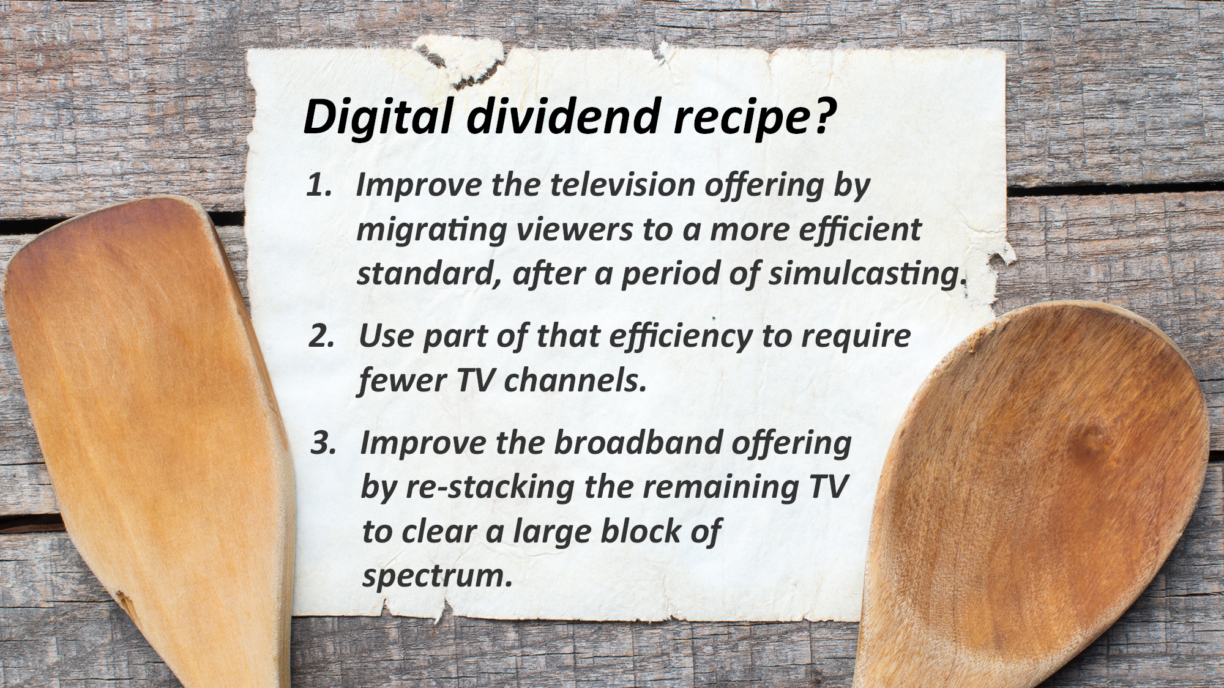

Slide 6
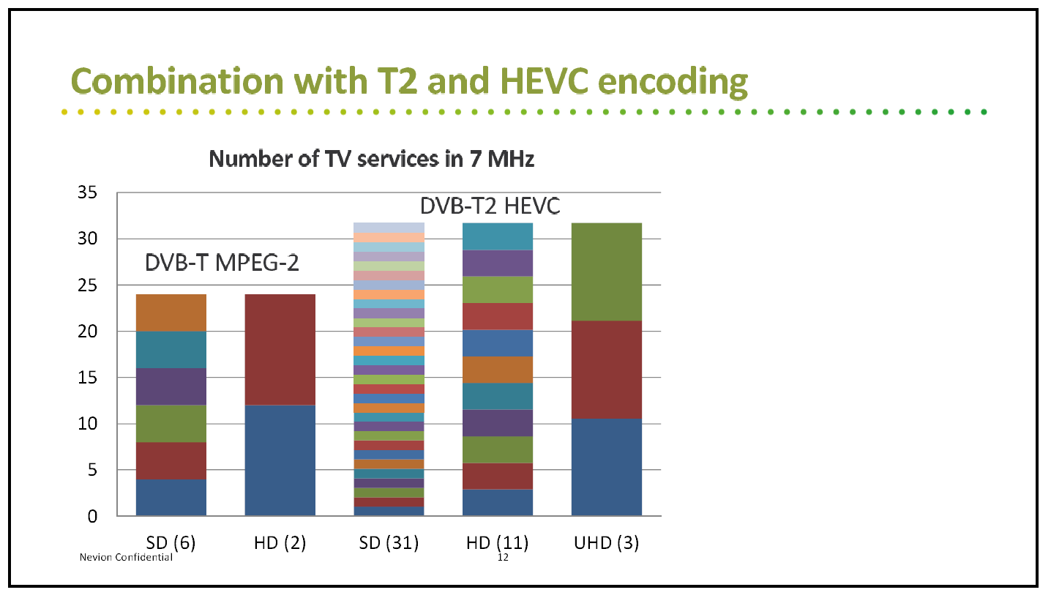
Slide borrowed from SMPTE 2013 presentation by Helge Stephansen of Nevion
Note that this diagram takes into account statistical multiplexing gains so the peak bit rates will be higher
Notes:
Here is what one company thinks might be possible.

Slide 7
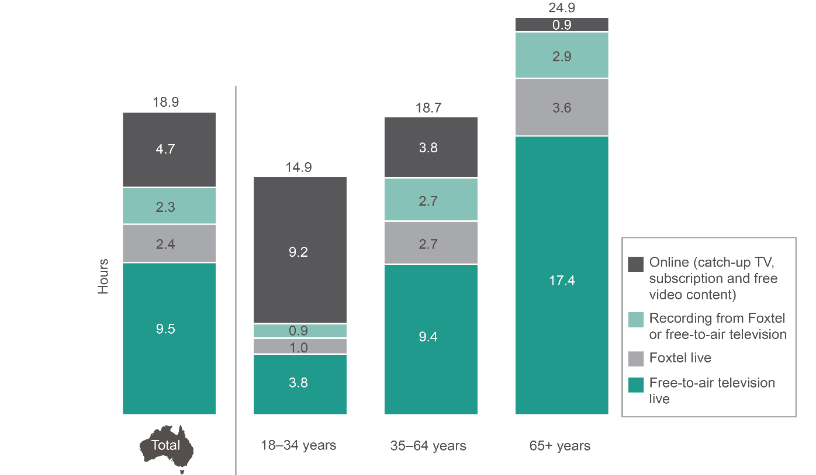
We’re still watching FTA television but…
While broadcast FTA TV viewing remains dominant among older Australians…
Younger Australians are mostly viewing online
FTA TV is going online too (catch-up TV)
Netflix is the most common type of video streaming service

Slide 8
2 x 35 MHz USA 600 MHz plan vs AUS TV
174 MHz
230 MHz
520 MHz
703 MHz
526 MHz
694 MHz
820 MHz
VHF Ch 6-12
Broadcast UHF TV Ch 28-51
Digital Dividend #1...
Not to scale
Block A
Block B
Block C
Block D
Block E
610 MHz
617 MHz
Base Tx
652 MHz
Mobile Tx
703 MHz
35 MHz
35 MHz
7 MHz
11 MHz
5 MHz
US ch 37 (608-614 MHz)
Region 2
Radio Astronomy
698 MHz

Slide 9
Digital dividend recipe?
Improve the television offering by migrating viewers to a more efficient standard, after a period of simulcasting.
Use part of that efficiency to require fewer TV channels
Improve the broadband offering by re-stacking the remaining TV to clear a large block of spectrum

