Slide 1
ViaSat-3: Ultra High Capacity Ka-Band Satellite Platform
Chris Hofer
Director, Regulatory Affairs
Viasat
October 31, 2018

Slide 2
Viasat is a global communications company that believes everyone and everything can be connected

Slide 3
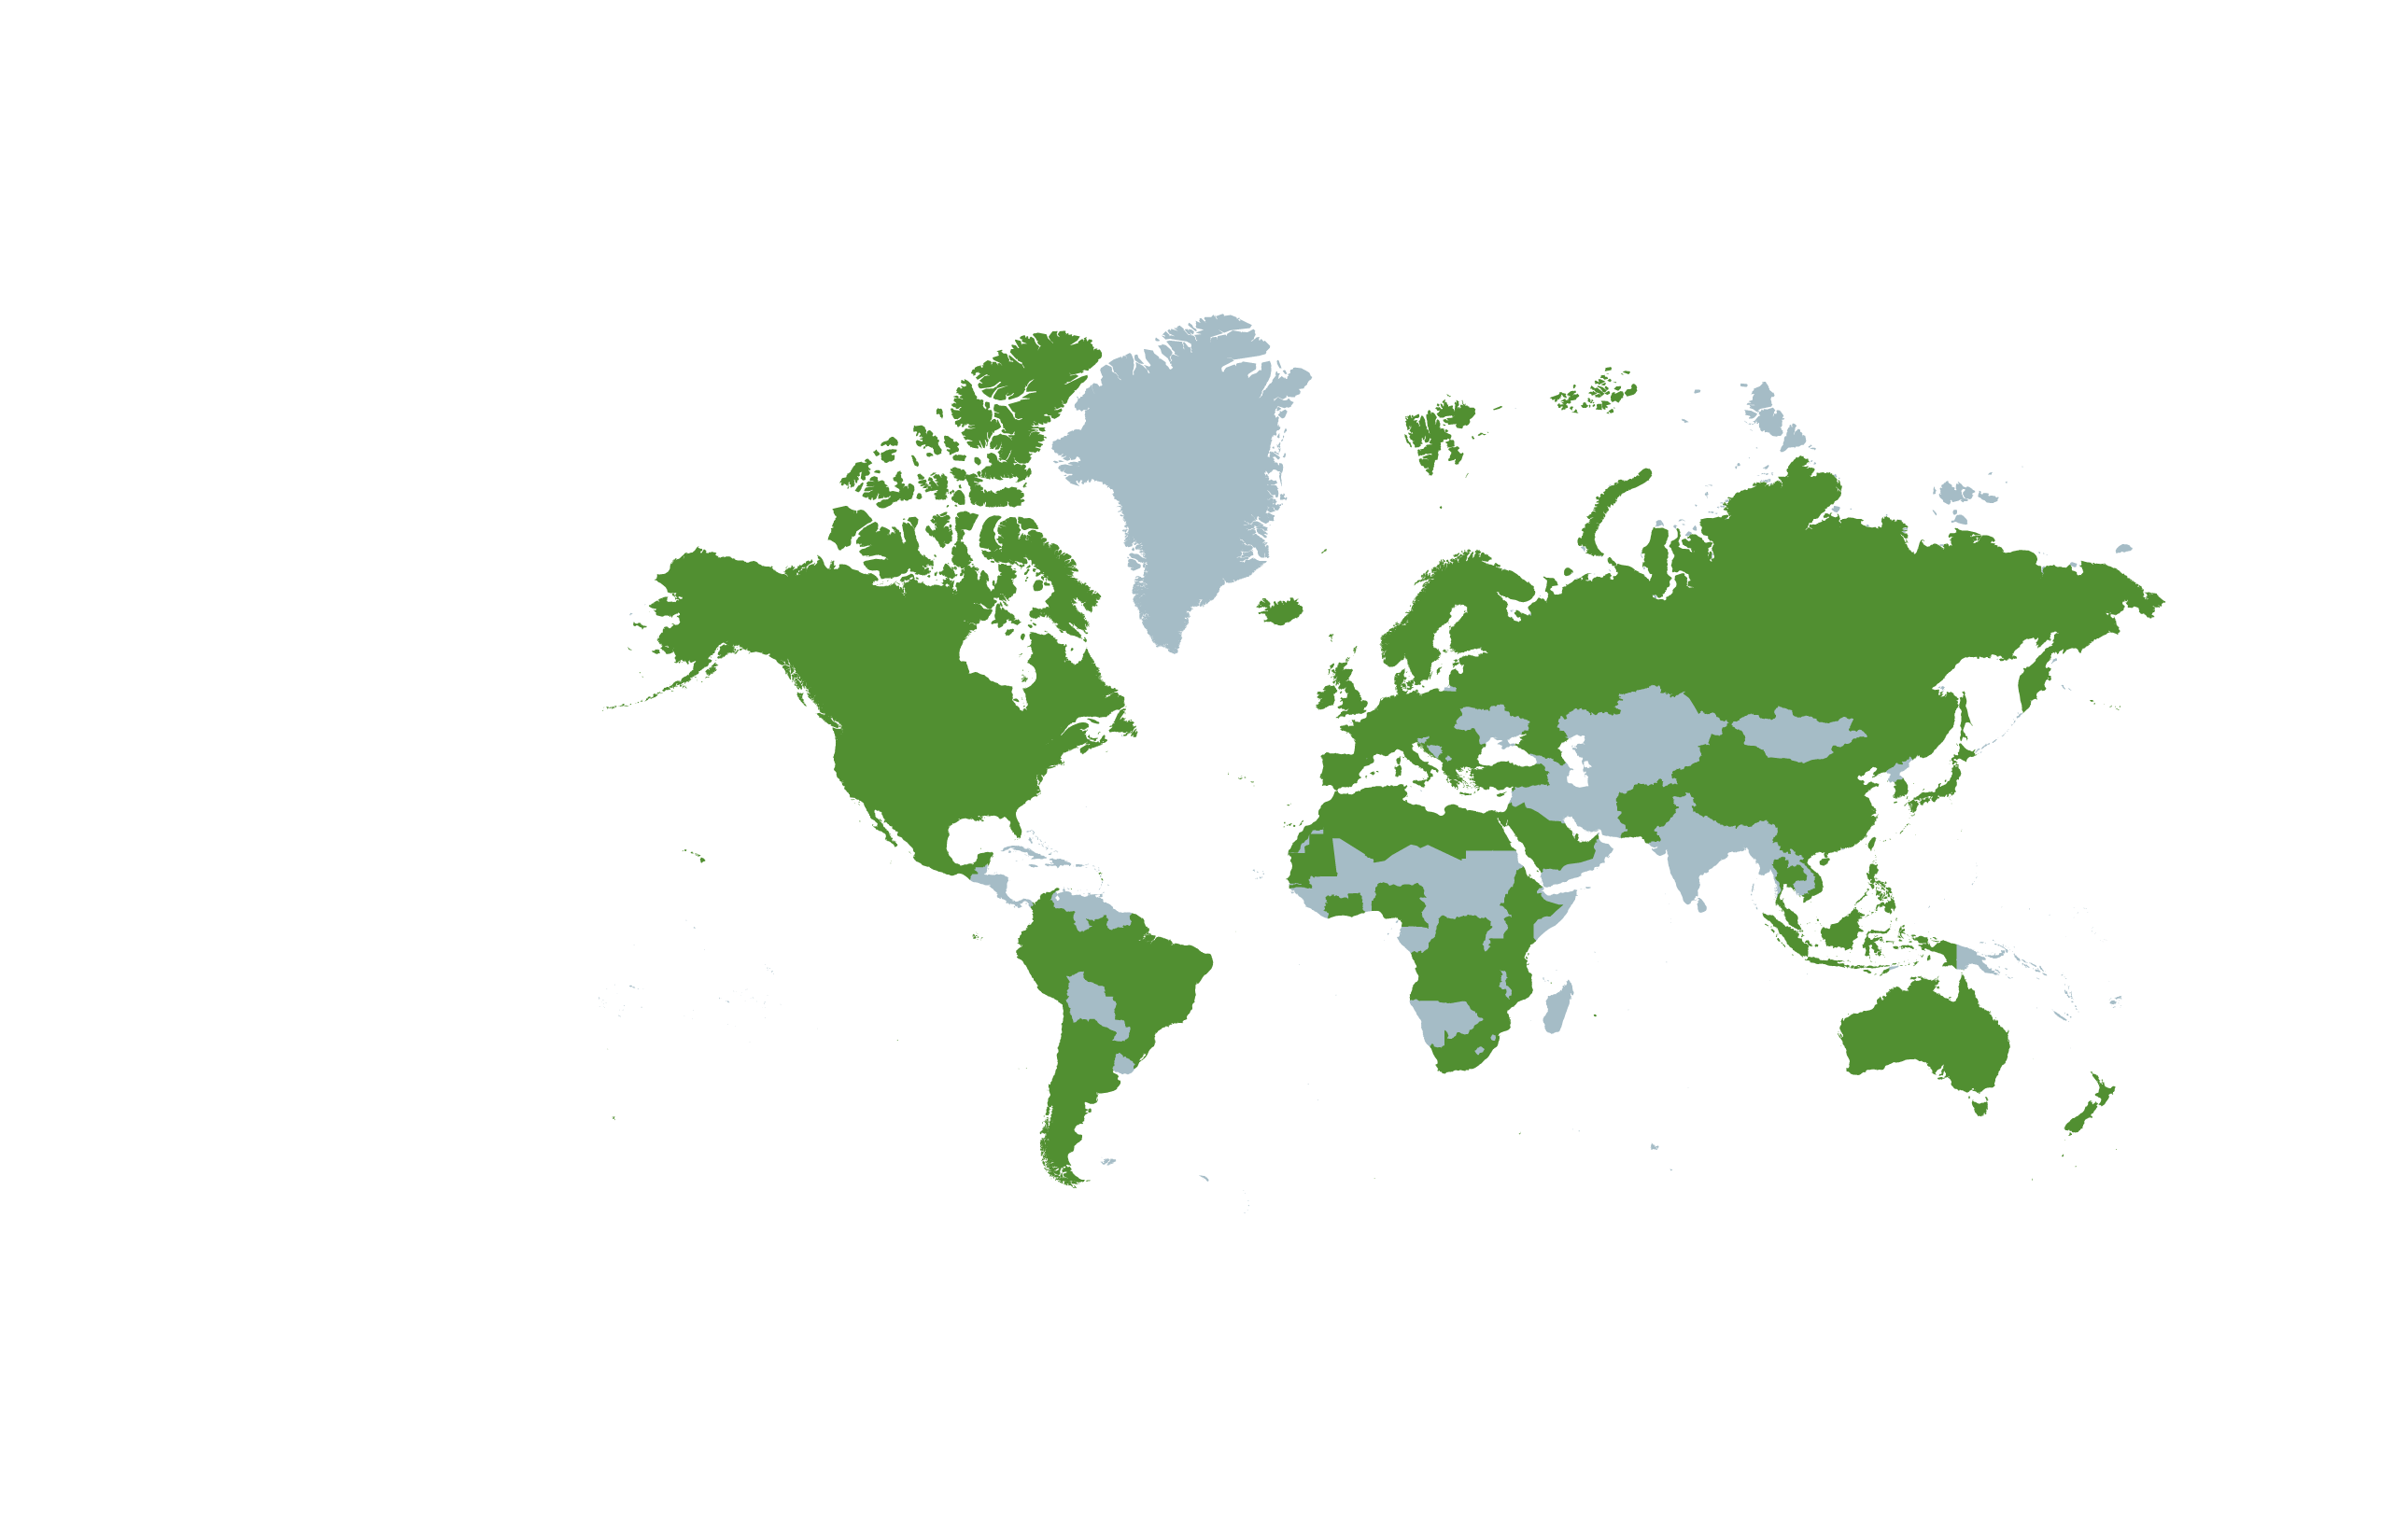
Viasat: Trusted Around The World
1986
year founded
5,200+
employees
28
offices around the globe
5
satellites in orbit
~700k
home internet subscribers
60 Million
devices on airplanes
connected by satellite annually
$1.6B
in annual sales*
$3.0B
broadband investment
* FY18, ended March 31, 2018
Countries Viasat currently serves

Slide 4
Satellite Broadband Applications Powered By Entire Ka-Band
Unlimited home internet plans provide unlimited possibilities
Business internet and Wi-Fi
Connecting the unconnected to affordable high-speed internet
The best Wi-Fi in the sky gives every passenger freedom to stream
Stay productive and entertained while traveling
Fast, reliable internet for cruise ships, pleasure craft, and other vessels

Slide 5
Fast, Reliable and Secure Military Communications
#1 Communications Provider to US Dept of Defense
— Frost & Sullivan, 2016
Fastest-Growing Defense Contractor
— Defense News Top 100, 2015, Organic Growth
“Anywhere, anytime” assured communications for the warfighter
Life-saving, instant access to ISR video, maps, voice, data, and more
Bold innovation and game-changing technology to transform missions
Satellite broadband for aircraft, ships, vehicles, and ground troops
Cybersecurity to protect classified information and prevent cyber attacks
Wireless and radio for short-range and “fighter jet” communications (Link 16)

Slide 6
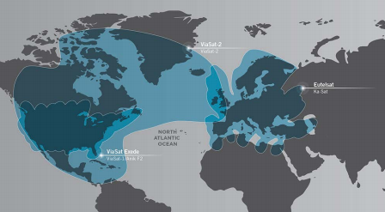
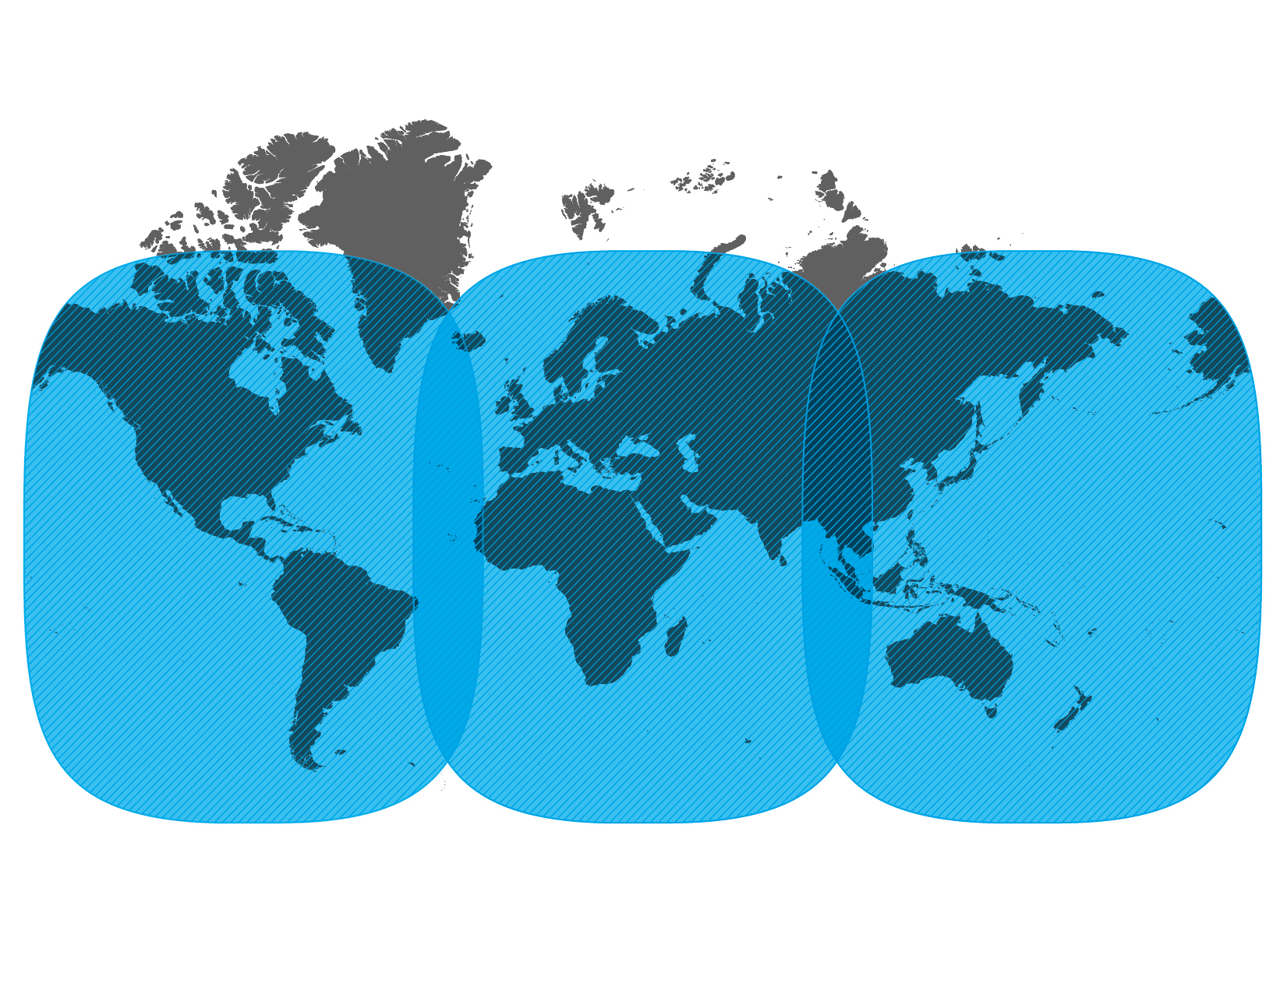
Coverage Evolution with Entire Ka-Band
ViaSat-1 & 2
ViaSat-3

Slide 7
Spectrum is Key
2.5GHz of Ka-Band spectrum used today to deliver satellite broadband
28 GHz
27.5 GHz
29.5 GHz
30 GHz

Slide 8
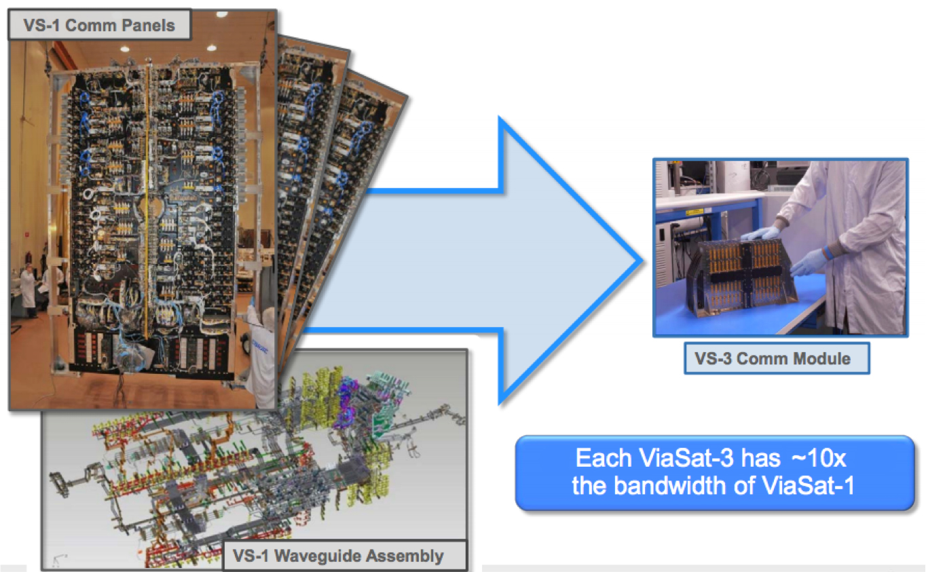
Ka-Band Broadband Satellite Evolution

Slide 9
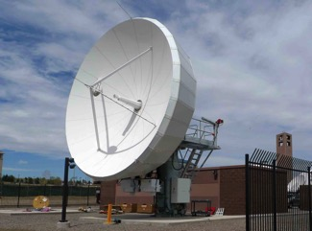
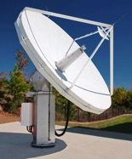
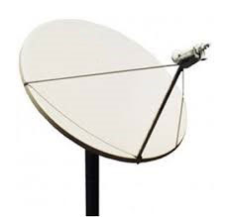
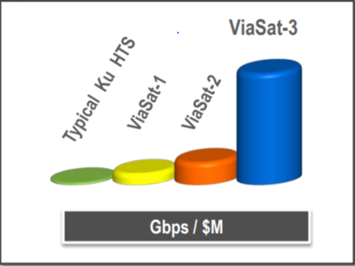
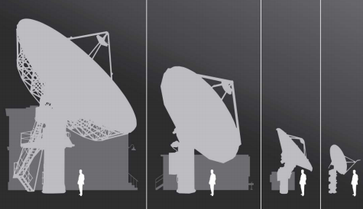
Ka-Band Gateway and Capacity Evolution
ViaSat-1
ViaSat-2
ViaSat-3
1+ Tbps capacity
Hundreds of sites
Even smaller antennas
Many located in urban/suburban areas to access cost-effective fiber
Max potential capacity of approx. 260 Gbit/s
More than 40 sites
4.1 m antennas
Many located in urban/suburban areas to access cost-effective fiber
At least 140 Gbit/s of total capacity
17 sites
7.3 m antennas
Mostly located outside urban areas

Slide 10
Ka-Band Service Evolution: Connecting Everyone Everywhere

Slide 11
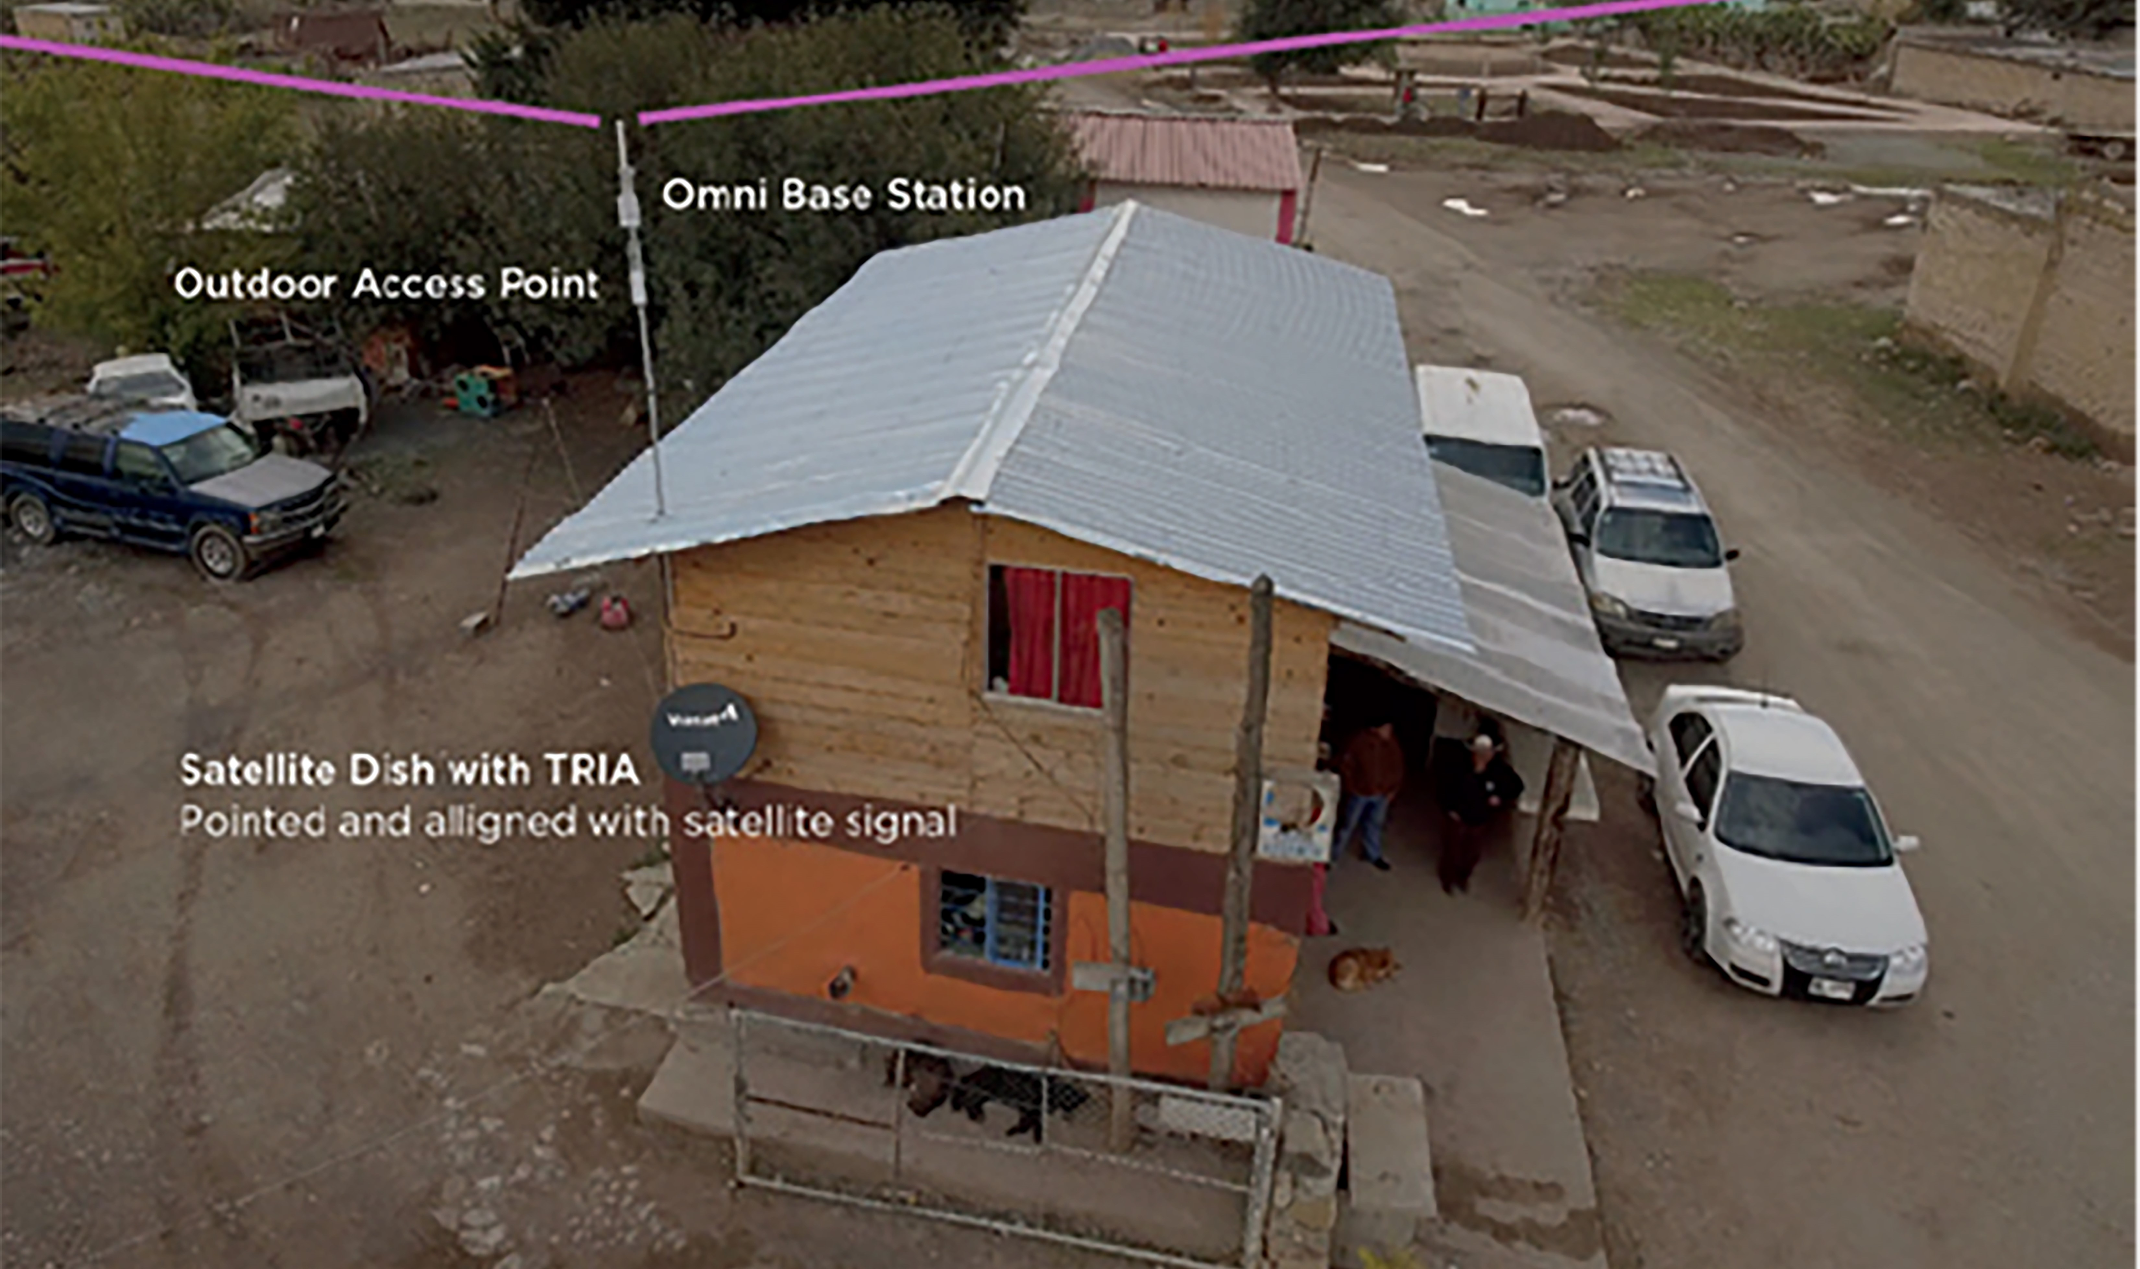
Ka-Band Satellite-Powered Community Wi-Fi
Wi-Fi hotspots powered by Ka-Band satellite serve entire communities
Deployable in hours
Customers use their existing phones and tablets for Internet access
~2,000 communities and 850,000 people covered in the first year
Adding 400-500 communities per month
Expanding around the world

Slide 12
28 GHz Band for Earth Stations in Motion (ESIMs)
Critical part of ensuring connectivity no matter whether person travelling by airplane, ship, train, bus, or car
Including critical gate-to-gate airline connectivity
Thousands of aircraft already provide Wi-Fi connectivity to passengers and crew, powered by 28 GHz ESIMs
LSE study projects market demand for ubiquitous connectivity on aircraft in the coming years of 7 billion passengers and $30 billion annually by 2035¹
Utilize existing Ka-band satellite spectrum at 27.5-29.5 GHz while fully protecting other spectrum uses
Will extend WRC-15 ESIM decision for 29.5-30 GHz to rest of satellite Ka-band providing a consistent global regulatory regime ensuring reliable connectivity everywhere
Will be addressed at WRC-19 under Agenda Item 1.5
¹ Grous, A (2017), Sky High Economics, Chapter One: Quantifying the commercial opportunities of passenger connectivity for the global airline industry, London School of Economics and Political Science; page 3
ESIMs at the ITU

Slide 13
Continued Access to the 28 GHz Band is Critical
Today’s satellite broadband connectivity is enabled by access to the full 28 GHz band
Serving millions of individuals and businesses no matter where located---urban, suburban and rural
Providing Wi-Fi connectivity on thousands of airplanes
Continued access to the 28 GHz band is the only way to
Meet exponentially growing customer demands
Enable new applications like community Wi-Fi to connect millions in the next 5 years
Extensive satellite use is why the international community decided in 2015 not to consider 28 GHz as a candidate for new 5G services
New 5G systems are not compatible with existing satellite uses of 28 GHz
5G readily accommodated in the 33+ GHz of other spectrum identified for 5G at WRC-15 as well as low and mid band spectrum being made available
Essential that current satellite access to 28 GHz be maintained throughout the world to connect the unconnected and meet the needs of individuals, businesses and governments

Slide 14
Thank you

