Slide 1



Session 7: Satellite Futures
Advances in Satellite Technologies: Impact on Capacity, Costs & Spectrum
Bashir Patel
Global Spectrum & Regulatory Policy, ESOA www.esoa.net | sg@esoa.net
RadComms 2018
31st October 2018
@ESOA_SAT
20 operators • Global & Regional • CEO driven
Notes:
Thank you for Mr Chairman,
Good morning, Distinguished Delegates, Friends and Colleagues
Before I begin, let me thank the organisers of RADCOMM 2018 for their kind invitation on behalf of Aarti Holla, Secretary General of Europe, Middle East & African Satellite Operators Association. Unfortunately, she was unable to make it, so, it is my pleasure to be here today in Sydney to speak on behalf of ESOA.
I know many of you will not have heard of ESOA: it is a trade association that represents 20 plus satellite operators providing broadcasting, voice and broadband services around the world.

Slide 2




























ESOA Members
Notes:
These are the members of ESOA - some operators are global and others are regional or even national. We also collaborate with other satellite operators in other regions and other associations including Asia –Pacific region and Americas.
Most importantly ESOA is led by a CEO Board of Directors who set the strategy and goals of the Association

Slide 3
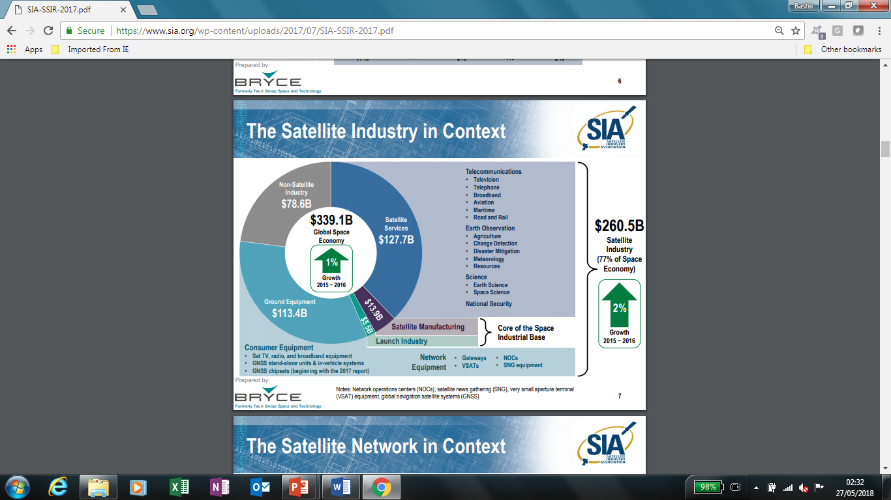
Global Satellite Industry Perspective
2
www.esoa.net
Technological Advanced • Global Coverage • Resilient Networks •
Notes:
Just to put the satellite Industry in perspective – today it is still over $340bn industry globally, employing several million people all over the world and providing services across the globe to billions of people – it is not just in rural& remote areas but also in suburban to urbans with DTH broadcasting millions of homes to telecommunication services and affordable connectivity, Earth observation and navigation etc

Slide 4
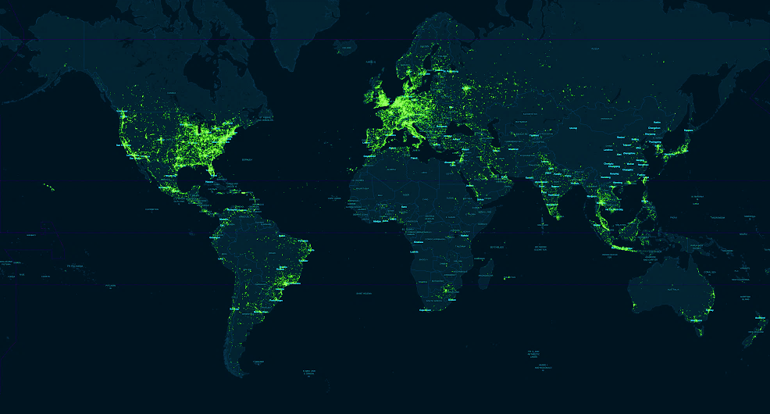
Drivers for Innovation in Satellite Systems (1)
“Digital divide” will be worse with 5G without satellite
  By 2020, LTE will cover
  63% of the worlds population but only
  37% of the landmass.
Source: OpenSignal
Notes:
So what is driving advances in the satellite sector?
On this session we’ve got companies like OneWeb, Viasat & there are others which are testimony to the amount of investment and innovation that is actually happening in our industry
Well there’s one thing that will always drive satellite systems – and that’s the Digital Divide: even if we consider forecasts for future coverage, prospects are grim
Satellites will always be better on coverage

Slide 5
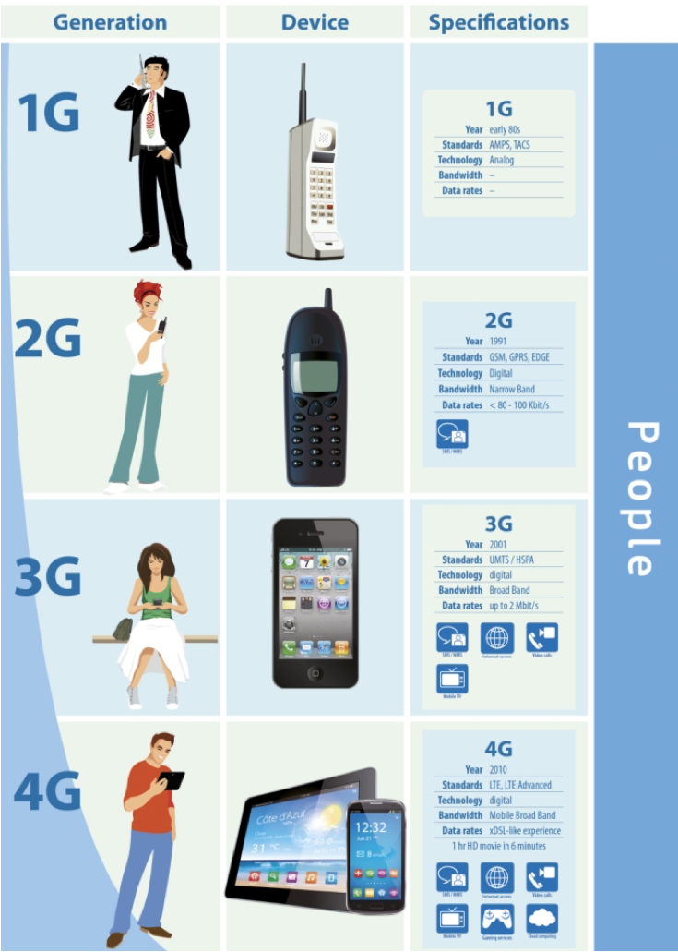

Drivers for Satellite Innovation (2)
Moving from a one-dimensional approach where people are connected
To an eco-system where global digital transformation is enabled through cross-sector collaboration
Sources: European Commission, 5G-PPP, ESOA
Notes:
But there is another more urgent driver and that’s the global digital transformation we see thanks to the pace of technology advancement: it’s being called 5G but even before 5G arrives, we can already see the trend happening
In the past, it was just about the “Gs” and we all know the evolution that took place: 2G was just cellular telephony but now we basically have PC functionality on a mobile device with 4G: that already drove a fundamental change in our behaviour but it’s the promise of 5G connectivity that really makes it exciting for satellite.
5G is meant to be a paradigm shift compared to 4G because it’s meant to connect people and things across verticals and transform the way the world works
For us that can only happen viably and sustainably with satellite and that is the true driver behind so much of the innovation we see happening in our sector today

Slide 6
The Digital connected world
Satellite strategies are adapting to growing end user expectations
Bandwidth hungry apps & critical services
Proliferation of Mobile Devices
Interactive behaviour & OTT
Cloud Computing
4G
High-speed access to anything, from any device, anywhere, anytime
Notes:
Read from the slide

Slide 7
Advances in ICT Technologies over time
As terrestrial technologies both in fixed + mobile environments have evolved
  Wired: from copper to fibre optics - high capacity urban rings
  Terrestrial Wireless: Analogue - 2G - 3G - 4G/LTE - to future 5G
So has the space + ground segment as well
  From 1st generation analogue satellite with simple bent pipe technology => fully on-board complex digital signal processors, high powered narrow or steerable beams with frequency re-use and global footprint
  High capacity throughput - going up to several hundred Gbps to Tbps
  Advance resilient global network - with end to end connectivity
  Integrated solutions - inter-operable hardware / network solutions with move towards universal air interface (both terrestrial/satellite compatible)
Notes:
So as terrestrial technologies have advanced both in fixed + mobile environments ----
So has satellite technologies both in space and ground ---- read from the slide

Slide 8
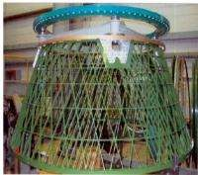
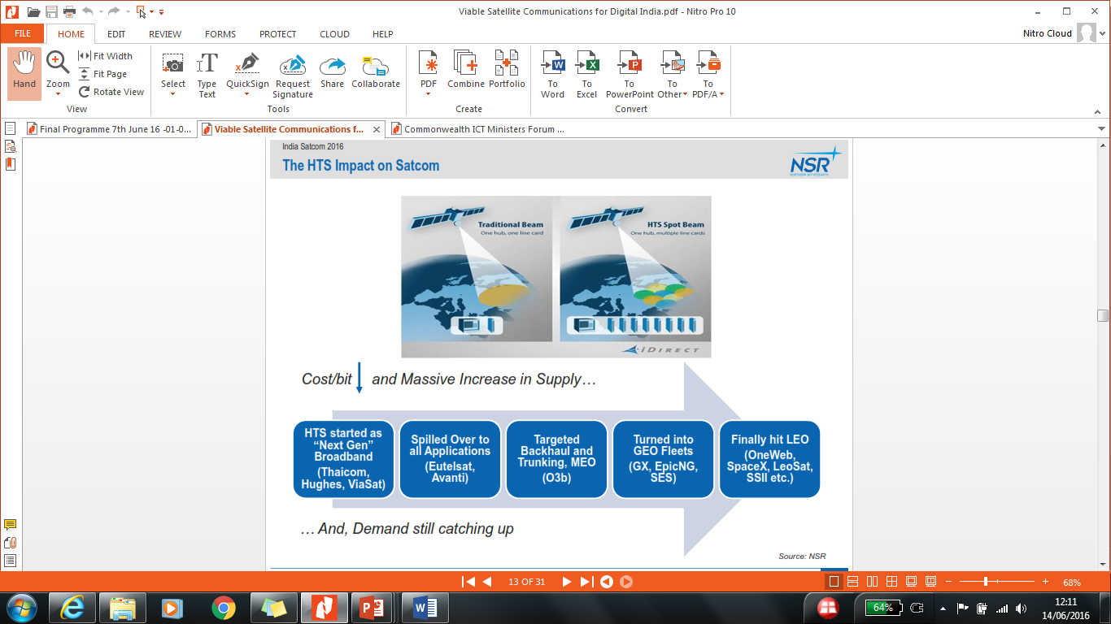
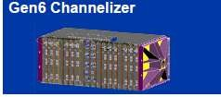
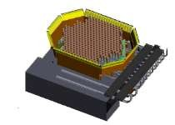

Major Advances in Satellite Technologies
Reduce infrastructure costs:
More efficient payloads
Advanced Electric Propulsion
Lower dry mass - lattice like structures
Increased Payload Flexibility:
Adv. Digital beam forming processors
Advanced phased arrays
Ka MPA - lower cost of capacity
HTS- 50-200 Gbps to 1 TBps by 2020s
Innovation in ALL Satellite Bands
  Hybrid C/Ku, L/S Bands
  Ka-Band, Q/V Bands
New Constellations - NGSO (1k+ satellites)
Open Architecture (all IP & 5G)
Higher Speeds 50/5 Mbps
Increased focus on M2M, IoT,
Enhanced Utility for rural/remote
Ubiquitous Connectivity Land/Sea/Air
Resilient end-to-end ground network
Higher performance, greater capacity, secure networks
Lower cost launch vehicles
Reduce launch mass
Larger payloads
Innovative use of new technologies is drastically reducing cost per Mbps
Notes:
Go through the slide

Slide 9
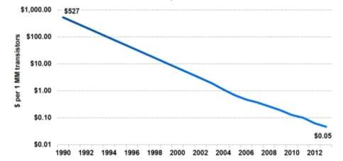
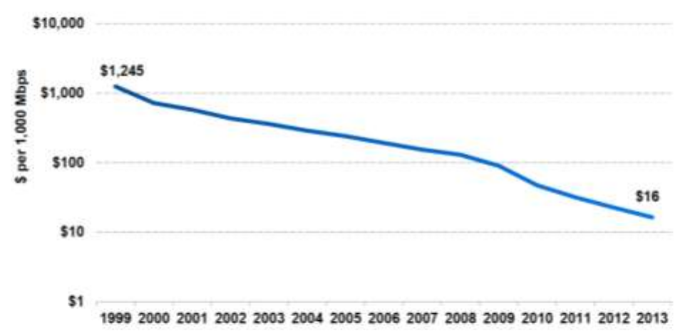
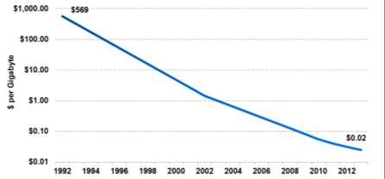
Economics underpin this transformation
Computing costs declined 33% p.a. since 1990 …
… bandwidth 27% p.a. since 1999 …
… and storage 38% p.a. since 1992
So©urc^{In}e^{m}: ªK^{r}P^{sa}C^{t}B^{c},ºJ^{n}o^{fi}h^{de}n^{n}H^{tia}a^{l} gel, Deloitte, 5/14
Notes:
These advances have been possible as a result of the economics in computing, storage , efficient use of bandwidths etc

Slide 10
Massive increase in available bandwidth
> Gbps (per sat)
Geostationary Wide-Beam Satellites
Broadcast / multicast (incl. IP) / IP data communications / Fixed / mobile platforms
Gbps - Tbps (per sat)
Geostationary High-Throughput Satellites (HTS)
Increasing Capacity
IP data communications / Fixed / mobile platforms
> Tbps
Non-geostationary HTS Constellations
IP data communications / Fixed / mobile platforms
A broad range of satellite capabilities to support 5G deployment needs
Notes:
We are able to think about such future services because of the enormous investment that is going into new innovative satellite systems we now have a constellation of High throughput satellites
There has been a huge evolution in satellite systems in recent years and this is continuing.
There are hundreds of traditional satellites still providing significant throughput globally
Now we’ve entered the era of HTS satellites and each one of those is delivering 100s of Gigabits per second
Existing and planned NGSO constellations are each talking about bringing terabits per second of connectivity
So you can see (besides coverage) the overall satellite offering is growing dramatically to meet the diverse user / 5G service requirements

Slide 11
Advances in Satellite Technology
• Dramatic Price/MB Decrease •
Launch Providers
Satellites
Antennas
Baseband
  New launchers on market
  Reusable rockets
  Cheaper Launchers
  Electric Propulsion
  High Throughput + narrow-beam Satellites -> 1 TBps by 2020
  GEO/MEO/LEO systems - more scalable capacity
  60+ Ka-band systems: >100 Ku/Ka band systems by 2020
  Smaller, thinner, lighter antennae
  No moving parts (electronically steered antennae)
  Lower production cost
  User can install - small, easy to point antennae
  More efficient payloads
  Increased processing power
  Link Efficiency Data traffic acceleration + compression
    e.g.DVB-S2, Adaptive Coding Mod, Carrier in Carrier, MPEG-4 Video Encoder, Multi-Demod
    Hub Cards
Notes:
Read the slide –
more launch providers, cheaper, re-usable rockets etc
Satellite technology have dramtically changed from simple bent pipe to a more complex, dynamic channellisation, freq re-use, narrow and steerable beams etc
Antennas – technology has advanced so much with electronic driven phased array patch antenna – cheaper to manufacture
Finally, on the baseband front with far greater efficiency in data traffic management with adaptive coding, mpeg 4 encoders, multi-demodulator etc

Slide 12
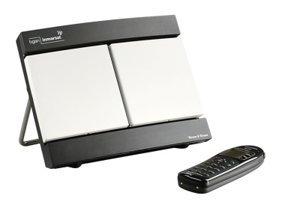
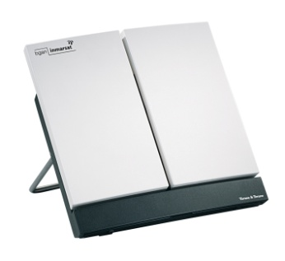
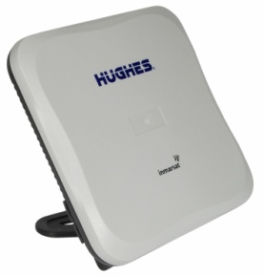
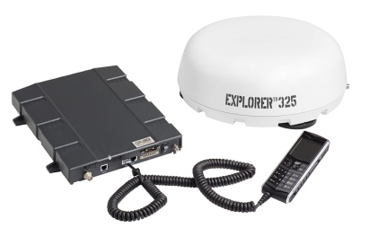
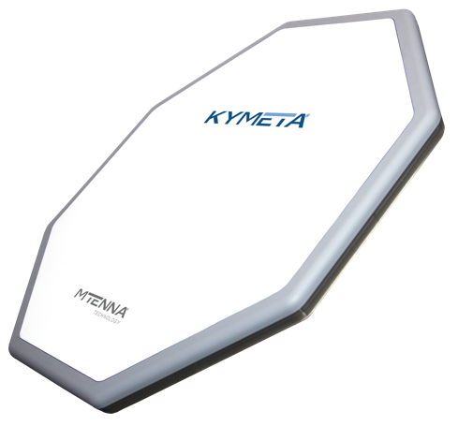
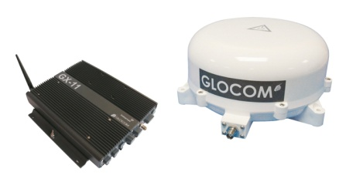


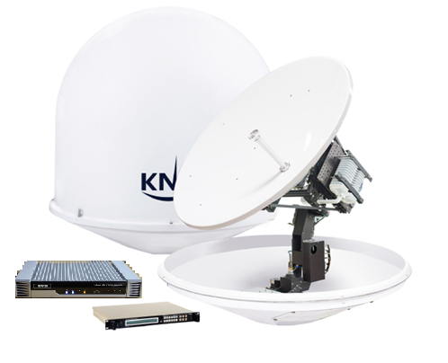
Portable and Mobile Services
Satellite Communications Antennae
Portable
antennae
Vehicular
antennae
Maritime
antennae
Notes:
With much more powerful satellite and narrow beams the user equipment has come down in size and costs for a variety of application, on the move for aero, maritime or on land to fixed applications with L, Ku and now Ka band solutions

Slide 13



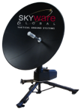
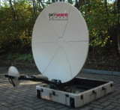
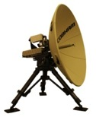



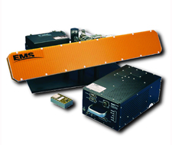



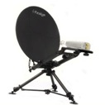

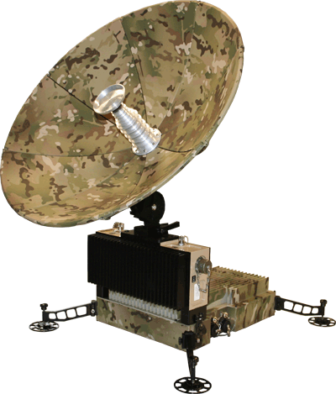
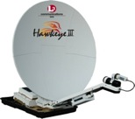
Growing List of Ka Terminal Suppliers
Broad range of terminals for air, sea, land
Launch manufacturers selected, contracts awarded
Ranging from 45-240 cm, most available at service launch
Ka-band facilitates dual-use
Hybrid L-Ka options

Slide 14

Evolving Role of Satellite Operators
From wholesale providers of bandwidth
To value-added
partners
HTS
GEO
MEO
LEO
VHTS
NGSO
Multi-media / Video
Broadband Access
IoT / M2M
Smart Cities
Smart Agriculture
Aero-connectivity
Connected Cars / Trains / ITS
Notes:
So based on technology evolution, the role of satellite operators is also evolving..
Satellites have undeniable strengths vital to next generation eco-systems: reach, resilience, quality, cost (point to multipoint delivery mechanism)
The satellite sector is evolving as demand for connectivity increases and doing it with private investment
The combination of GEO / MEO / LEO satellite systems that are all coming into play means that satellites are already providing next generation connectivity such – aero is one example but they will also be directly relevant to numerous 5G use cases

Slide 15
Spectrum for Satellite Operators
Based on technical feasibility
Certain spectrum cannot be shared
  E.g. for ubiquitously deployed satellite user terminals. This cannot be shared on a co-primary basis with IMT
Need to maintain access of individually licensed earth stations
  Such spectrum can be shared, but there must be adequate protection measures to ensure non- interference
Protection measures should recognize the risk of aggregate interference of millions of mm Wave base stations
  Regulatory measures needed, such as EIRP limits above the horizon
Constructive approach of Satellite Industry based on Technical Feasibility
Notes:
On the question of Spectrum, the satellite industry’s approach is maybe too fair. WE are willing to share spectrum where possible as long as certain principles are respected to allow continuity of services and future grow of satellite services.

Slide 16
WRC-19 AI 1.13 - IMT-2020 / 5G Frequency bands
Stick to WRC-15 Identified Study Bands for IMT
26 GHz (24.25 - 27.5 GHz)
Candidate Band for Global Harmonisation
  Protect existing & planned use by FSS, ISS, SRS, EESS passive
  Sustainable basis without undue constraint
Many satellite networks extensively use 28GHz globally
US position comes from a historically different approach to this band
28 GHz (… - … GHz)
NOT on the shopping list!
38 GHz (37 - 40 GHz)
NOT Candidate Band for Global Harmonisation
  Needs appropriate shared basis for coordinated FSS earth stations
40-42 GHz / 48-50 GHz
NOT Candidate Band for Global Harmonisation
Future satellites (in construction) will use 40/50 GHz
(40-42 GHz / 48-50 GHz for HDFSS user terminals in Region 2)
Close to 57-66 GHz: already designated / used for WiGig
Existing primary ITU allocation to for terrestrial mobile
Doubles available spectrum for terrestrial mobile 5G services so provides future-proofing for 5G/IMT-2020
Above 66 GHz (66 - 71 GHz & above)
Candidate Band for Global Harmonisation
Notes:
In terms of mm wave frequency bands for 5G what that means is:
Stick to bands identified by WRC-15 – there are plenty of them!
Recognize that 26GHz is a priority band in all other world regions and is likely to be identified for 5G while protecting existing and planned satellite and space services
Avoid 28GHz – the US has a historically different approach which does not justify its exporting its position around the world given huge satellite investments that have happened here
Recognize that what works for one region with respect to the 40GHz band will not work for other regions and note need for coordinating with FSS which is deploying HDFSS user terminals in different parts of the band in different world regions – this is therefore not a candidate band for global harmonization
Recognize that the very high mm wave bands provide a lot of available spectrum for use by mobile operators on a contiguous basis & so provide future-proofing for 5G

Slide 17




What does the Future Hold ?
Satellite Integration into ‘5G’ Ecosystem
Higher throughput
5G
x 100
HTS Satellite
(GSO and NGSO)
Normalized Typical User
Throughput
[bps/device]
x 1
-
Coverage expansion
Big Cell
Small Cell
Increase capacity
IMT-Advanced
x 10⁻³
10⁻³
1
10³
User density
[devices/km2]
Isolated
Rural/
Suburban
Urban
Dense
Extreme
Notes:
But is not only about existing services, but also about future 5G services.
Key 5G use cases such as Comms on the Move 5G require service availability across the territory.
Other 5G use cases such as IoT or media & entertainment solutions require backhauling or transmission of massive amounts of data and the best quality which only satellite can adequately provide.
These examples just highlight the need for all technologies to play a role.
It’s not just about giving more spectrum to one technology but finding solutions in terms of spectrum and standards that allow all technologies to work together to enable Smart Solutions for the benefit of a maximum of users.

Slide 18
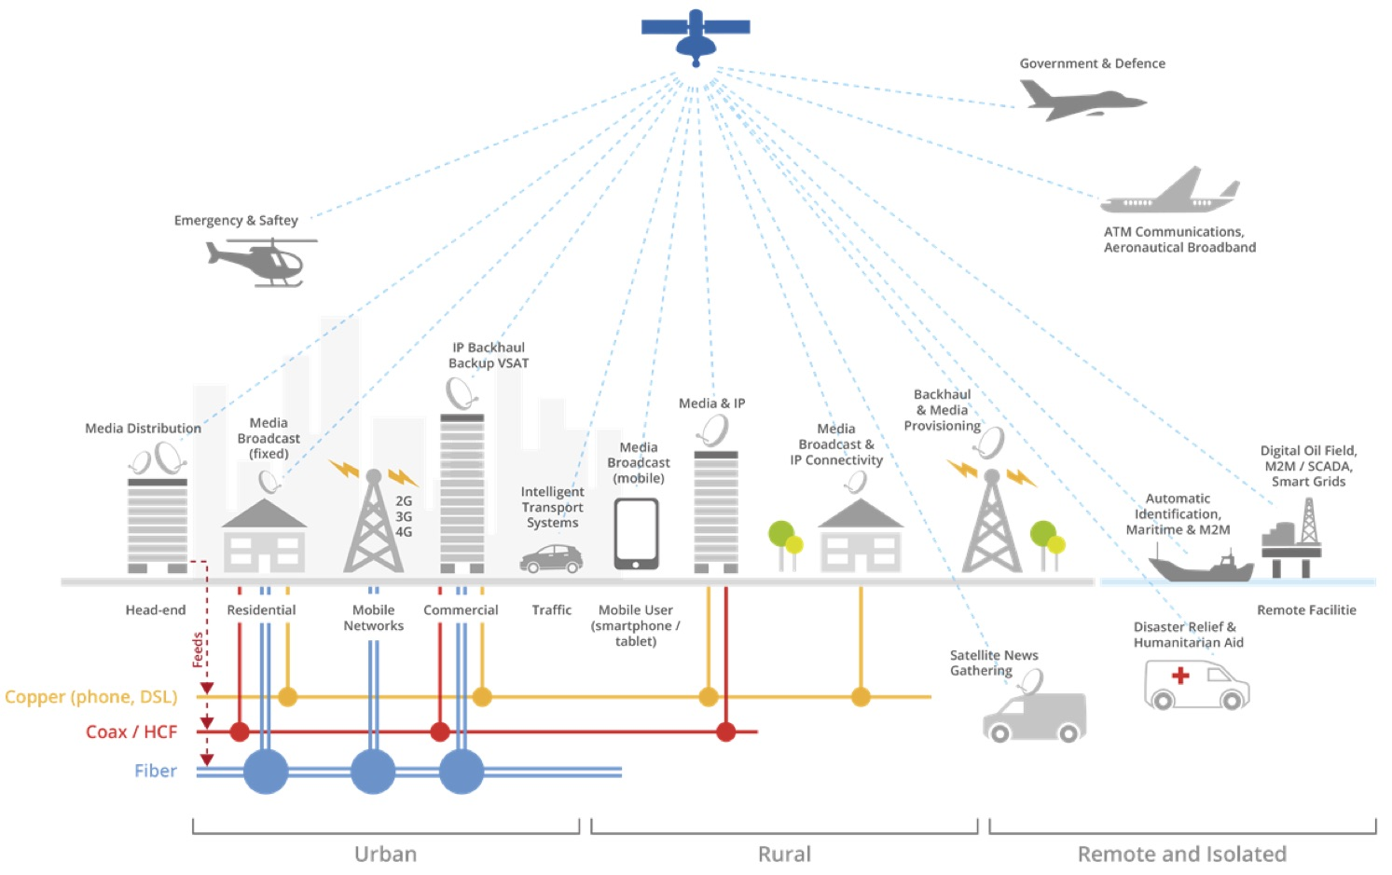
  Inclusive & robust 5G Eco-system based on satellite - terrestrial integration
  Two Industries working together to maximise benefits to consumers
Notes:
Finally, Mr Chairman, when we look at the ICT Eco-system as whole, then both terrestrial and satellite integration has to be way forward in order to provide more inclusive and robust future generation of 5G services………………………..
Thank you.

Slide 19
Thank you!
Satellite - Beyond the Reach of Other Technologies
info@esoa.net
www.esoa.net

