Slide 1
Satellite Based Augmentation System – the User Perspective
RadComms 2018 – Australian National Maritime Museum, Sydney – 30 October 2018
Simon Reynolds
Air Navigation Services

Slide 2
Contents
Overview of Airservices
How do aircraft navigate?
SBAS and the value of Continuous Vertical Guidance
Next generation Dual Frequency Multi Constellation

Slide 3
Airservices
Industry-funded, government-owned
Australia’s civil air navigation service provider

Slide 4
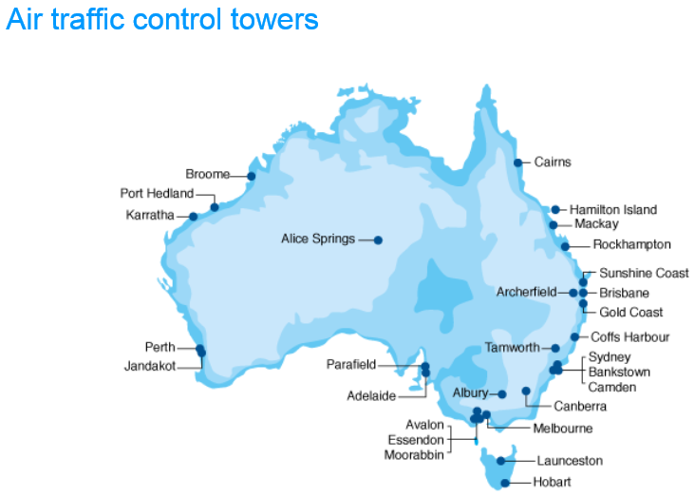
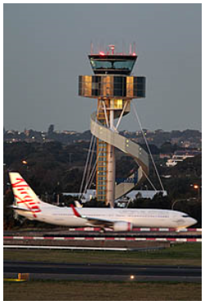
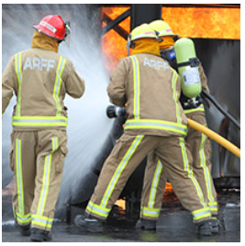
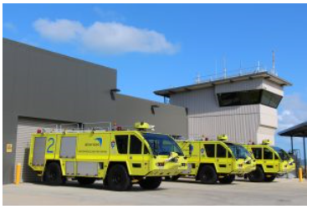
Airports
29 Control Towers
26 Aviation Rescue
and Fire Fighting

Slide 5
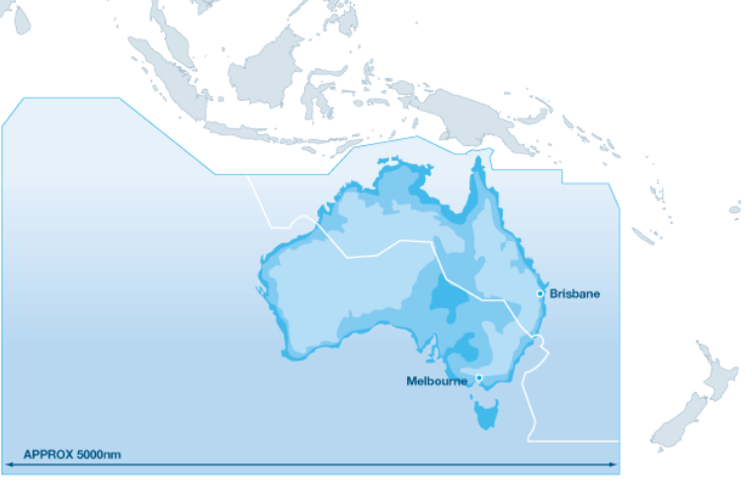
Airspace 11% of the world’s airspace
2 Air Traffic Services
Centres
8 Terminal Control Units
(PH and SY separate)
4 million flights
152 million passengers

Slide 6
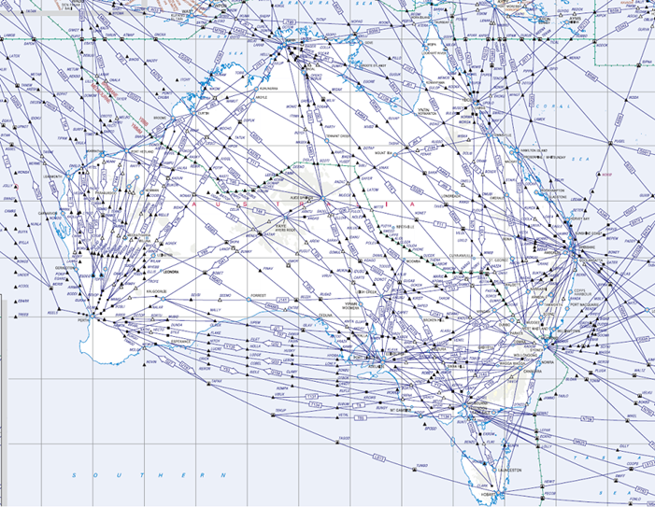
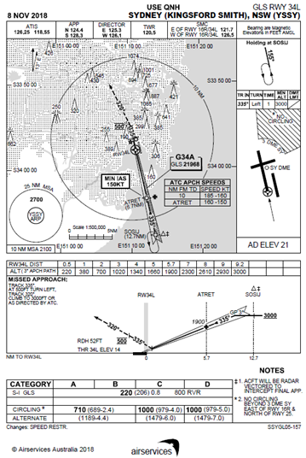
Aeronautical Information Publications

Slide 7
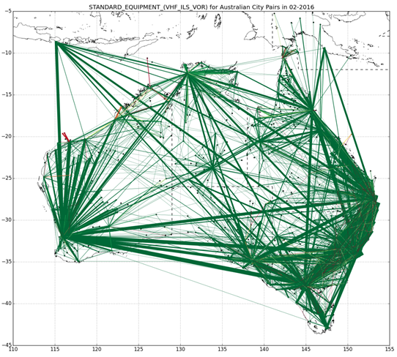
Air Traffic
Busiest air routes:
1st: Jeju-Seoul (South Korea)
2nd: Melbourne-Sydney
17th: Brisbane-Sydney
29th: Brisbane-Melbourne
>66% of passengers fly into Brisbane, Melbourne, Perth, or Sydney
Line width indicates traffic between city pairs – logarithmic scale

Slide 8
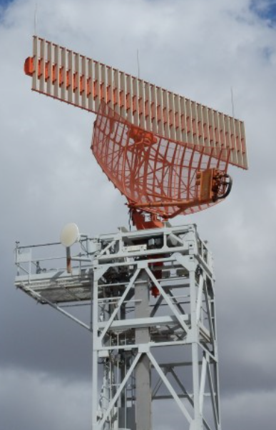
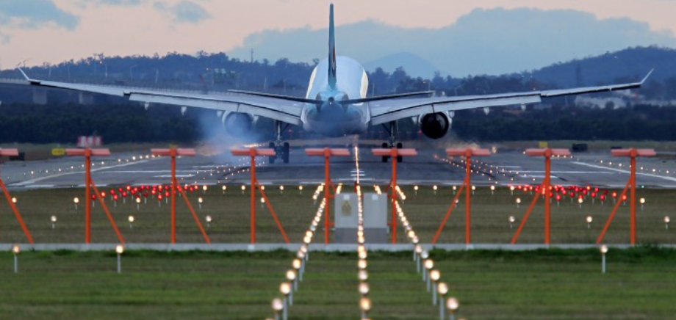
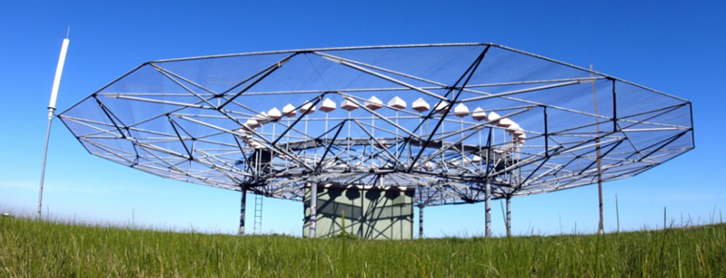
ATC/ANS Spectrum Usage

Slide 9
Air Navigation

Slide 10
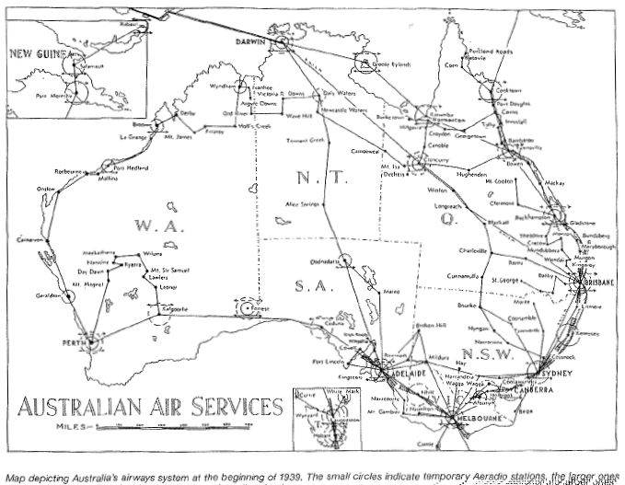

Slide 11
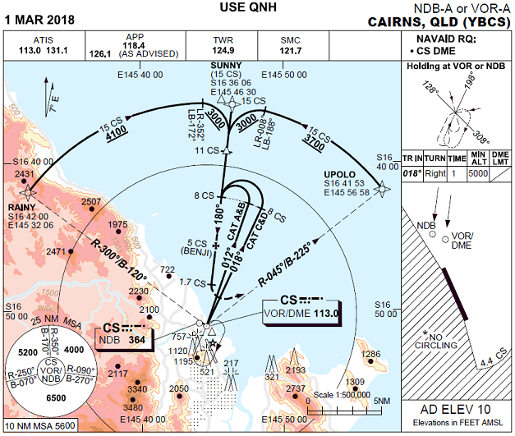
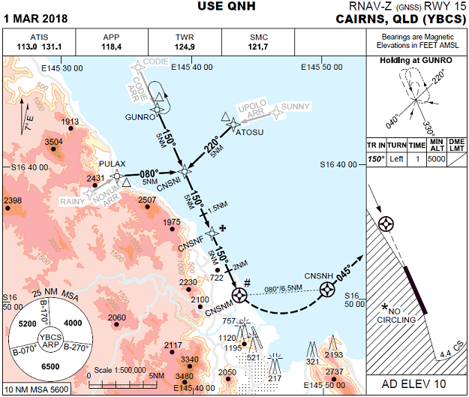
Modern Navigation

Slide 12
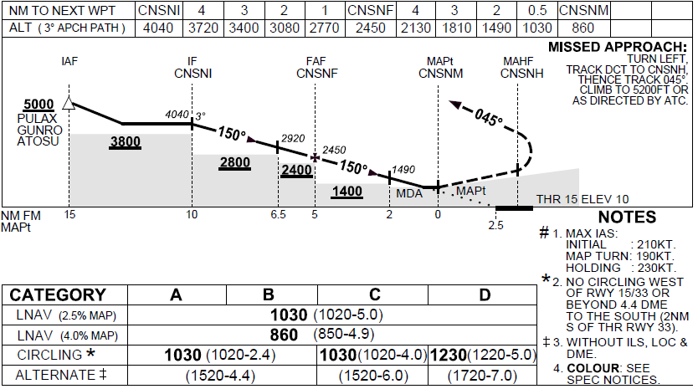
Vertical Path
Pilot has to control:
Nose up/down (pitch)
Distance to run
Altitude
Airspeed
Engines
Radio (ATC/other pilots)
High workload for single pilot operations

Slide 13
Instrument Landing System
Airservices/Defence operates ILS to 23 runway ends
Australia has 1,050 runway ends

Slide 14
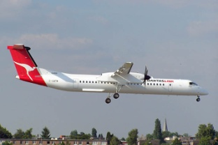
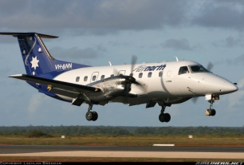
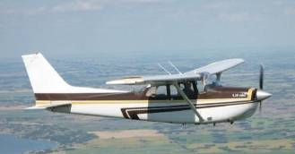
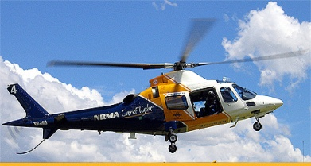
SBAS – an ILS for Regional Airports

Slide 15
Dual Frequency (L1/L5) Multi Constellation (GPS/Galileo)
Increased accuracy and availability
Reduced ground infrastructure
Increase access to airports during adverse weather
Less than 200 foot vertical visibility
Less than 550 metres forward visibility

Slide 16
Thank you
simon.reynolds@airservicesaustralia.com
02 6268 4919
www.airservicesaustralia.com

