Slide 1
Iridium Satellite Communications
Pat Tatum – Chief Engineer, Satellite Operations

Slide 2
Who is iridium?
A vital, global communications provider of mobile voice and data services via 66 in-orbit satellites with truly global coverage
Serving
Backed by 300+
Distribution Partners (wholesale-only business)
Business Lines:
1Million+
Aviation
IOT (M2M)
Maritime
Land Mobile
Government
Subscribers globally
Notes:
Iridium Currently
Has more than three quarters of a million subscribers
More than 300 technology partners
Over $400M in revenue
More potential with new network.

Slide 3
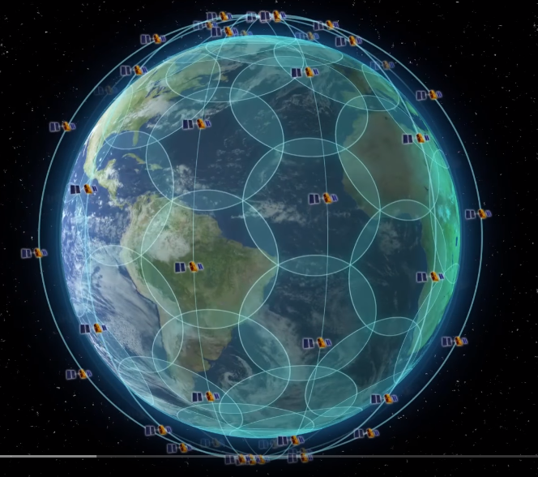
Iridium constellation in motion
https://www.youtube.com/watch iridium constellation

Slide 4
Iridium service used around the world
Note: Single day plot of M2M/SBD session, voice call and Iridium OpenPort broadband data origination points taking place on 19-Jan, 2018 (commercial traffic only)

Slide 5
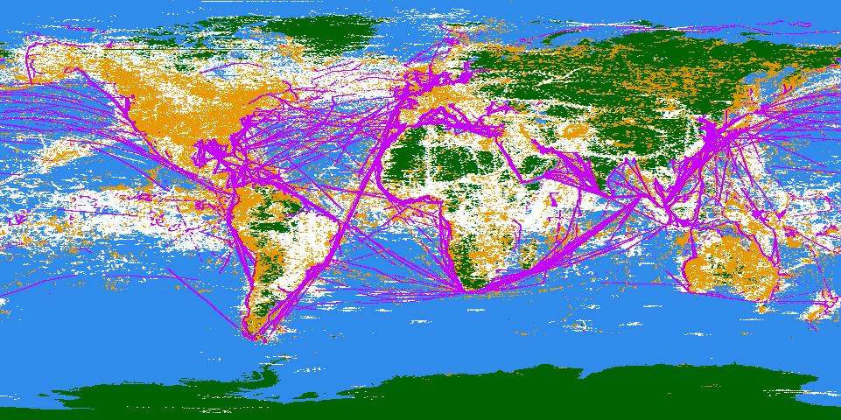
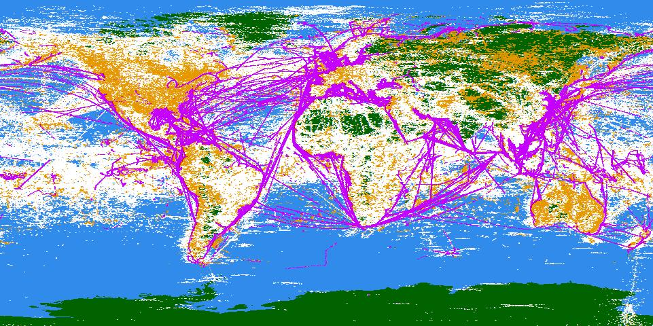
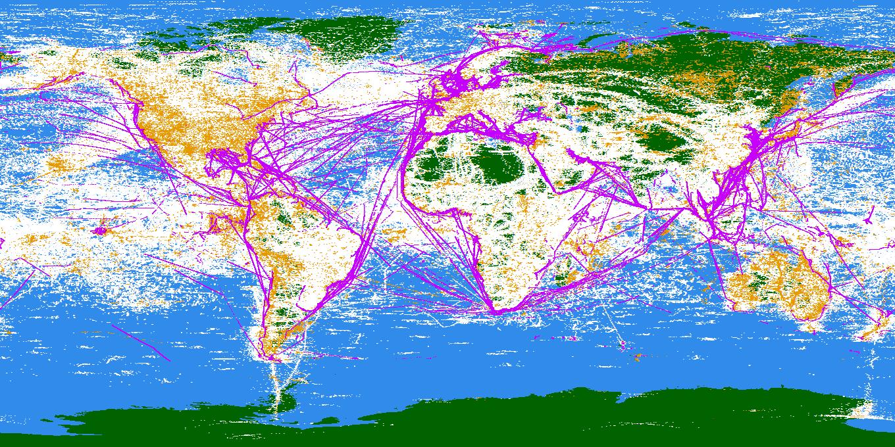
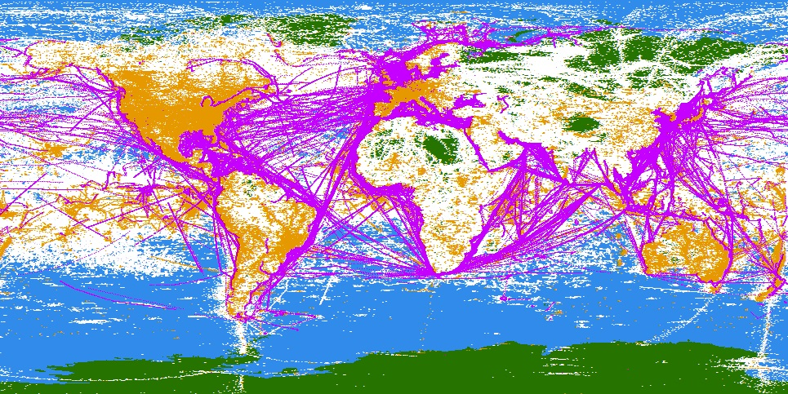
Growth in Global Voice & Data
One week plot of Session Origination Points
Oct 2010
Oct 2013
Oct 2015
Oct 2017
M2M Data Transmission
Voice Calls and 2kbps data
Iridium OpenPort Traffic

Slide 6
$3 billion satellite upgrade currently underway with 75 Iridium NEXT satellites (66 in mission, 9 in-orbit spares) sent to orbit via 8 SpaceX Falcon9 rockets
The largest satellite constellation replacement ever
As of August 15, 2018, 7 of 8 launches complete with 60 of 66 mission satellites already upgraded with no service disruption
All legacy services work on both legacy and new satellites
One more launch planned in 2018 to complete constellation upgrade

Slide 7
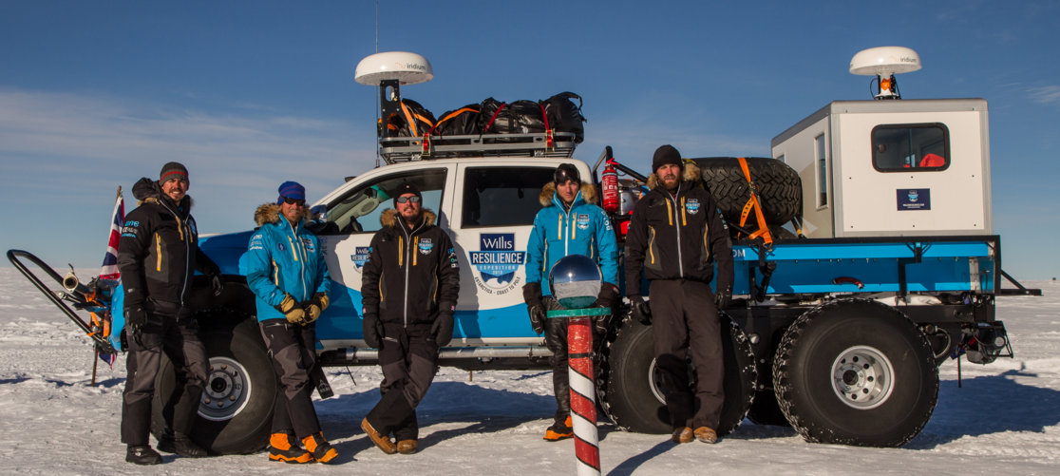
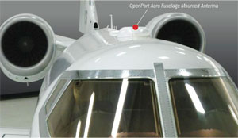
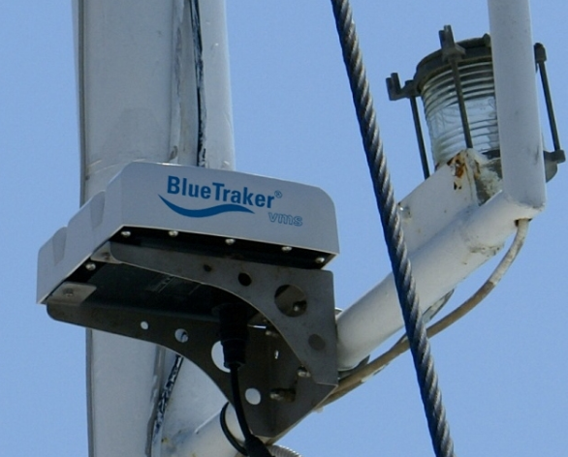
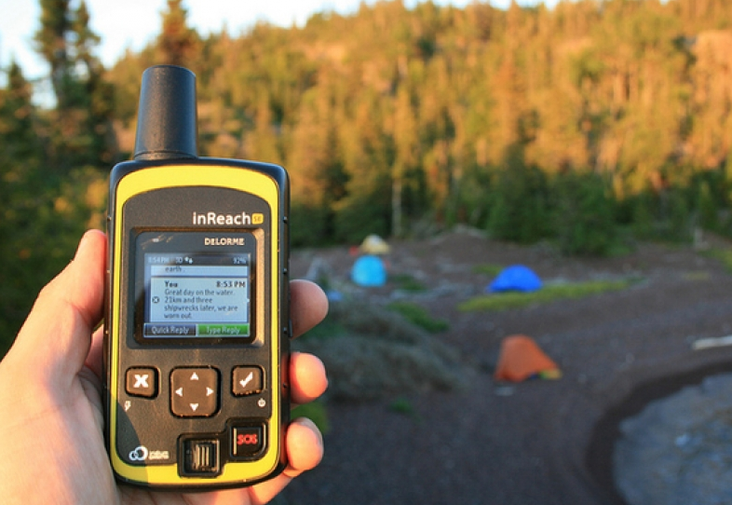
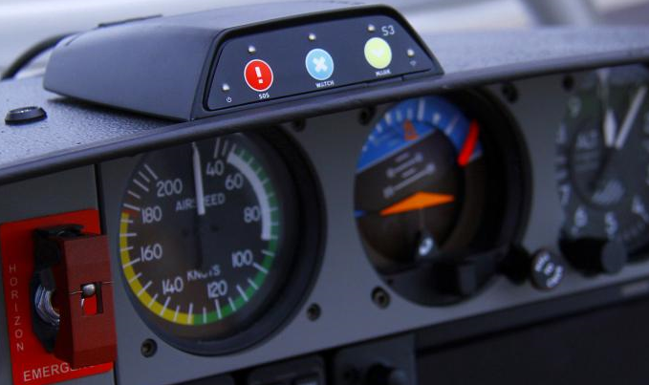
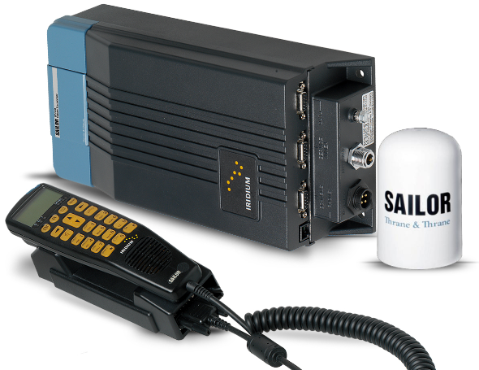
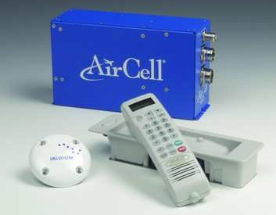
Iridium SAMPLE product portfolio
Today, Iridium and its manufacturing partners offer a suite of mobility-focused communication products providing voice communications, tracking, and broadband access across several vertical markets
Maritime
Land
Aviation
Broadband
> 128kbps IP Data
IoT (M2M)
> Short Burst Data
Voice
> Circuit-Switched

Slide 8
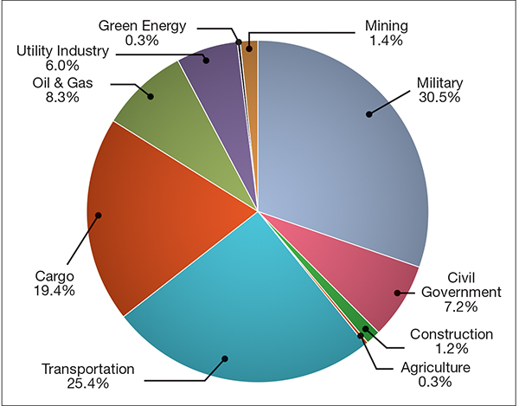
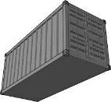
KEY MARKETS SERVED BY IOT SATELLITE APPLICATIONS
Source NSR 2015
Notes:
Strong markets / key growth markets include transportation, asset management / tracking, military and to a lesser degree utilities / oil & gas. We actually disagree and believe agriculture and construction from strong and growing market's over and above these forecasts.
Transportation & Fleet
medium & long haul, high value, highly secure, incl specific geographies (Brazil, LATAM, Sub Saharan Africa). Increasingly dual mode
Cargo & Asset Tracking
Container, inter modal, Reefer, Dry goods, oilfield services, pharmaceutical, hi tech & high value
Heavy Equipment
Telemetry & Tracking - Off road heavy equipment, mining, construction, agricultural, forestry, marine, oil exploration increasingly multi mode
Utilities
Telemetry, SCADA, Asset Tracking, Cathodic Protection,
Maritime
VMS, Tracking, Telemetry (Ship OEM),
Aviation
Flight Tracking, Data Recording, Trip Management, Flight Bag, Flight Safety
Govt & Military
Tracking, BFT, Telemetry, Security, Asset & Situational Awareness, Smart Munitions

Slide 9
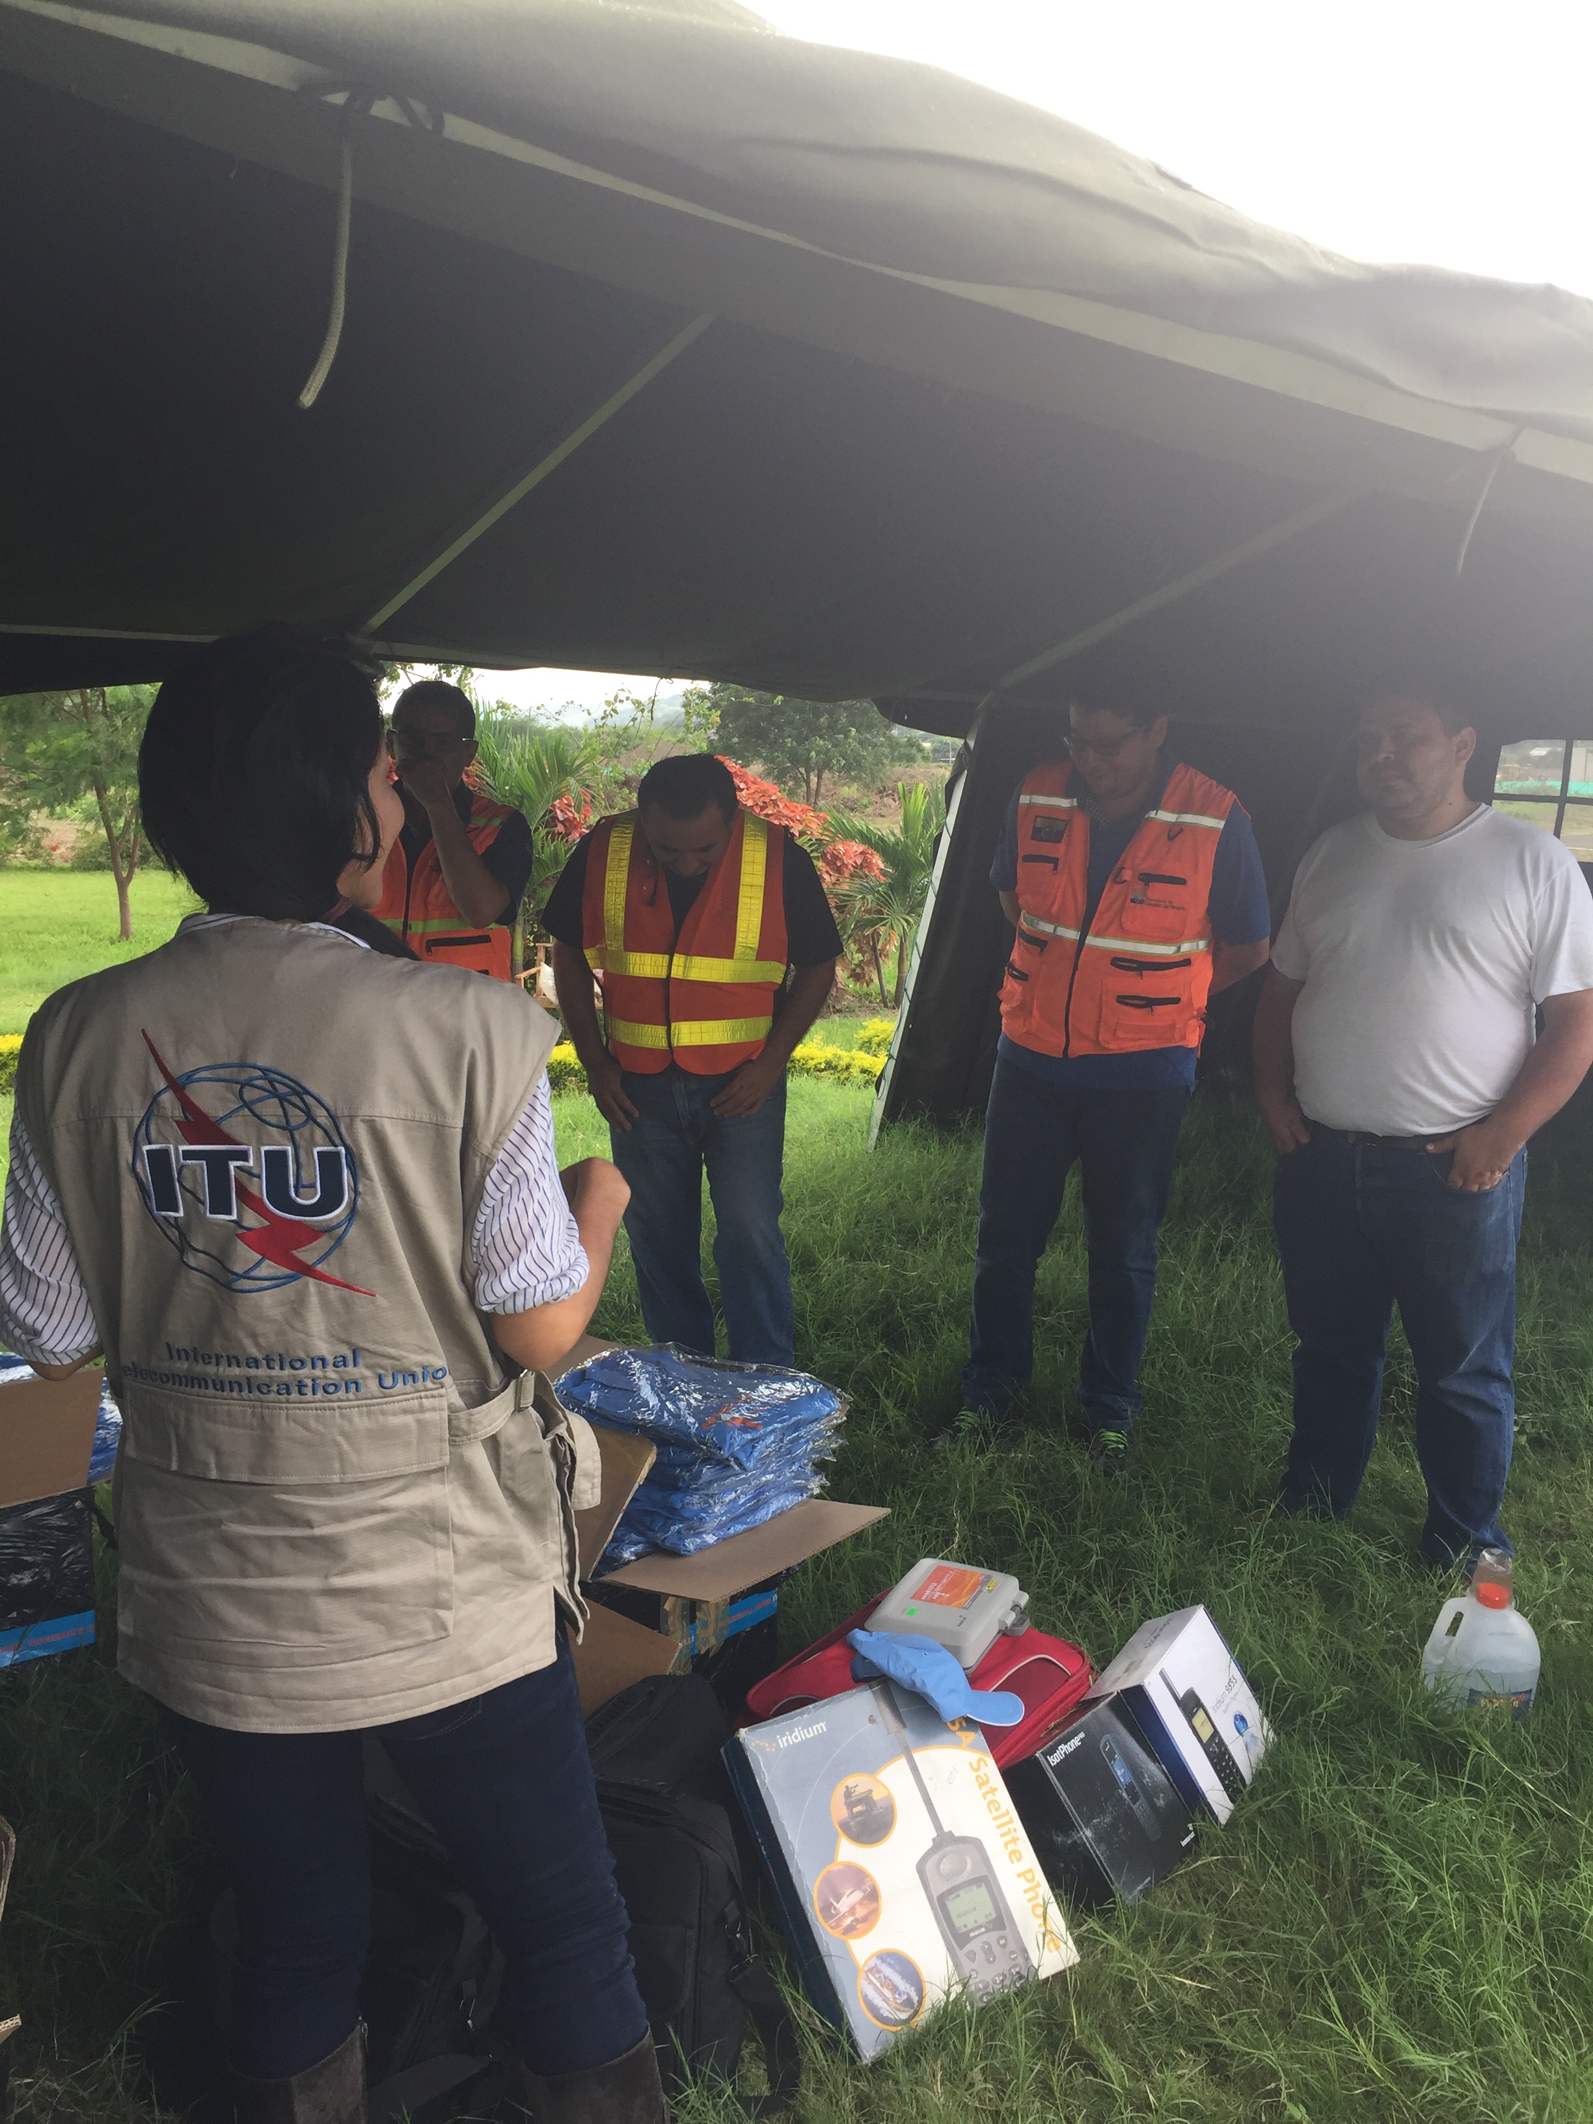
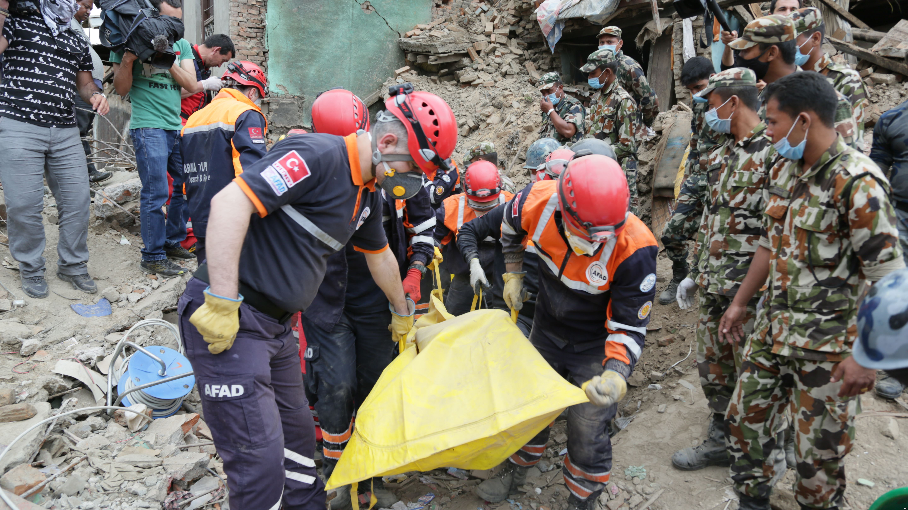
Iridium EMERGENCY AND SAFETY SERVICES
Iridium provides critical emergency and disaster relief service—especially valuable when terrestrial systems not available after a natural disaster
Iridium has donated phones to the ITU, and works with ITU-D closely to assist when disaster strikes
Iridium provides aviation safety services and critical maritime services
Iridium satellite phones used for earthquake response in Chile
This Photo by Unknown Author is licensed under CC BY-SA

Slide 10
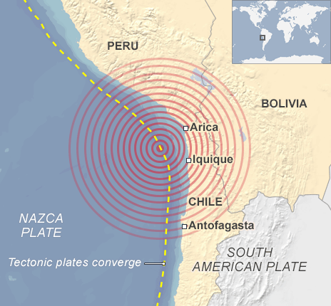
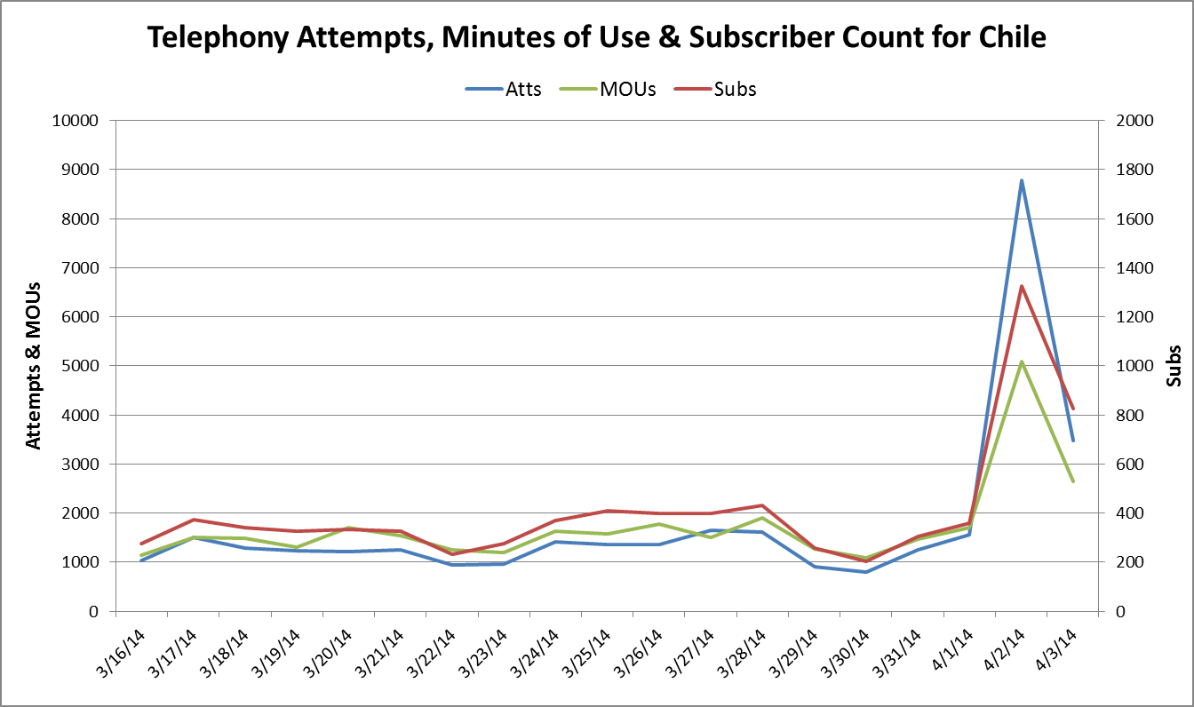
EMERGENCY USE IN CHILE: Elevated iridium activity after 2014 earthquake
April 1st - 8.2 Earthquake off the Northern Chile coastline
April 2nd - 7.7 Aftershock
8 fold increase in Iridium Calls
Earthquake Epicenter

Slide 11
Global Maritime Distress and Safety System (GMDSS)
Safety
Required on all passenger and cargo ships over 300 gross tons on international voyages
Must carry certified equipment for sending and receiving distress messages and maritime safety information
Iridium has been recognized by UN International Maritime Organization IMO and plans to provide full GMDSS services by 1 January 2020
Iridium GMDSS service will extend GMDSS to south Atlantic/Antarctic area covered by Chilean maritime rescue coordination center (RCC) and NAVAREA (where Chile responsible for navigation and weather warnings)
11

Slide 12
Global Maritime Distress and Safety System (GMDSS)
Iridium initiated process to become a GMDSS provider in 2013 and has been evaluated for compliance with requirements
Expert Group determined Iridium meets all conditions for “recognition”
In May 2018, the IMO’s Maritime Safety Committee (MSC) recognized Iridium to offer maritime distress and safety communications within the GMDSS
This is a significant achievement for maritime safety and for mariners
The second GMDSS system provides competition, global coverage, state of the art equipment
Iridium GMDSS equipment developed by Lars Thrane A/S combines voice and data in one simple installation
Demo has been done for IMO experts to demonstrate its capabilities
As Iridium works with partners to develop GMDSS product solutions, the new competition is expected to drive supplier diversity and reduce the costs of shipboard equipment
Iridium’s global coverage is especially important for national Rescue Coordination Centers with Arctic or Antarctic areas of search-and-rescue (SAR) responsibility
Australia is responsible for one of the largest SAR areas in the world, covering a large slice of the South Polar (Antarctic) region
Currently no satellite GMDSS coverage available to aid navigation or SAR in these regions

Slide 13
radio astronomy (RA) protection
Iridium acknowledge issue of compatibility in some geographic areas, due to limitations of first-generation system
Problem arose through seventh-order intermods around areas of very high traffic density (notably Western Europe, parts of North America)
Radio Astronomy Spectrum (RAS) protection thresholds exceeded during peak traffic events
First-generation design offered little traffic flexibility or frequency management
Iridium NEXT designed with features to resolve compatibility
Bandwidth limiting, with frequency crowding toward the upper end of the spectrum for satellites passing over an RA site
“Load Stealing” - reducing the coverage area of a single satellite by deactivating beams (traffic transferred to adjacent, less heavily-loaded satellites)
Combination results in significant reduction in intermods, and much greater additional protection for the adjacent RAS band
Before

Slide 14
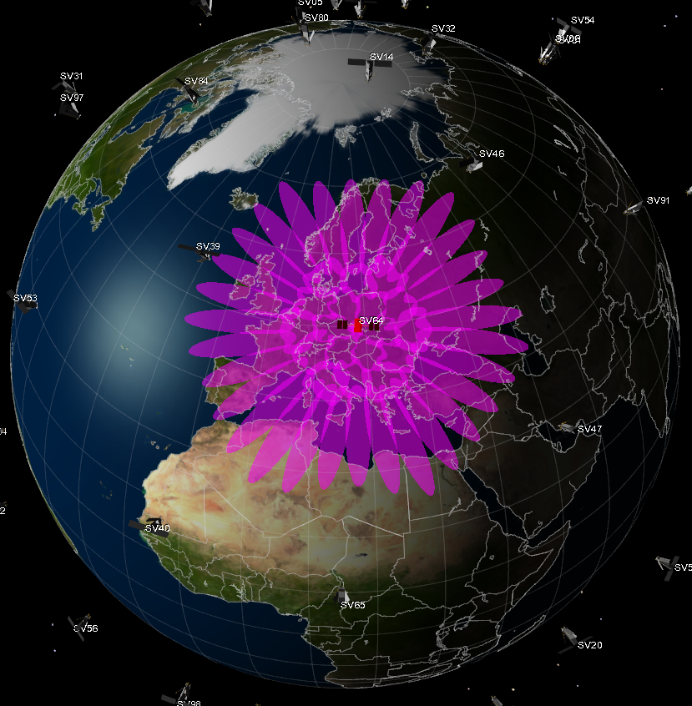
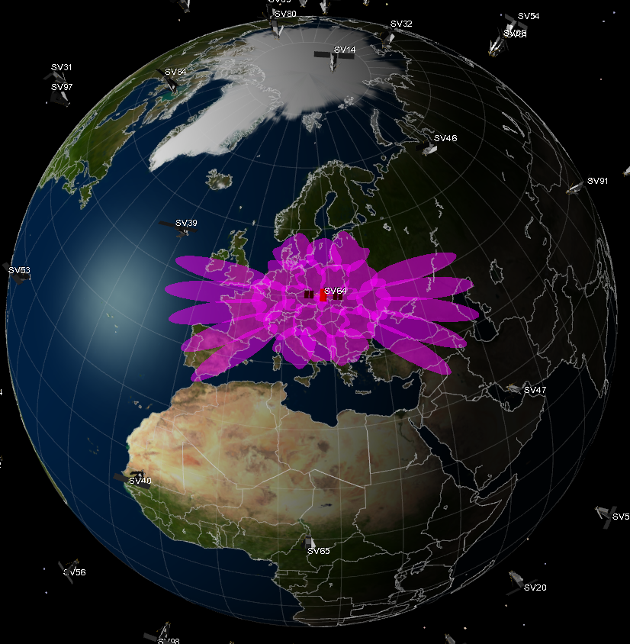
New radio astronomy protection Approach
Beam control applied at higher (lower) latitudes
Iridium NEXT design allows full control of active beams
Deactivating beams results in fewer intermods generated
Traffic transferred to adjacent satellites
Before
After

Slide 15
Iridium Next Generation
End of Presentation
Thank You!

