Slide 1


5G and EME
Assessment and impact of Electromagnetic Energy associated with 5G
ACMA RadComms
30 October 2018
Mike Wood
Principal - Telstra EME Strategy, Standards & Risk Management
Chairman - AMTA EME H&S Committee
Chairman - International Electrotechnical Commission TC106
1

Slide 2
Presentation Overview
What is 5G?
How does 5G work?
Standards - for 5G & EME
EME Exposure – what it means for 5G
Telstra’s 5G Trial – EME assessment
Responsible framework for 5G & EME
Observations and Conclusions
2

Slide 3
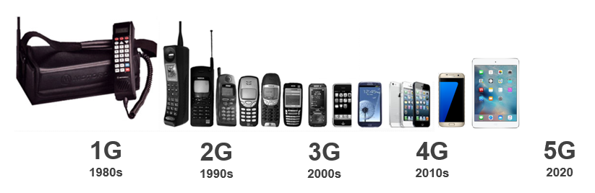
What is 5G?
5G is the 5th generation of mobile networks
Extreme speeds - Gbps
High Capacity – 10x
Low Latency – 1ms
Analogue
Digital
SMS
Multimedia
Video Calling
Mobile internet
Mobile Broadband
Enhanced Video
Mobile Connected World
Enhanced Mobile Broadband
Low latency applications
Internet of Things
Augmented and Virtual Reality (AR & VR)
3

Slide 4
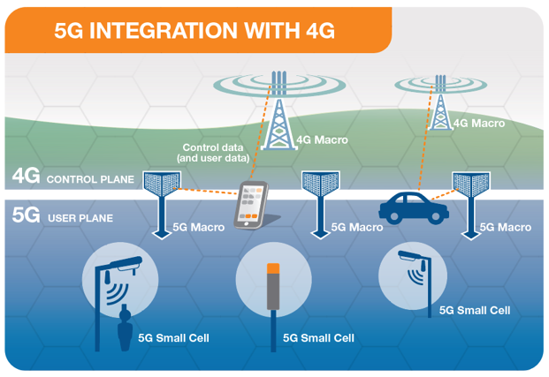
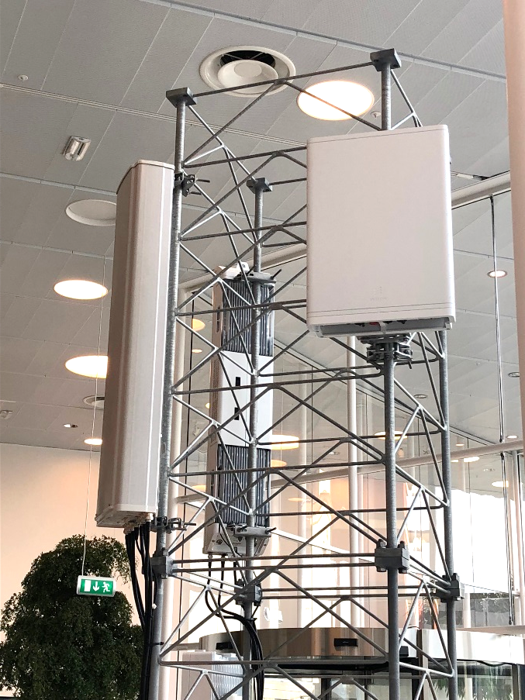
How does 5G work?
5G works together with 4G (initially non standalone NSA)
4G acts as control plane
5G acts as data/user plane
5G will operate stand alone in later releases
5G
5G
4G
4G
5G - 3.5GHz
5G – mmWave 27GHz
4

Slide 5
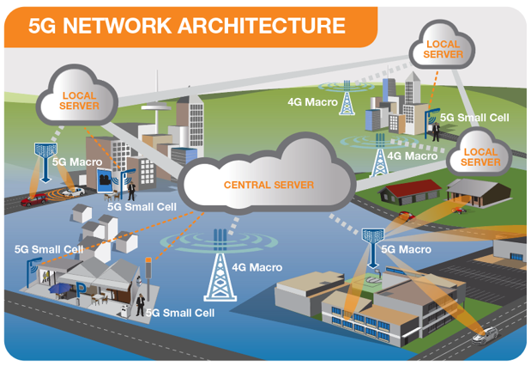
How does 5G work – network architecture
Radio Access Network - small cells, towers, masts dedicated in-building and home systems that connect mobile users and wireless devices to the core network
Core Network - mobile exchange and data network, manages mobile voice, data and internet connections.
Redesigned to integrate with the internet and cloud based services, distributed servers across the network.
Network Slicing – smart way to segment network
for separate applications – e.g. emergency services
5G network architecture - illustrating 5G and 4G working together, with central and local servers providing faster content to users and low latency applications
5

Slide 6
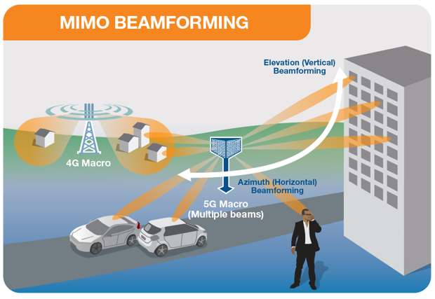
5G Technology - Beamforming
  Dedicated radio signal towards the user
  A 4G signal is typically spread across a wide area
  Enabled by Massive MIMO technology
  Identifies most efficient signal path
  Improves connection reliability
  Reduces interference (unwanted signals)
  Efficient use of spectrum and power
  Allows more simultaneous data streams
Key Point – Beamforming is more efficient and reduces average RF exposure levels
6

Slide 7
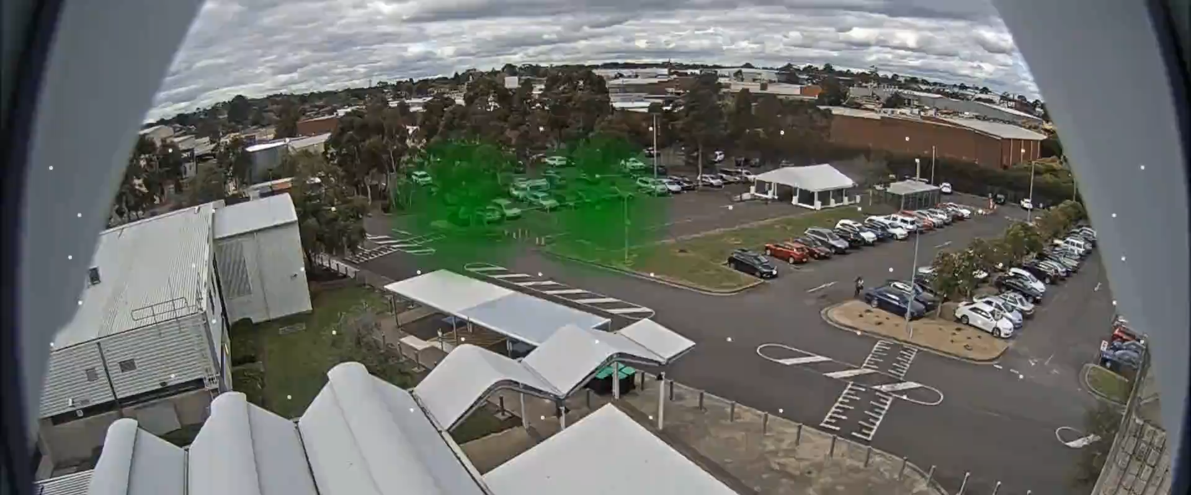
5G Technology – Beamforming live example
Beamforming - Example from Telstra’s 5G Trial in Melbourne 2016
green dots show active beams connected to 5G Van driving in carpark
7

Slide 8
5G & EME Standards – challenges & progress
Globally harmonised EMF exposure limits
Revised ICNIRP, IEEE, FCC exposure guidelines are critical especially for 5G devices >6/10GHz
Development and implementation of new network and device testing procedures to meet 5G technology evolution
Devices
mmWave
Complex devices
Far field – E or H is measured
Near field - E&H field, Phase, field reconstruction
Multiple tx, beam steering & varied shapes
Advanced modelling techniques
Networks
mmWave
Complex antennas
Near field and far field
MIMO & beam steering
Power averaging for true EMF level
Advanced modelling techniques
Challenge – IEC TC106 has responsibility to develop assessment standards
for 5G devices and networks to 100GHz (by 2018)
8

Slide 9
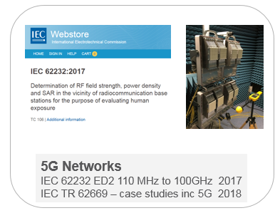
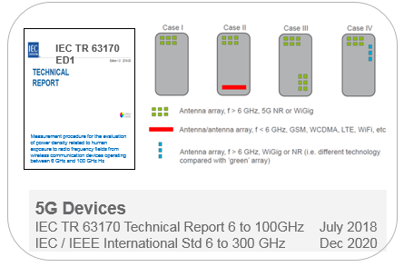
New 5G Exposure Assessment Standards - IEC
IEC Strategic Business Plan - prepare for 5G
Ensure Standards and Technical Reports are developed
- Trials & early deployments in 2018 – 2019, Commercial Launch 2019 - 2020
9
Notes:
See previous comments

Slide 10
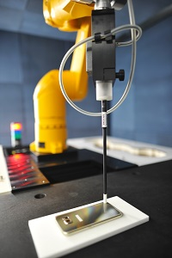
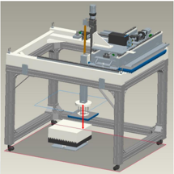
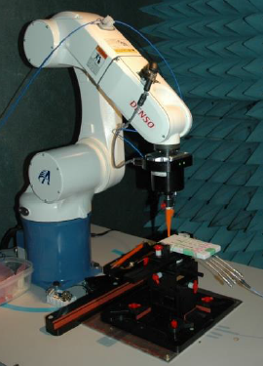
5G Device Test systems – power density measurements
During development of the IEC 5G Technical Report in 2017, test laboratories initiated development of 5G mmWave device test systems
Nearfield
probe
Device under test placed here
Waveguide probe
Art-Fi mmWave guide probe development
APREL mmWave probe development
IT’IS EUmmW Poynting vector probe
10

Slide 11
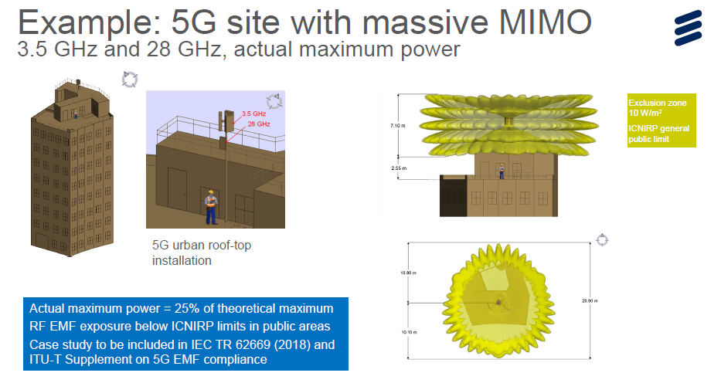
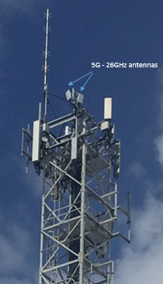
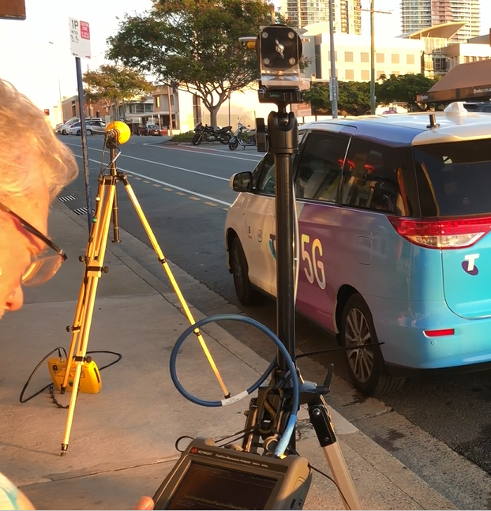
5G Macro Cell Assessment using IEC 62232
5G Base Station Antenna
Field Measurements
Modelling actual power due to beam steering
Measurements of 5G in Australia using IEC 62232
Locating beam and observing level variation
Lab Measurements
11

Slide 12
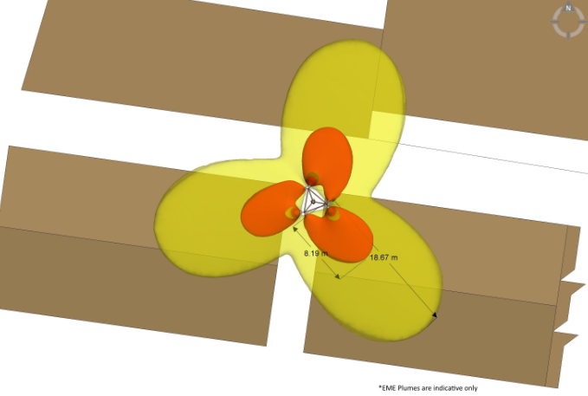
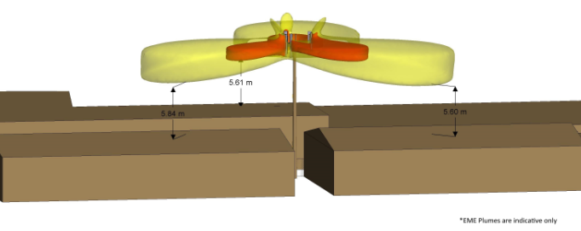
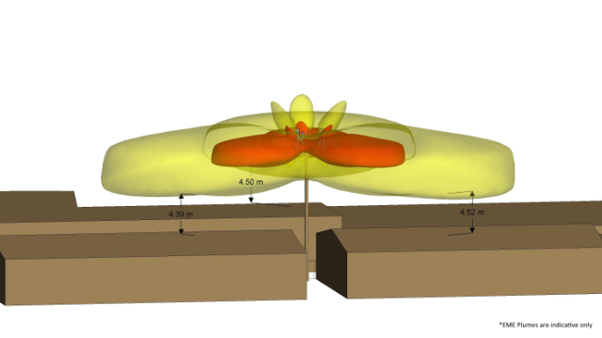
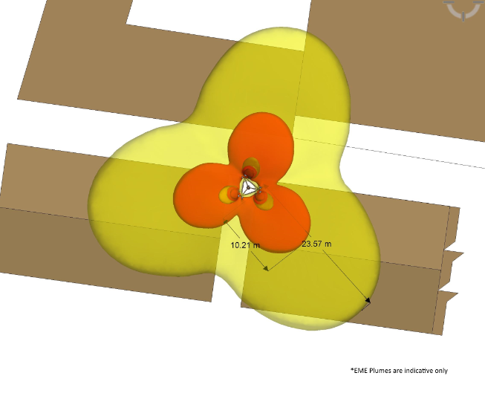
5G Macro Cell Assessment using IEC 62232
Without 5G
5G Base Station Antenna
18.67m
Field Measurements
With 5G
modelled at 100 Watts
(50% theoretical Max
23.57m
Note – actual EME exposure will be significantly less that theoretical maximum as 5G with MIMO & beam steering greatly increases efficiency
Lab Measurements
12

Slide 13
5G & EME – what it means for RF exposure
Key Points
5G uses radio frequency like existing mobile technologies and many other radio services e.g. TV, FM, emergency and commercial radio services, microwave links & satellite
Significant evolution of 4G technology – greater efficiency
Typical EMF levels from all networks (3G, 4G, 5G) and devices in everyday use will remain low
5G Devices
Must comply with safety standards
very efficient & low levels of EMF
5G Networks
Very efficient - EMF levels in public areas will be well below safety standards - many more connections
Environmental EMF levels may increase slightly (near to sites) with the addition of 5G networks
EMF Compliance zone evaluation – actual EMF levels under investigation with results to date showing levels well below theoretical maximum
13

Slide 14
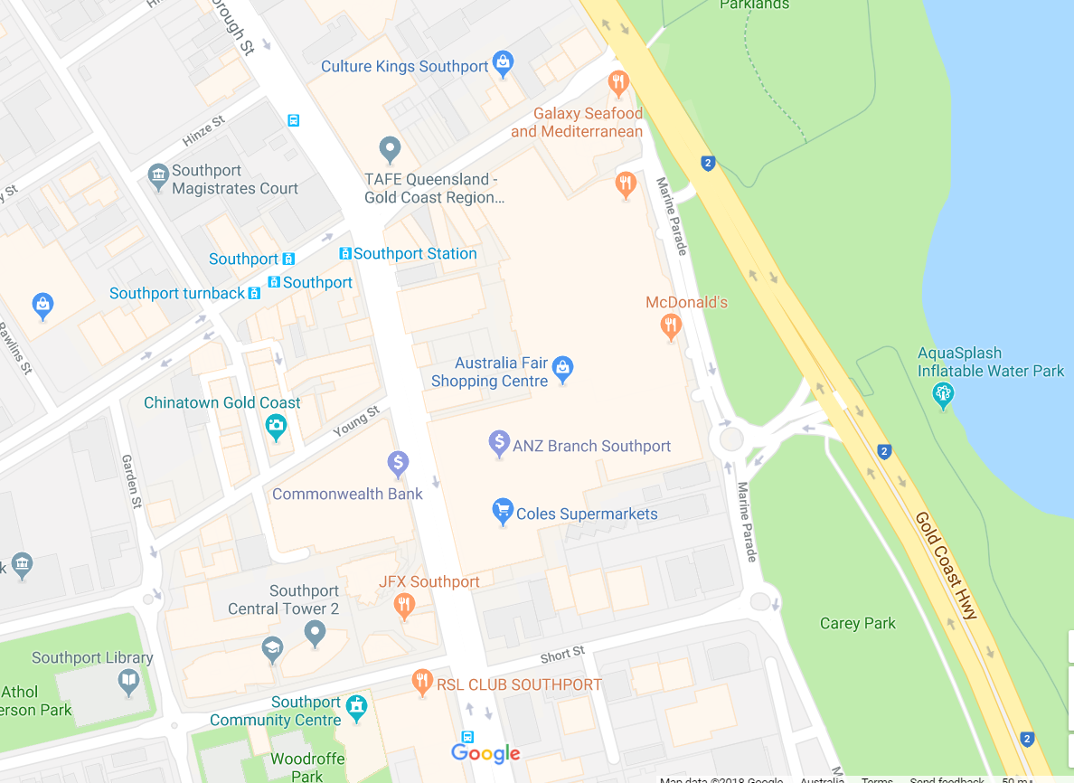
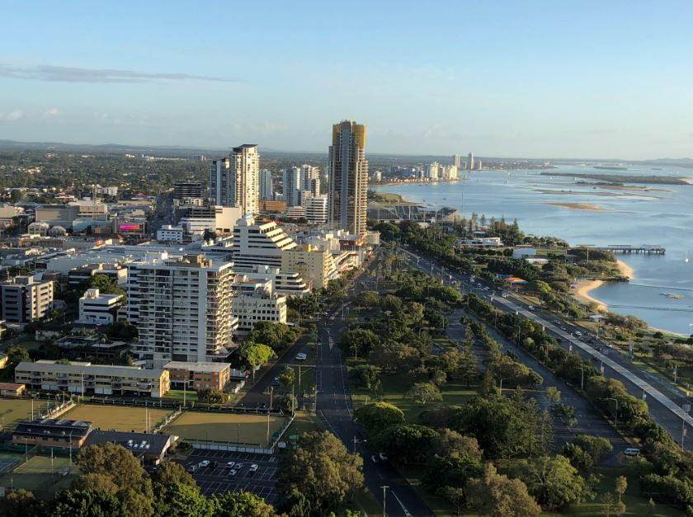
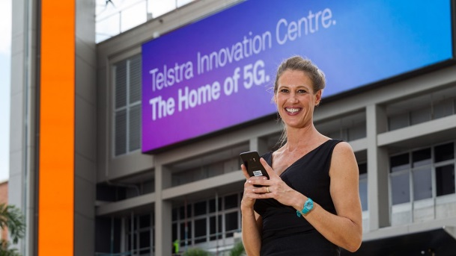
Testing 5G Radio Frequency Exposure
Telstra Exchange
Telstra Exchange
Telstra 5G Innovation Centre - Southport Exchange
14

Slide 15
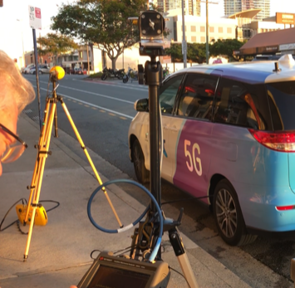
5G Outdoor EME measurements
pizza shop
44 m radio tower
carpark
5G - 27 GHz antennas
5G sector bearings
Southport exchange
Pizza Shop
https://www.google.com.au/maps/@-27.974846,153.3818768,14z
15

Slide 16
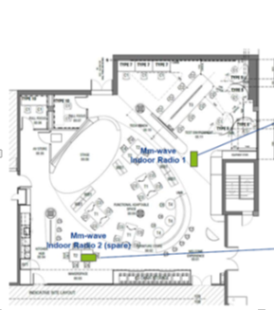
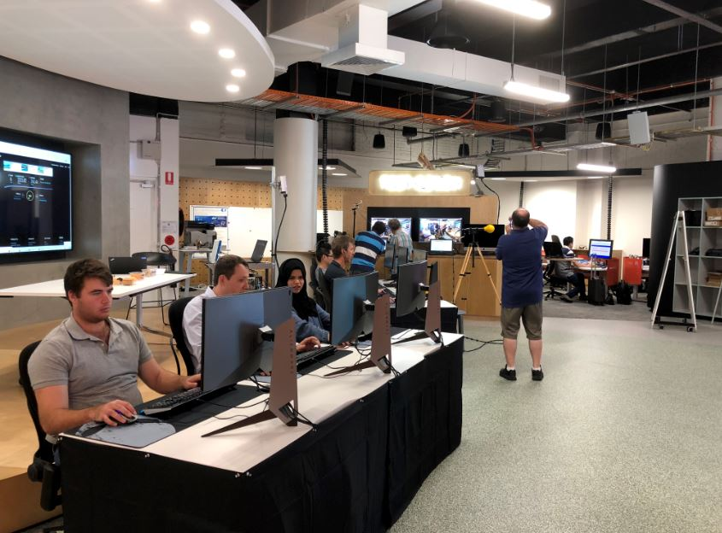
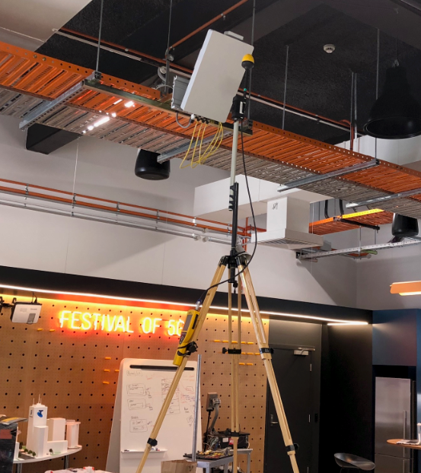
5G Indoor EME measurements
5G 27GHz
Indoor Antenna
5G Device
5G Device
5G eSports
Demonstration
16

Slide 17
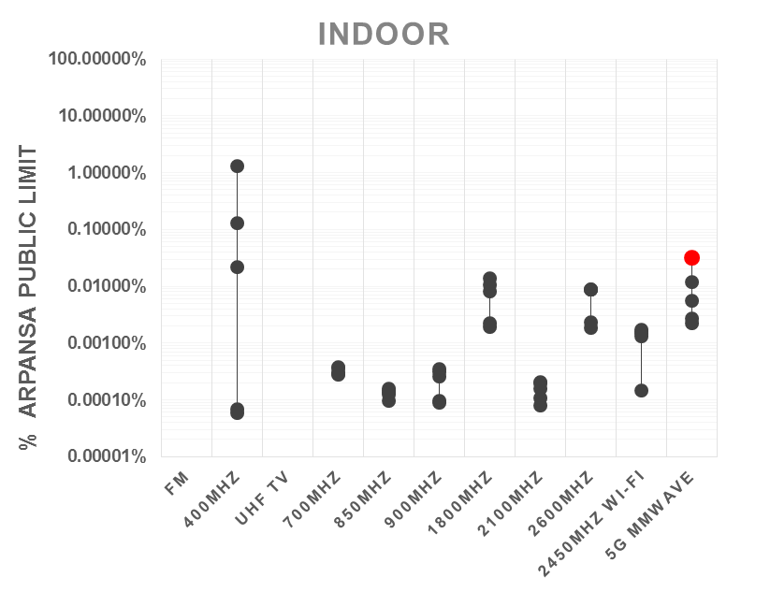
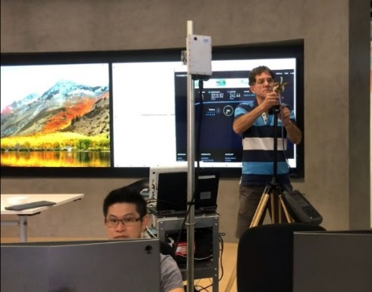
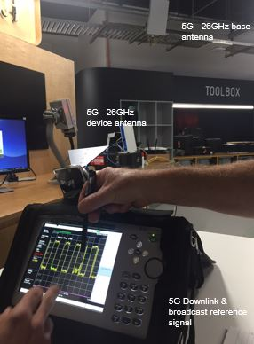
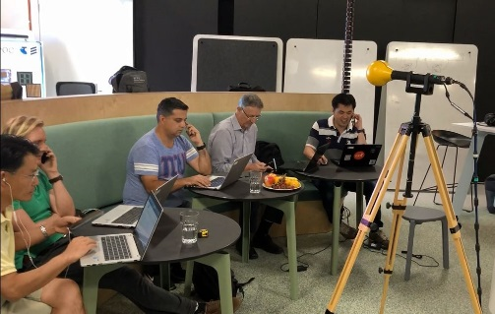
Environmental EME levels - indoor
ARPANSA / ICNIRP public limit
Near (~0.45 m) Walkie Talkie
5G
~0.3 m from 5G user equipment (UE)
4G inc laptop
baby monitor
5G levels inside
IBC
IBC
• Measurements at different positions
17
Notes:
Telstra spectrum
LTE
700 (20 MHz)
1800 (10/15 MHz)
2600 (40MHz)
IBC LTE 900
3G 850 (5/10 MHz)
2100

Slide 18
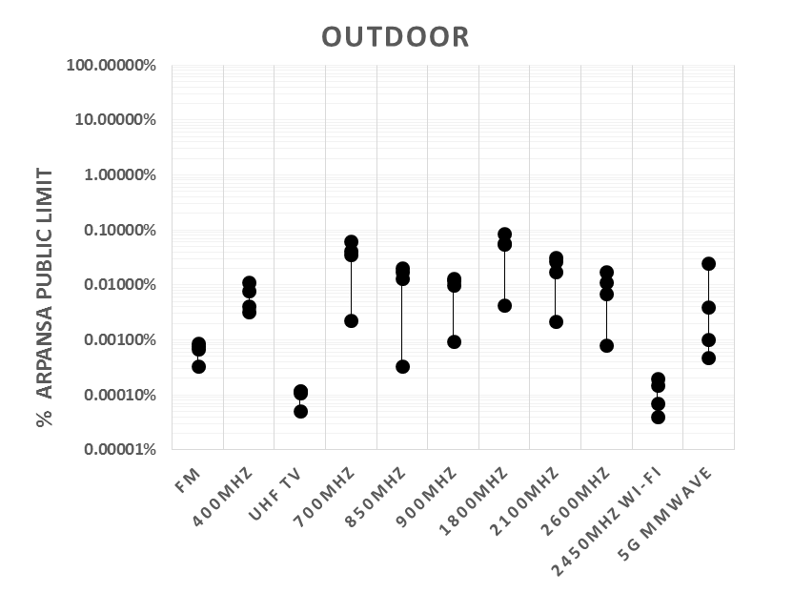
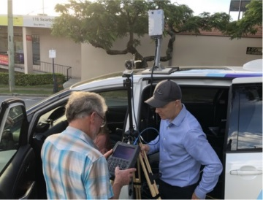
Environmental EME levels - outdoor
ARPANSA / ICNIRP public limit
Sum of car mounted 5G UE + BS @ 0.3 m from car, carpark
5G
Sum of car mounted 5G UE + BS @ 1.5 m from car, carpark
Towards BS, carpark
Towards BS, pizza shop
• Measurements at different positions
18
Notes:
Telstra spectrum
LTE
700 (20 MHz)
1800 (10/15 MHz)
2600 (40MHz)
IBC LTE 900
3G 850 (5/10 MHz)
2100

Slide 19
5G & EME - Observations & Conclusions
Overall EMF Levels
All mobile technologies including 5G significantly below ARPANSA RPS3 / ICNIRP limits
What does 5G add?
Indoor & Small cells – similar EMF to current technology (more data/ more users)
Outdoors Macro cells – predict similar EMF to current macro technology (more data/ more users)
5G is more efficient – more data/users for same power. (Will replace older technology)
Many more devices – no significant increase in environmental/background EMF
- devices will have increased efficiency
- devices will comply with EMF limits
- EMF levels from devices decrease very rapidly with distance
- many devices have intermittent transmission (low EMF)
19

Slide 20
5G & EME – Next Steps
Validate 5G EME assessment methods using actual power
EME Site Assessments
Update RFNSA database with 5G site designs
Environmental EME Reports
Site Compliance Certificate
Community and Stakeholder Information
20

Slide 21






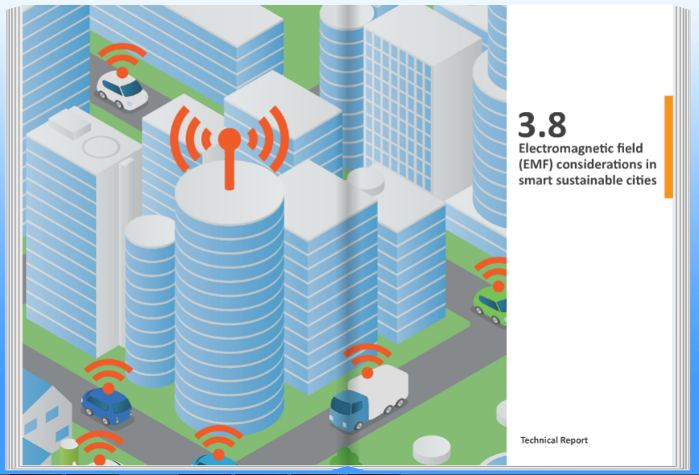

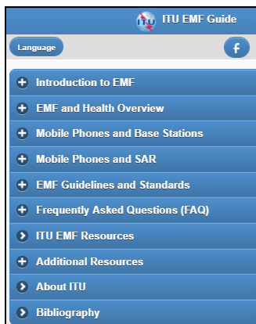
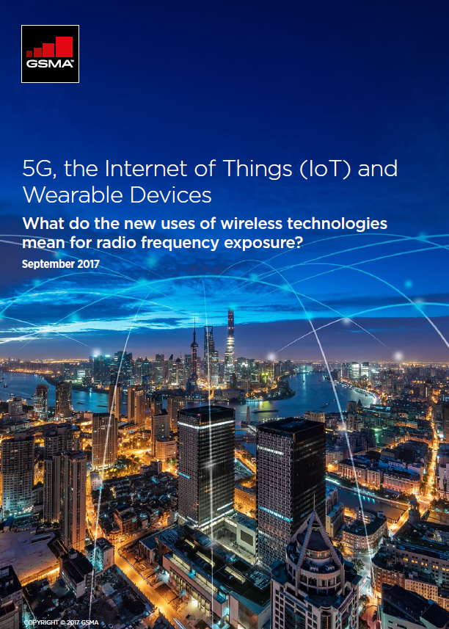
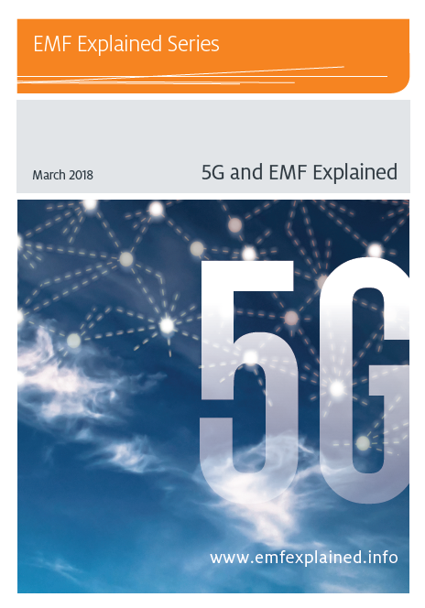
5G & EME - Responsible Global Framework
Harmonised EMF Standards
- adoption of International EMF Exposure Limits
- adoption of International EMF Exposure Assessment Methods
- implementation of realistic exposure assessments
Responsible Network Deployment
- spectrum allocation for 5G
- government policy supporting efficient network rollout
- responsible and efficient network design & deployment
Stakeholder Engagement
- provision of EMF information to governments and stakeholders
- compliance information
- open information to communities and citizens
ITU Smart City Guide
21
5G Explained
ITU EMF Guide
GSMA 5G EMF

Slide 22
Thank you
22

