Slide 1
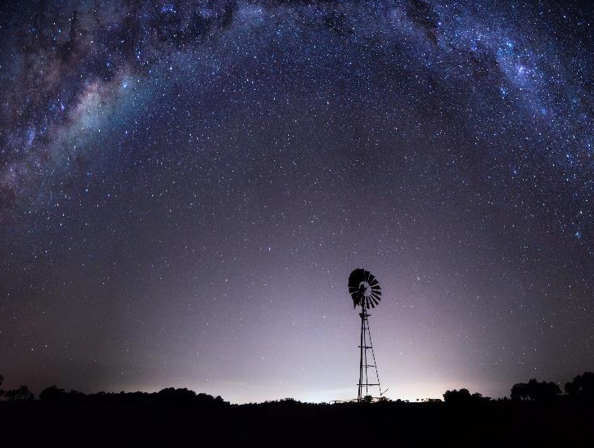

Supporting Australian Space
Karl Rodrigues
Executive Director, International and National Engagement Australian Space Agency
RadComms 2018
Tuesday, 30 October
Notes:
This is a 30 minute presentation

Slide 2
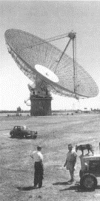
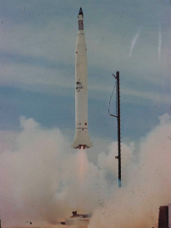
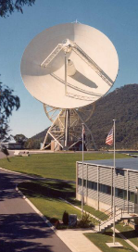
Australia's long history in space
Third country to launch its own satellite from sovereign soil (1967)
Honeysuckle Creek and Parkes Radio telescopes role in Apollo moon landings
Contribution to science, research and technological developments to support NASA and ESA over many years
Notes:
Australia has a long and proud history in space.
Whilst the Agency is new, Australia has been involved in space from an early stage
WRESAT was the name of the first Australian satellite. It stands for Weapons Research Establishments Satellite. WRESAT was launched on 29 November 1967 using a modified American Redstone rocket with two upper stages known as a Sparta from the Woomera Test Range in South Australia. The Sparta, was donated by the United States.
Image one – Parkes in 1969
Image two – WRESAT launch
Image three – Honeysuckle in 1970

Slide 3
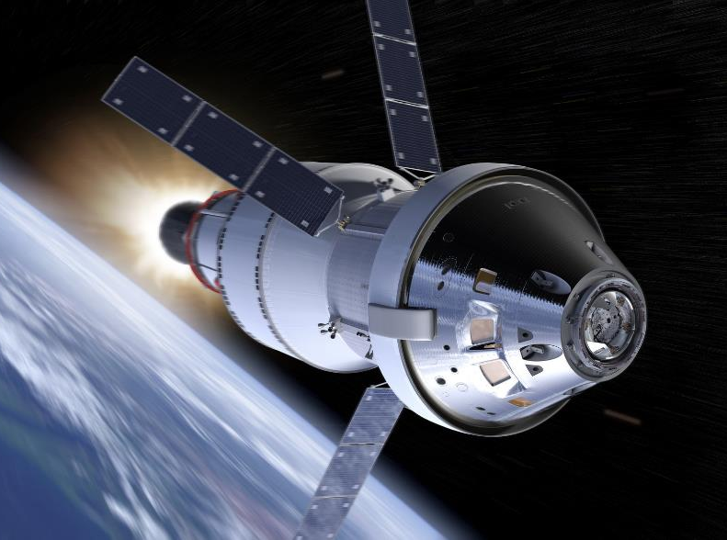
Space is a future industry
A rapidly growing industry
Estimated value globally $345.0b, $3.9b nationally
Australia has a highly skilled workforce
Excellent R&D capabilities
Creating up to 20,000 new jobs

Slide 4
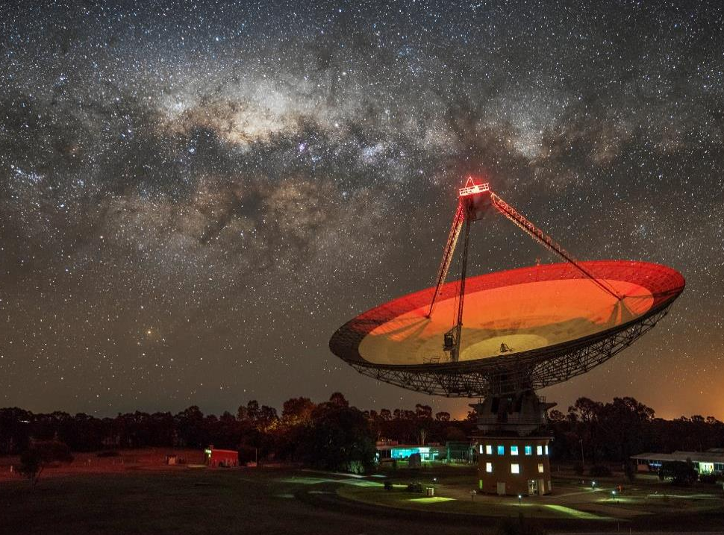
“To transform and grow a globally respected Australian space industry that lifts the broader economy, inspires and improves the lives of Australians – underpinned by strong national and international engagement”
The Australian Space Agency
Established 1 July 2018
Multidisciplinary
Focusing on key priorities

Slide 5
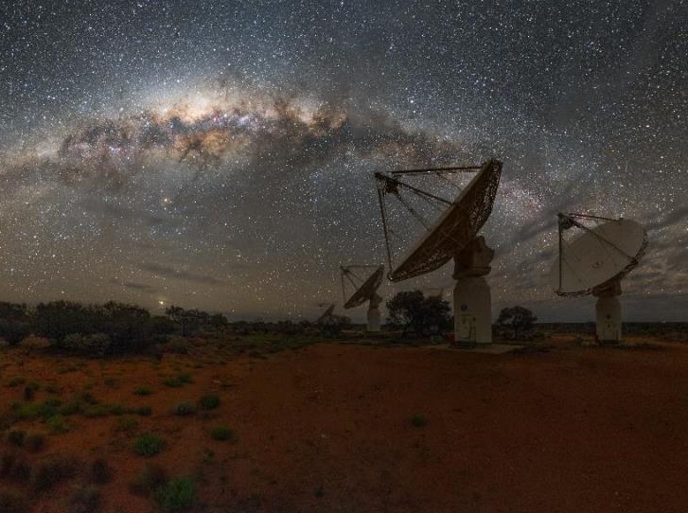
Supporting the space sector
Providing policy and strategic advice
Coordinating Australia’s civil space sector
Growing the space industry and the use of space
International civil space engagement
Legislation and international obligations
Inspiring Australia
Notes:
(short) Since the establishment of the Australian Space Agency on 1 July, guided by our purpose and core responsibilities, the Agency has achieved some major milestones:

Slide 6

How do we achieve our purpose?
”
One door and one voice for the civil and commercial space sector…
”
Partner and Facilitator
Helping to connect and open up opportunities domestically and internationally
Responsive Regulator
Working with industry
Legislation that provides safety while encouraging growth
Coordinate Domestically
Draw on Australian capabilities
  Work closely with government partners and jurisdictions
  Build a complementary industry
  Multidisciplinary team

Slide 7
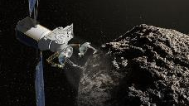
The Agency priorities are Australia’s areas of competitive advantage
Communications technologies, services and ground stations
Space Situational Awareness and debris monitoring
Space services
Positioning, Navigation and Timing infrastructure
Earth observation services
Robotics and autonomous systems
R&D and leapfrog technologies
Inspiring the Australian community

Slide 8




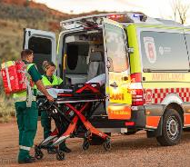
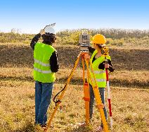
Space is not just satellites and rockets
Precision Agriculture
Mining and Remote Operation
Biomedicine
Advanced Manufacturing
Emergency Services
Urban Planning

Slide 9






Our first 100 days
22.9 million Australians (cumulative reach)
Strong engagement with states and territories and industry
Active international engagement with three signed MoUs
Space Amendment Act 2018 – Royal Assent August

Slide 10







Identifying opportunities internationally
  Matching our capabilities to gaps
  Access to international collaborations
  Growing the industry

Slide 11
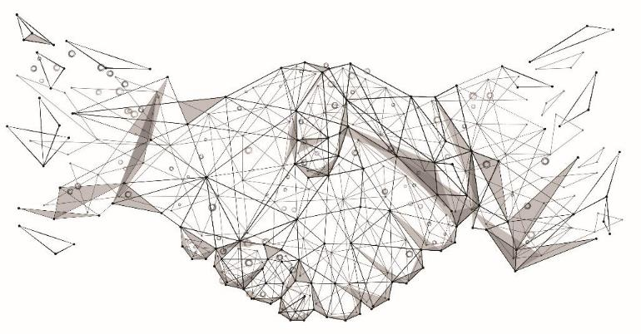






Collaborating with other Agencies
Notes:
Mention our relationship with GA (and other agencies) and that we are not assuming these roles
Also might mention that John is speaking next about the more technical aspects of SBAS

Slide 12
Questions?
enquiries@space.gov.au
www.space.gov.au
Tweet: @AusSpaceAgency
LinkedIn: australian-space-agency
Industry House
10 Binara Street
Canberra City, ACT 2601, Australia
Telephone +61 2 6213 6000

