Slide 1
Ms Joan Warner CEO of Commercial Radio Australia
RadComms – 30 October, Sydney
Radio – Broadcasting Future

Slide 2
Global audio renaissance with technology driving change

Slide 3
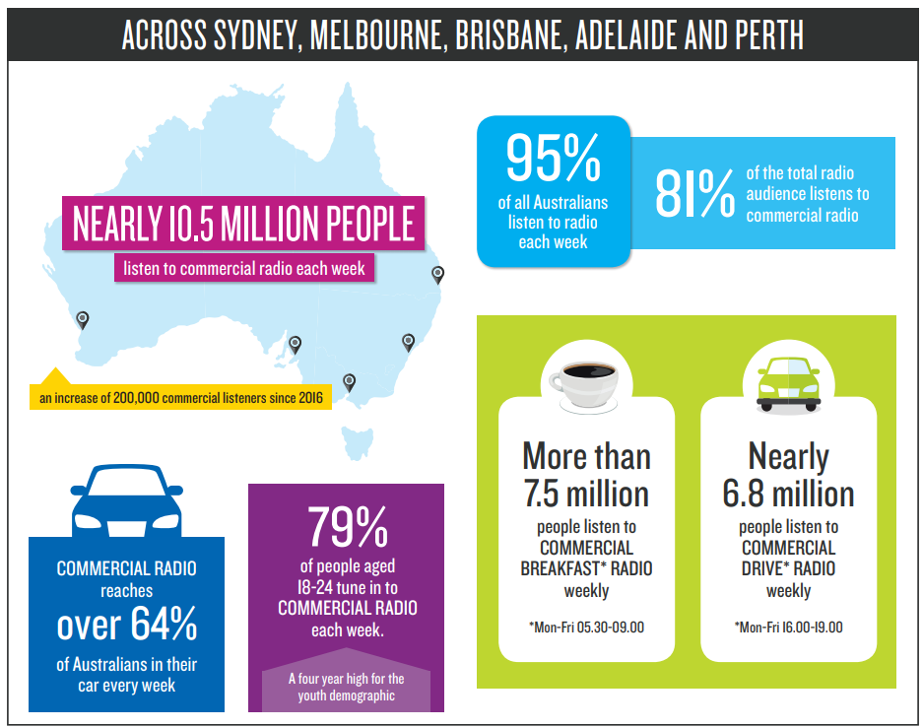
What does radio look like in 2018

Slide 4
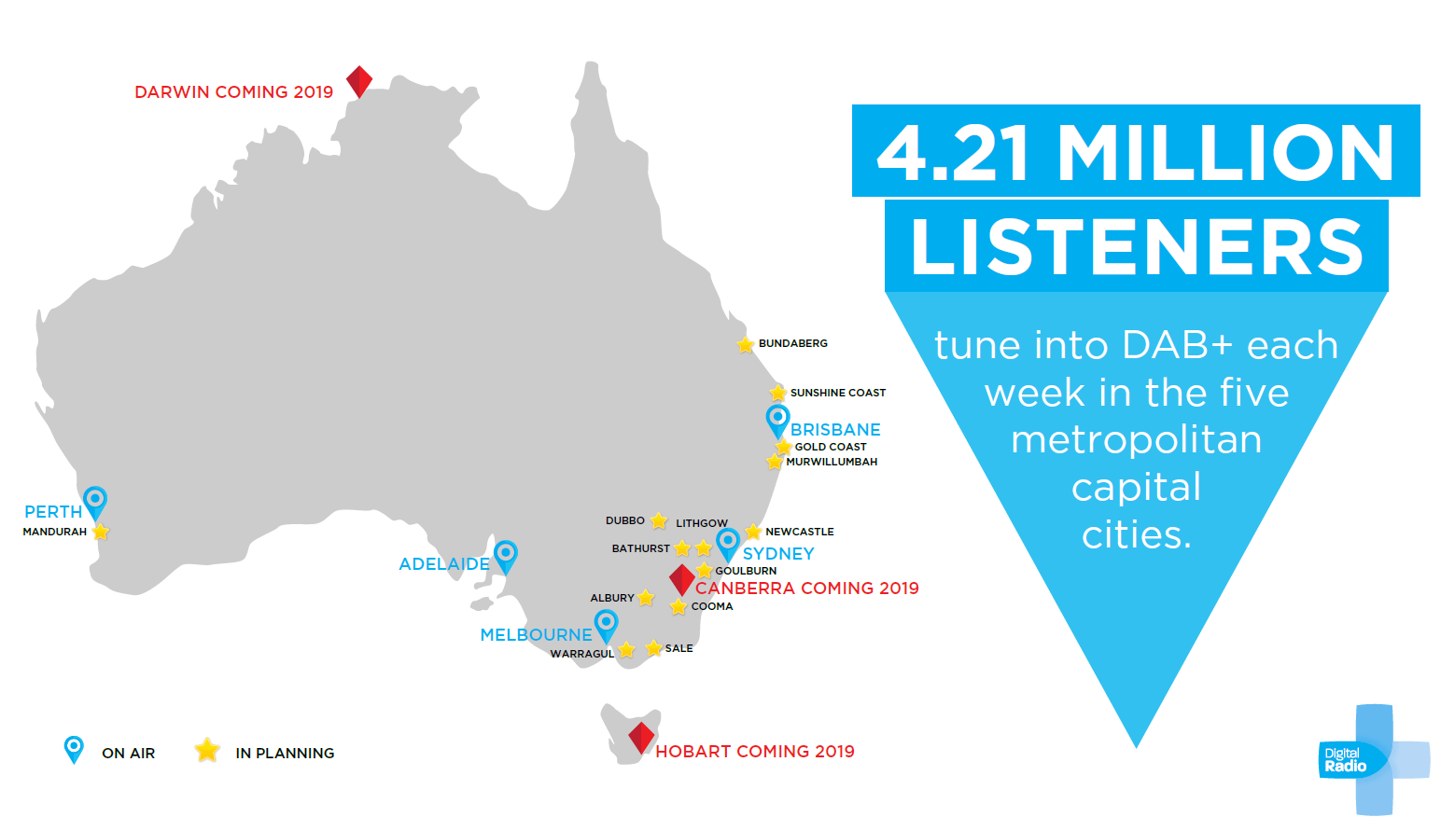
DAB+ digital radio in Australia

Slide 5
DAB+ digital radio listening growing

Slide 6
DAB+ listening double via streaming

Slide 7
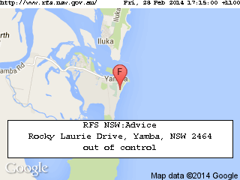
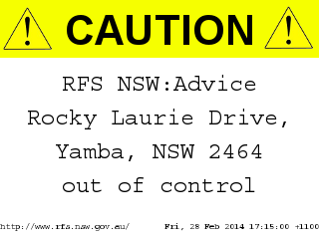
Radio in Emergency
Safety alerts to home radio, cars and mobile phones

Slide 8
RadioAPP
Aust radio industry launched RadioApp to allow access to all DAB+, AM & FM stations via the app on smartphones, tablets etc to nearly 300 live and local Australian radio stations from around the country – public & commercial
Offering listeners another way of accessing radio

Slide 9
RadioApp Launch

Slide 10
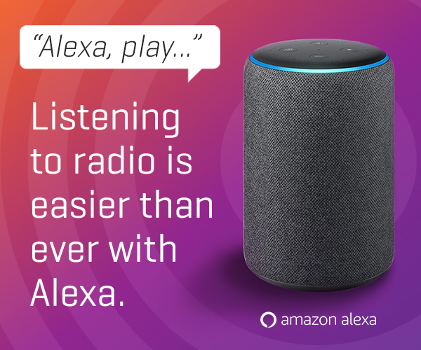
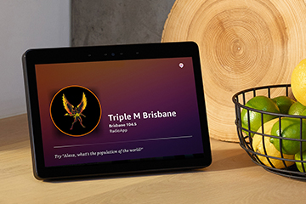
Voice activated devices – Alexa

Slide 11
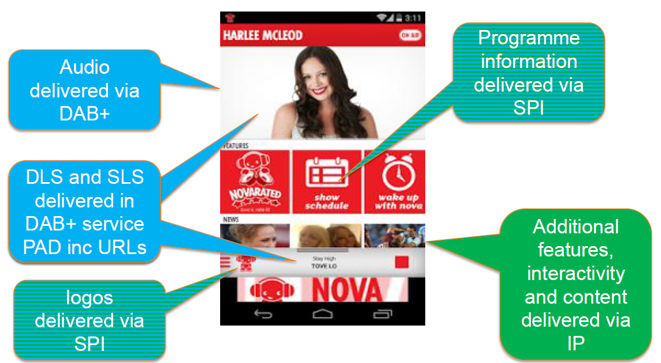
Hybrid Radio – information delivery

Slide 12
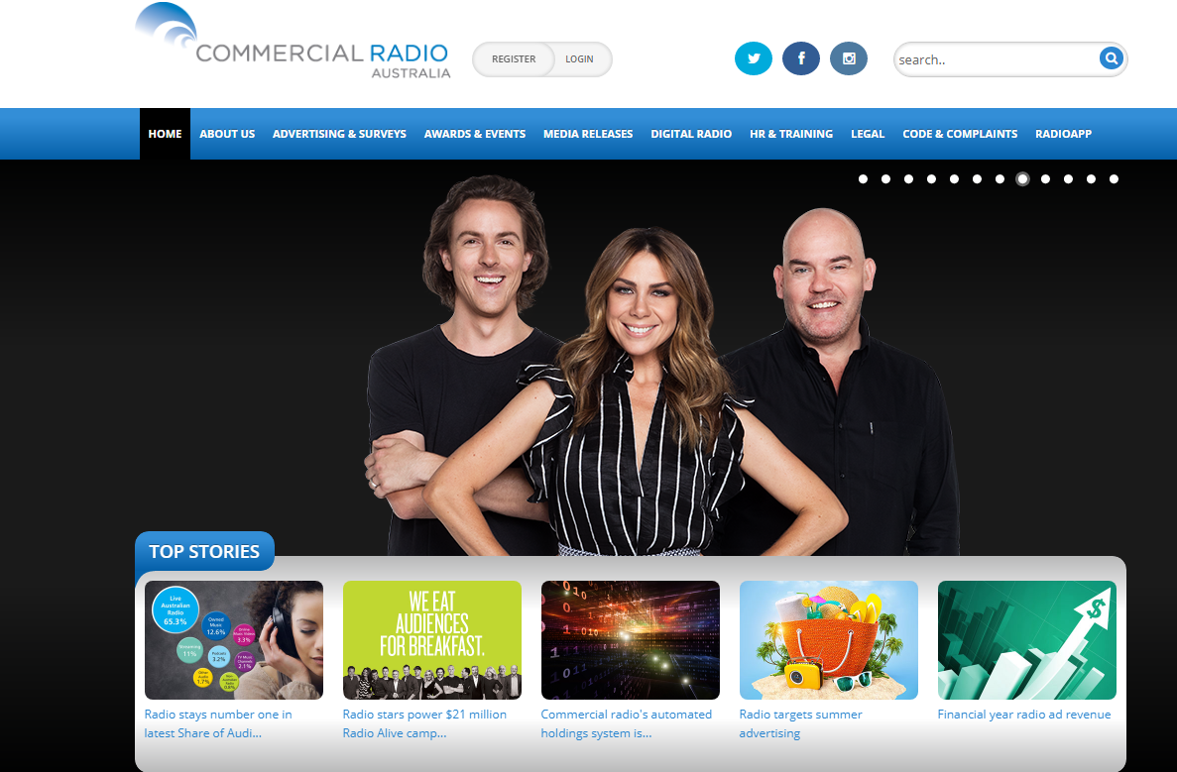
Radio must remain easily accessible: anywhere anytime
www.commercialradio.com.au www.digitalradioplus.com.au www.radioalive.com.au

