Slide 1
Positioning Australia for the Future
Dr John Dawson

Slide 3
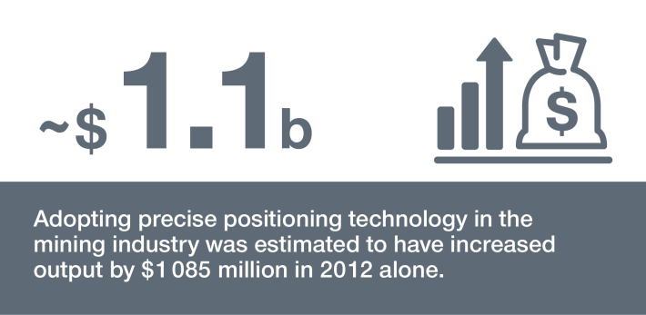
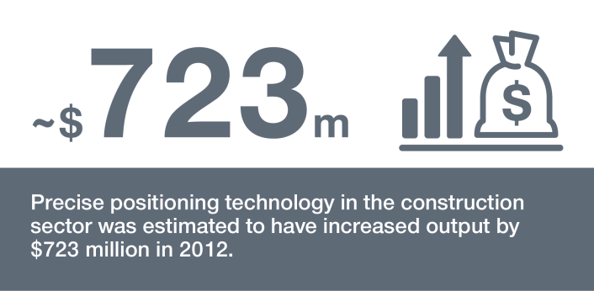
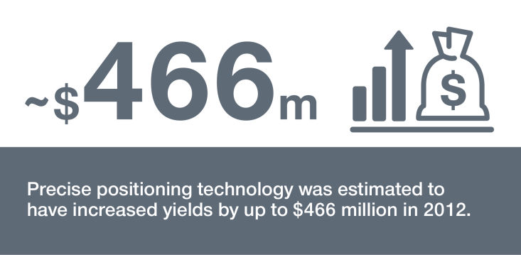
Positioning, Navigation and Timing (PNT)
Downstream applications and benefits of Precision PNT
Mining Construction Agriculture

Slide 4
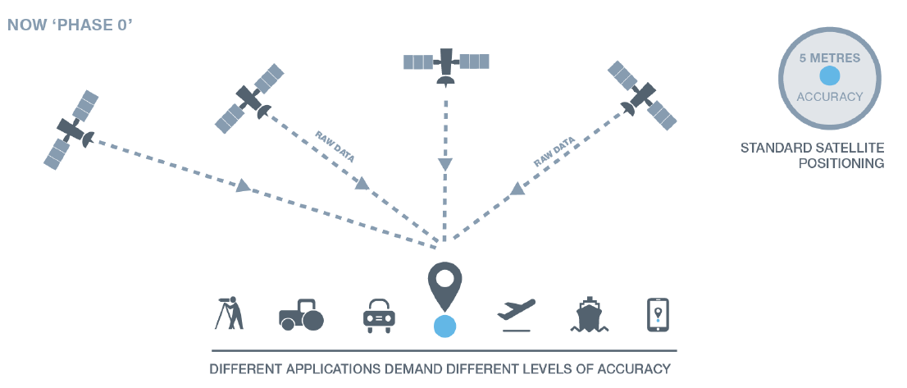
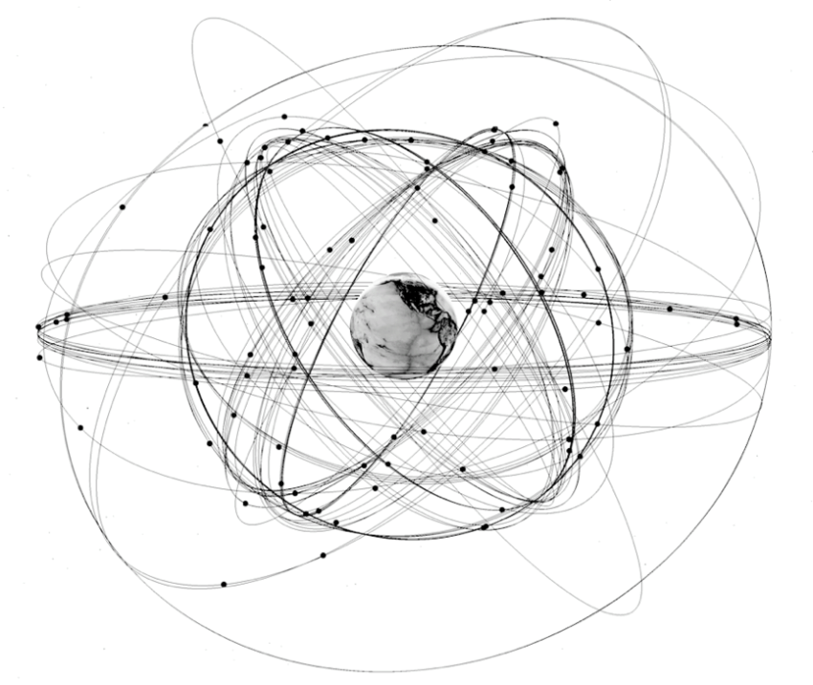
GNSS Positioning
Image: Reid, 2017

Slide 5
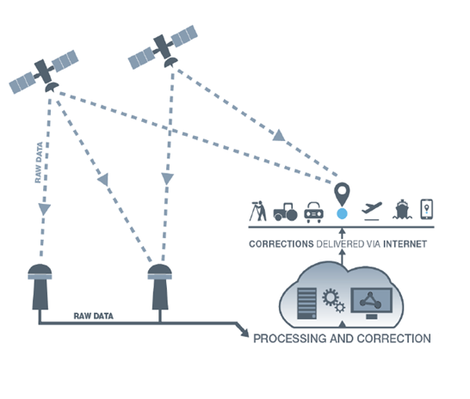
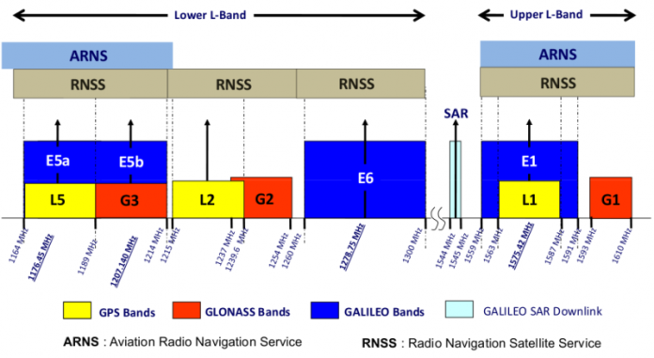
Augmented GNSS and Signals

Slide 6
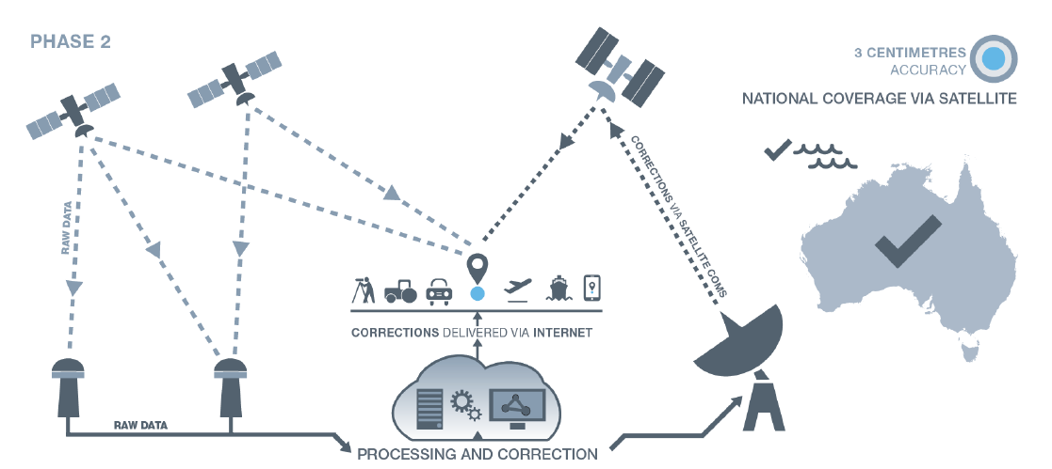
Satellite-Based Augmentation System (SBAS)

Slide 7
2018-19 Australian Federal Budget
Allocates $225 million for better satellite positioning
AUD $161 million for a Satellite-Based Augmentation System (SBAS)
AUD $64 million to establish a National Positioning Infrastructure Capability (NPIC)
Ongoing operational funding ($50 million / year)

Slide 8
Integrated national positioning system
SBAS
NPIC
+
L1 GPS SBAS (aviation)
DFMC SBAS open service
Open access PPP (10cm)
High reliability core network
Open CORS data
Open source software

Slide 10
