Slide 1
Mythbusting the Future of Free to Air Television
RadComms 2018
Broadcasting Futures
Bridget Fair, Chief Executive Officer, Free TV Australia

Slide 2
#1
Nobody I know watches TV any more

Slide 3
TV going strong
554 mins per week BVOD
Average viewing time
13m
2 hours
27 mins
Australians tune into something on commercial television every day
FTA reaches
22m
90%
Australians every month
of 2 hours 27 mins is people watching
LIVE TV

Slide 4
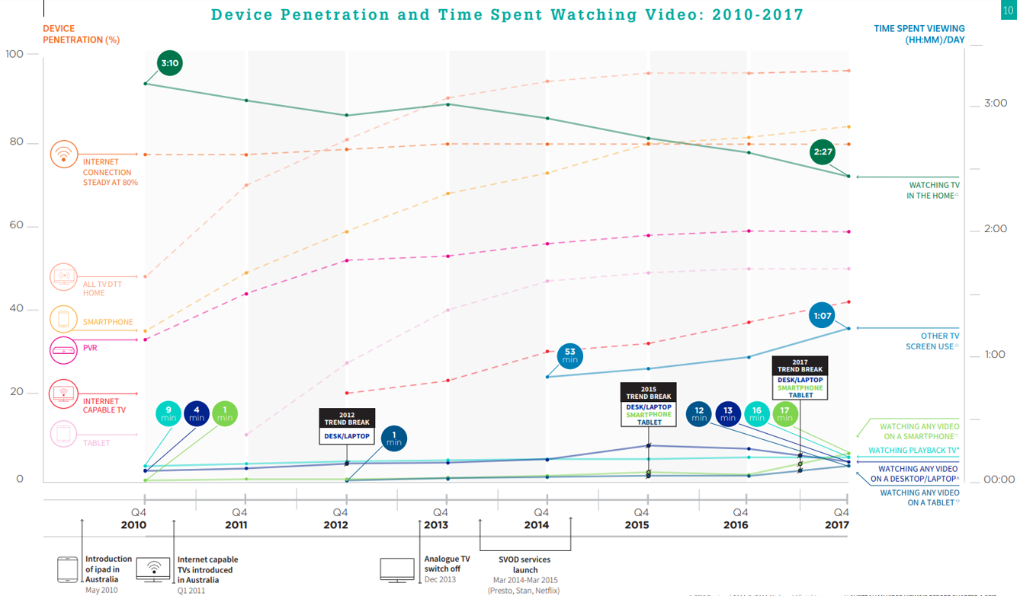
In-home snapshot
Source: 2018 Regional TAM, OzTAM, Nielsen, All rights reserved, Australian Video Viewing Report Q4, 2017

Slide 5
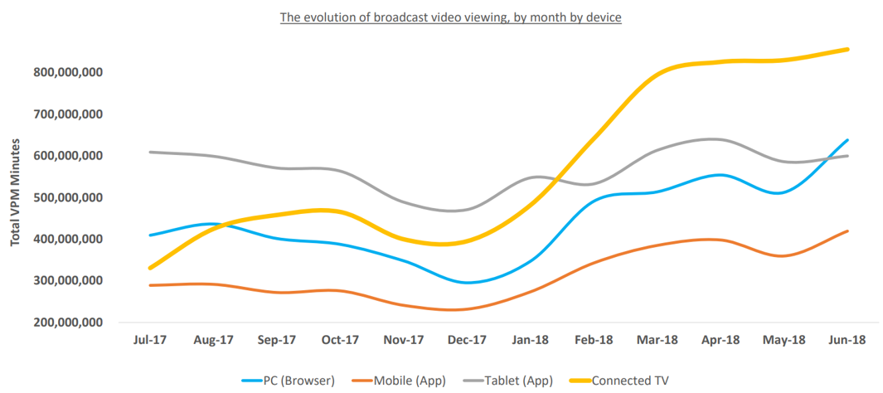
Connected TV takes over
Source: Think TV (1) OzTAM, AUSTRALIAN VIDEO VIEWING REPORT Q2, 2018 (2)

Slide 6
#2
All TV will be online

Slide 7
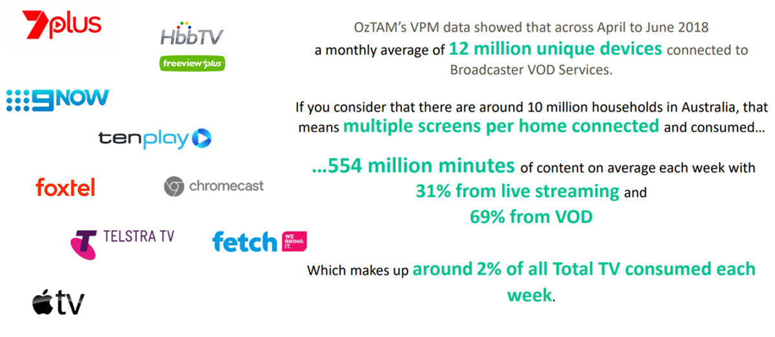
Free TV is everywhere
Source: ThinkTV; OZTAM Video Player Measurement (VPM), Q2 2018 VPM data (1)

Slide 8
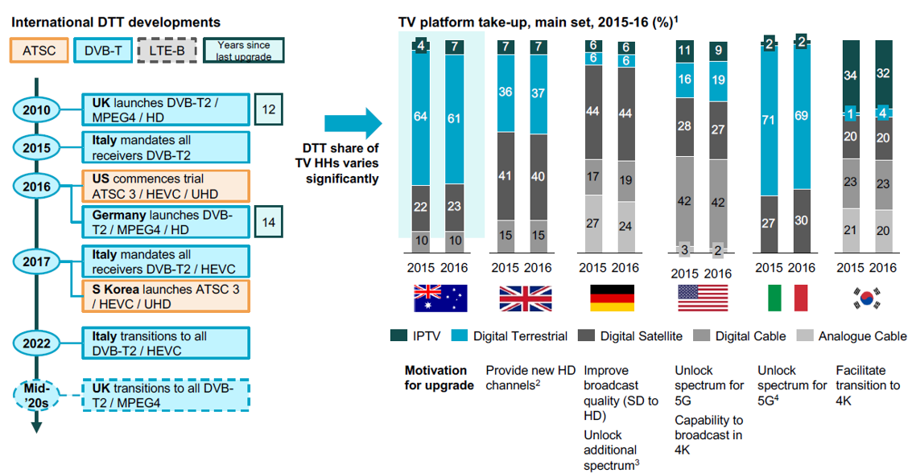
DTT remains important
Source: (1) OfCom, IHS, BARB (2) Venture Consulting

Slide 9
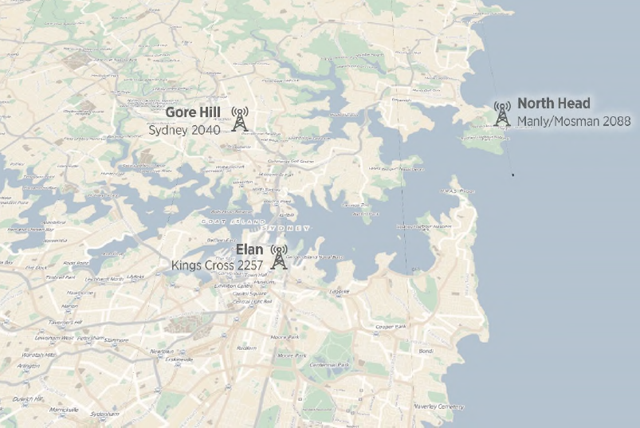
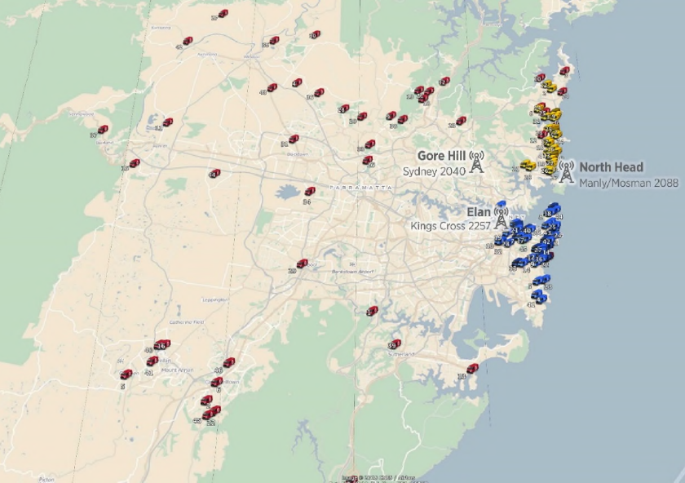
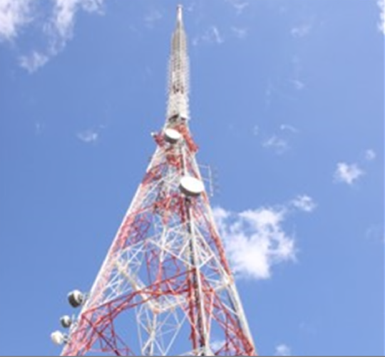
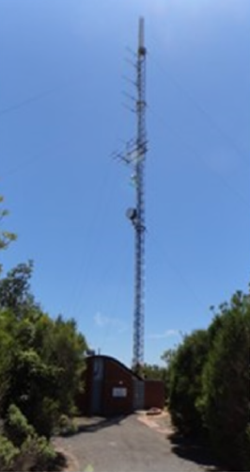
Free TV / Broadcast Australia joint DVB T2 trial
Gore Hill
Elan Building
North Head

Slide 10
#3
5G will solve all
the problems

Slide 11
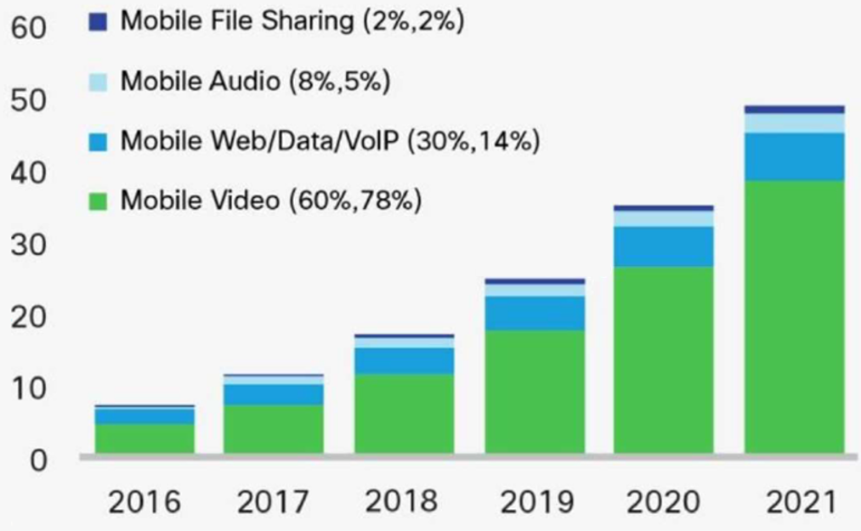
Global data traffic over cellular networks
Cellular networks become video networks
Exabytes per month
Source: Prof. Dr.-Ing. Ulrich Reimers; CISCO Visual Networking Index 2017

Slide 12
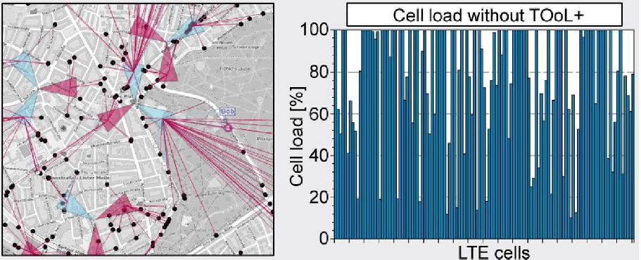
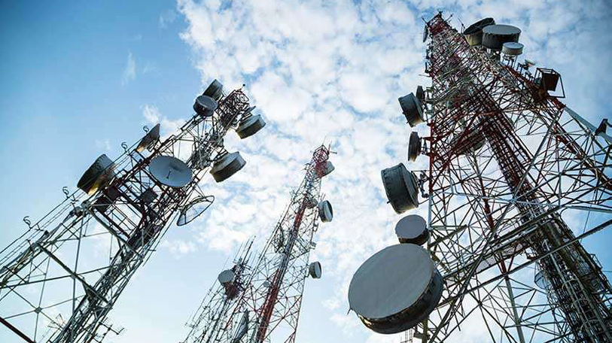
Unicast v Broadcast
LTE cell overload due to HD video demand
Source: Prof. Dr.-Ing. Ulrich Reimers

Slide 13
Some final thoughts

Slide 14
Thank you

